Slide 1
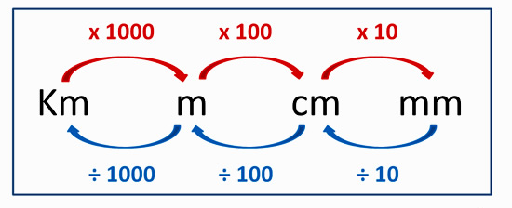

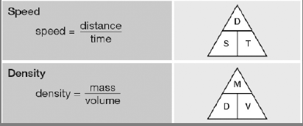

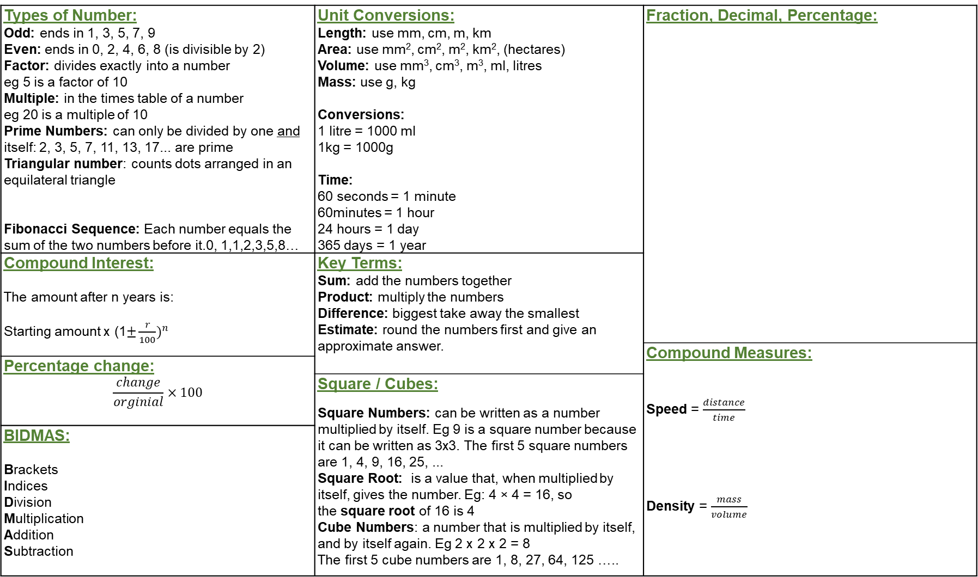
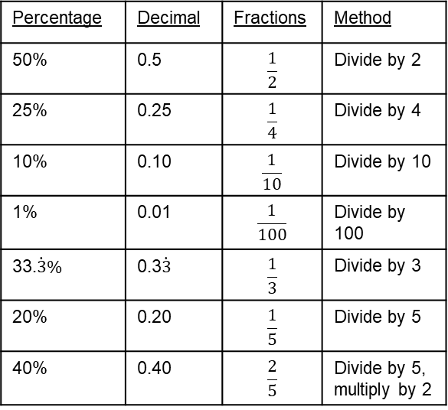
Types of Number: Odd: ends in 1, 3, 5, 7, 9 Even: ends in 0, 2, 4, 6, 8 (is divisible by 2) Factor: divides exactly into a number eg 5 is a factor of 10 Multiple: in the times table of a number eg 20 is a multiple of 10 Prime Numbers: can only be divided by one and itself: 2, 3, 5, 7, 11, 13, 17... are prime Triangular number: counts dots arranged in an equilateral triangle Fibonacci Sequence: Each number equals the sum of the two numbers before it.0, 1,1,2,3,5,8… | Unit Conversions: Length: use mm, cm, m, km Area: use mm², cm², m², km², (hectares) Volume: use mm³, cm³, m³, ml, litres Mass: use g, kg Conversions: 1 litre = 1000 ml 1kg = 1000g Time: 60 seconds = 1 minute 60minutes = 1 hour 24 hours = 1 day 365 days = 1 year | Fraction, Decimal, Percentage:
Compound Interest: The amount after n years is: Starting amount x (1$±\frac{r}{100})^{n}$ | Key Terms: Sum: add the numbers together Product: multiply the numbers Difference: biggest take away the smallest Estimate: round the numbers first and give an approximate answer.
 |  | Compound Measures: Speed = $\frac{distance}{time}$ Density = $\frac{mass}{volume}$
Percentage change: $$\frac{change}{orginial}×100$$
 | Square / Cubes: Square Numbers: can be written as a number multiplied by itself. Eg 9 is a square number because it can be written as 3x3. The first 5 square numbers are 1, 4, 9, 16, 25, ... Square Root: is a value that, when multiplied by itself, gives the number. Eg: 4 × 4 = 16, so the square root of 16 is 4 Cube Numbers: a number that is multiplied by itself, and by itself again. Eg 2 x 2 x 2 = 8 The first 5 cube numbers are 1, 8, 27, 64, 125 …..
BIDMAS: Brackets Indices Division Multiplication Addition Subtraction
Percentage | Decimal | Fractions | Method
50% | 0.5 | $$\frac{1}{2}$$ | Divide by 2
25% | 0.25 | $$\frac{1}{4}$$ | Divide by 4
10% | 0.10 | $$\frac{1}{10}$$ | Divide by 10
1% | 0.01 | $$\frac{1}{100}$$ | Divide by 100
33.$\dot{3}\%$ | 0.3$\dot{3}$ | $$\frac{1}{3}$$ | Divide by 3
20% | 0.20 | $$\frac{1}{5}$$ | Divide by 5
40% | 0.40 | $$\frac{2}{5}$$ | Divide by 5, multiply by 2

Slide 2
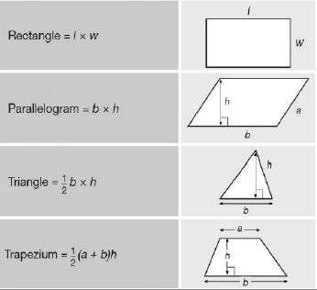
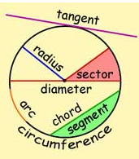
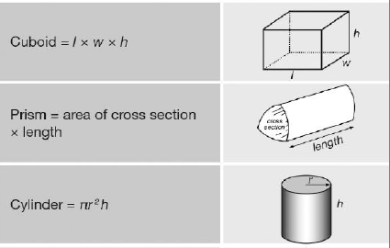
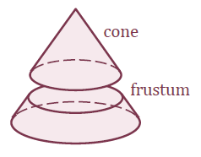
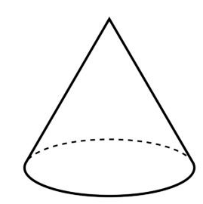
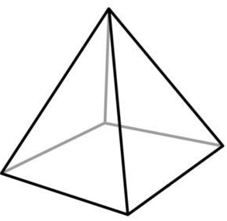
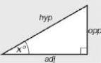
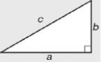
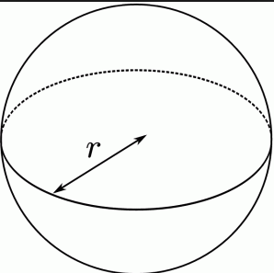
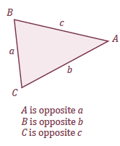
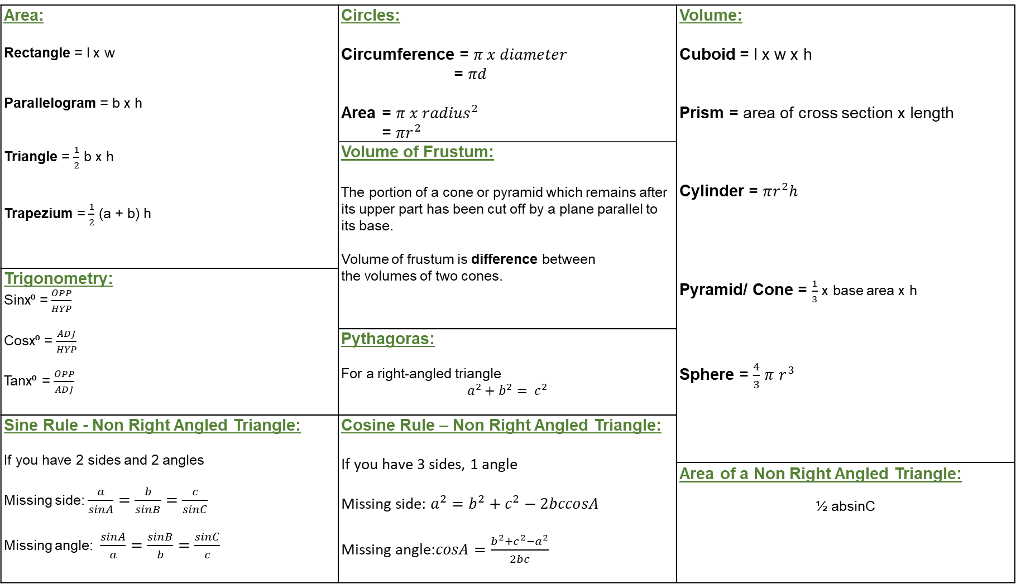
Area: Rectangle = l x w Parallelogram = b x h Triangle = $\frac{1}{2}$ b x h Trapezium = $\frac{1}{2}$ (a + b) h | Circles: Circumference = $π x diameter$ = $πd$ Area = $π x {radius}^{2}$ = $πr^{2}$ | Volume: Cuboid = l x w x h Prism = area of cross section x length Cylinder = $πr^{2}h$ Pyramid/ Cone = $\frac{1}{3}$ x base area x h Sphere = $\frac{4}{3}$ $π$ $r^{3}$
 | Volume of Frustum: The portion of a cone or pyramid which remains after its upper part has been cut off by a plane parallel to its base. Volume of frustum is difference between the volumes of two cones.
Trigonometry: Sinx⁰ = $\frac{OPP}{HYP}$ Cosx⁰ = $\frac{ADJ}{HYP}$ Tanx⁰ = $\frac{OPP}{ADJ}$
 | Pythagoras: For a right-angled triangle $$a^{2}+b^{2}= c^{2}$$
Sine Rule - Non Right Angled Triangle: If you have 2 sides and 2 angles Missing side: $\frac{a}{sinA}=\frac{b}{sinB}=\frac{c}{sinC}$ Missing angle: $\frac{sinA}{a}=\frac{sinB}{b}=\frac{sinC}{c}$ | Cosine Rule – Non Right Angled Triangle: If you have 3 sides, 1 angle Missing side: $a^{2}=b^{2}+c^{2}−2bccosA$ Missing angle:$cosA=\frac{b^{2}+c^{2}−a^{2}}{2bc}$
 |  | Area of a Non Right Angled Triangle: ½ absinC

Slide 3
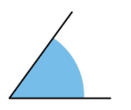
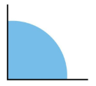
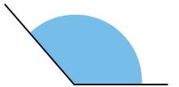

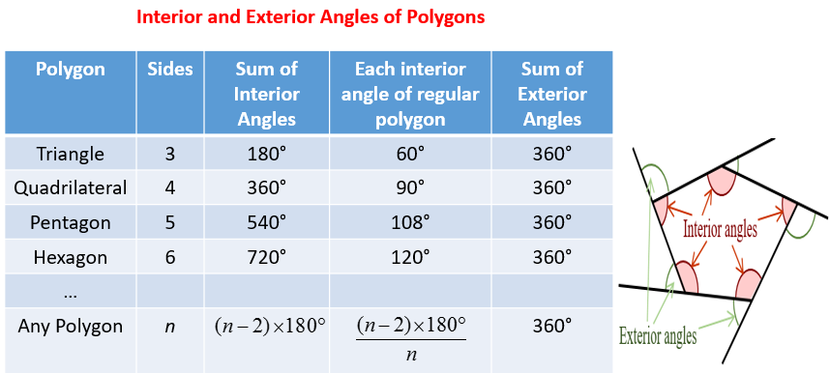
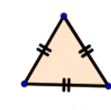
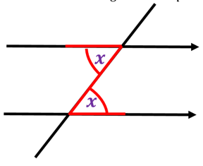

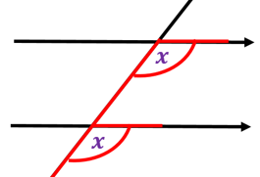

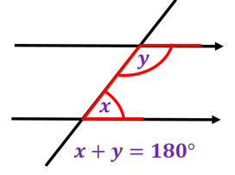
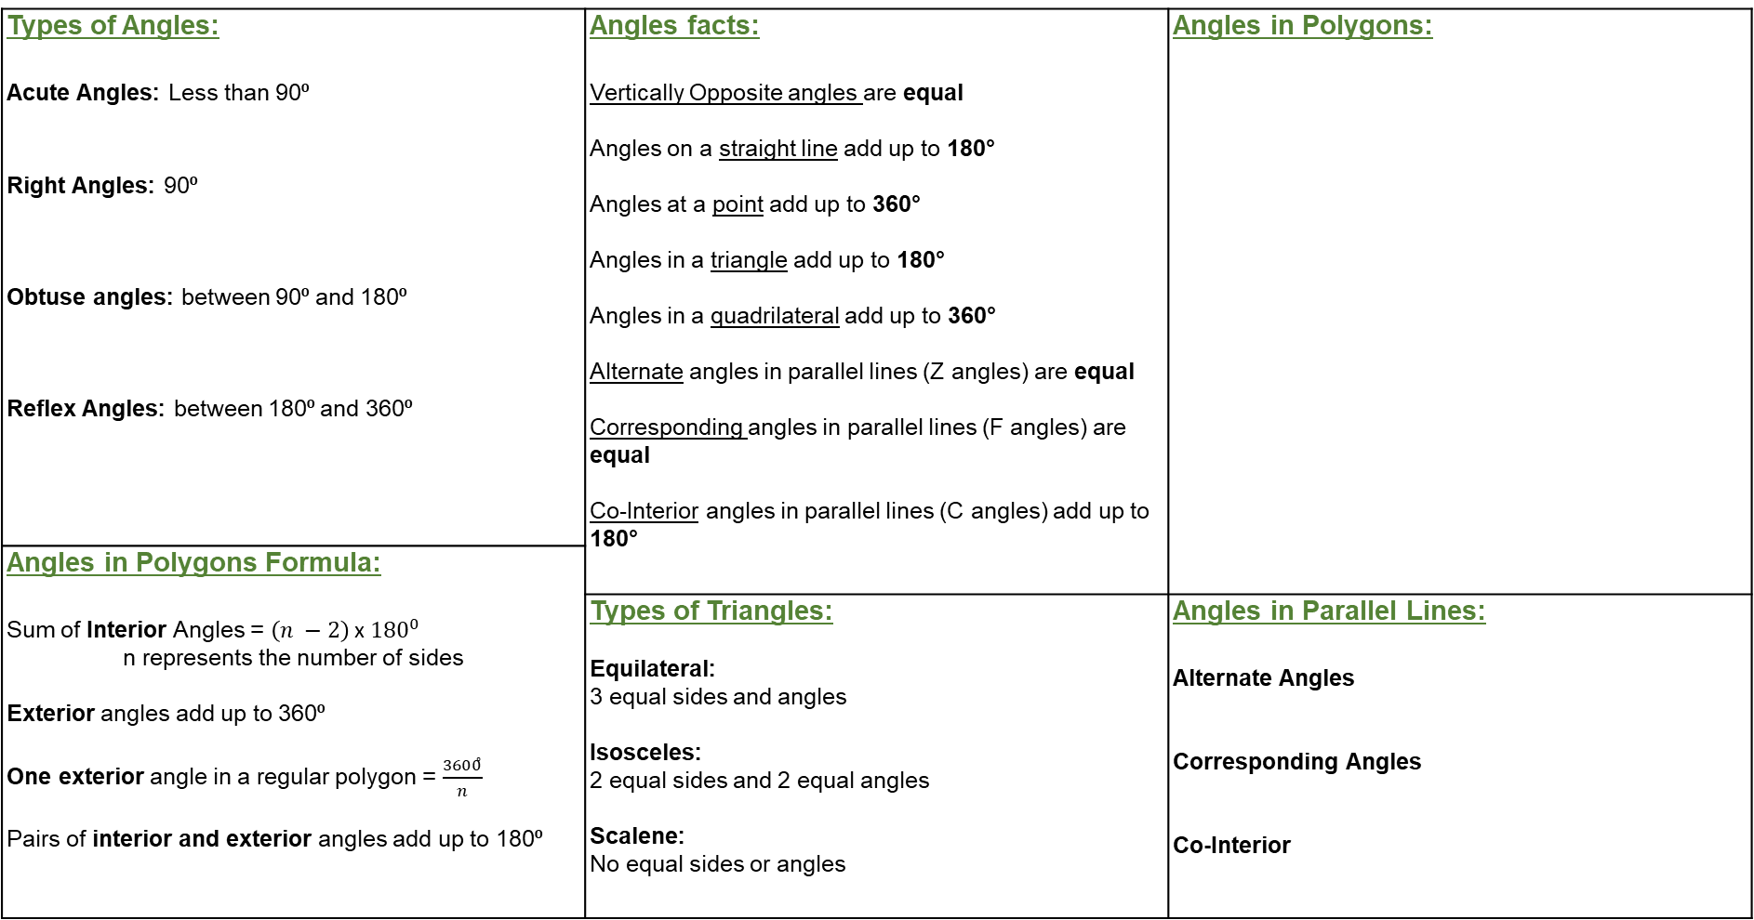
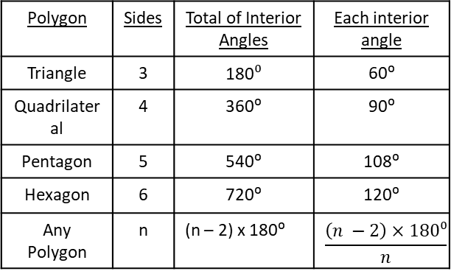
Types of Angles: Acute Angles: Less than 90⁰ Right Angles: 90⁰ Obtuse angles: between 90⁰ and 180⁰ Reflex Angles: between 180⁰ and 360⁰ | Angles facts: Vertically Opposite angles are equal Angles on a straight line add up to 180° Angles at a point add up to 360° Angles in a triangle add up to 180° Angles in a quadrilateral add up to 360° Alternate angles in parallel lines (Z angles) are equal Corresponding angles in parallel lines (F angles) are equal Co-Interior angles in parallel lines (C angles) add up to 180° | Angles in Polygons:
Angles in Polygons Formula: Sum of Interior Angles = $\left(n −2\right)$x${180}^{0}$ n represents the number of sides Exterior angles add up to 360⁰ One exterior angle in a regular polygon = $\frac{3600ͦ}{n}$ Pairs of interior and exterior angles add up to 180⁰
 | Types of Triangles: Equilateral: 3 equal sides and angles Isosceles: 2 equal sides and 2 equal angles Scalene: No equal sides or angles | Angles in Parallel Lines: Alternate Angles Corresponding Angles Co-Interior
Polygon | Sides | Total of Interior Angles | Each interior angle
Triangle | 3 | 180$⁰$ | 60⁰
Quadrilateral | 4 | 360⁰ | 90⁰
Pentagon | 5 | 540⁰ | 108⁰
Hexagon | 6 | 720⁰ | 120⁰
Any Polygon | n | (n – 2) x 180⁰ | $$\frac{\left(n −2\right)×180⁰}{n}$$

Slide 4
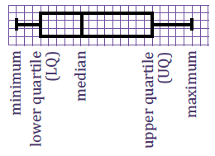
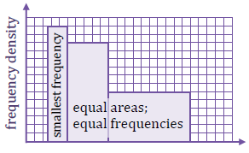
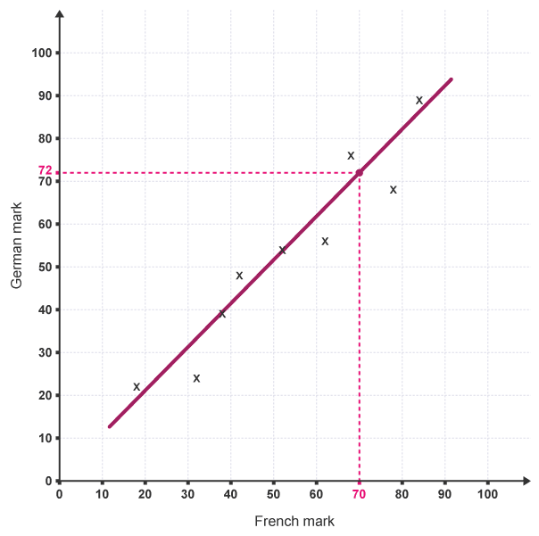
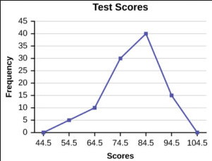
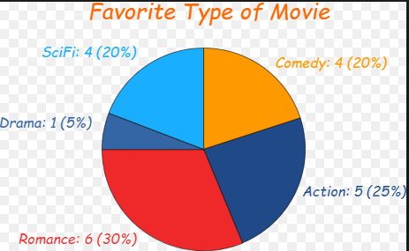
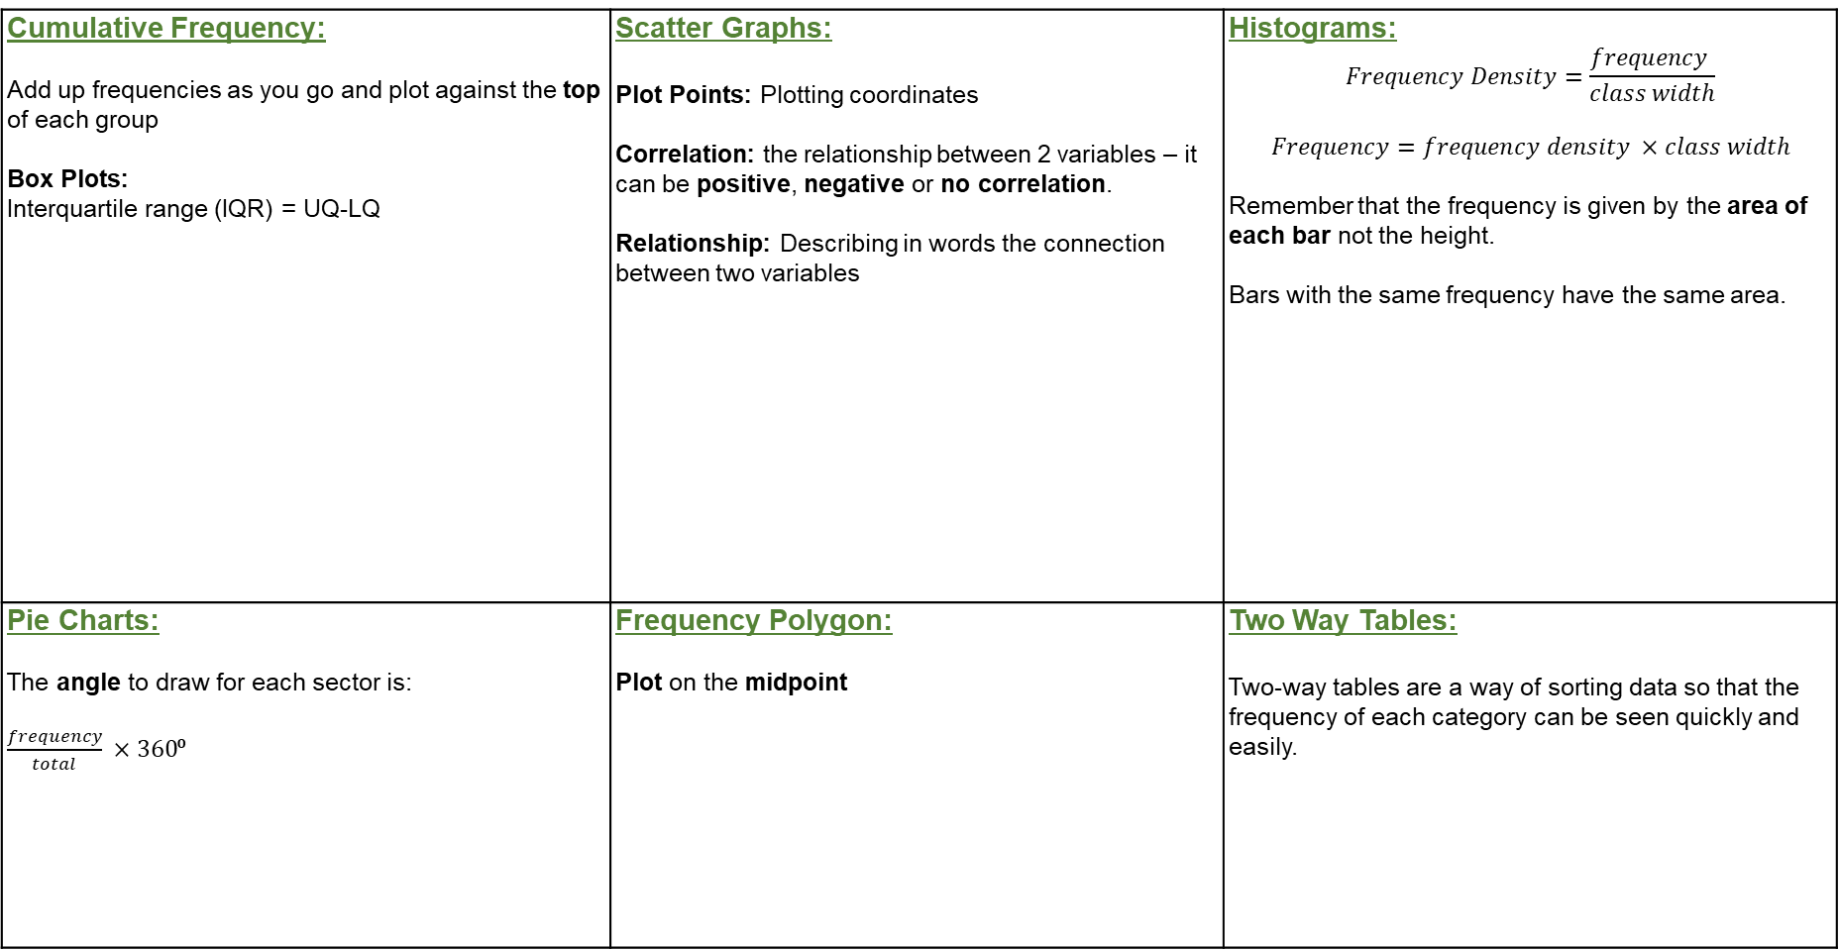
Cumulative Frequency: Add up frequencies as you go and plot against the top of each group Box Plots: Interquartile range (IQR) = UQ-LQ | Scatter Graphs: Plot Points: Plotting coordinates Correlation: the relationship between 2 variables – it can be positive, negative or no correlation. Relationship: Describing in words the connection between two variables | Histograms: $$Frequency Density=\frac{frequency }{class width}$$ $$Frequency=frequency density ×class width$$ Remember that the frequency is given by the area of each bar not the height. Bars with the same frequency have the same area.
Pie Charts: The angle to draw for each sector is: $\frac{frequency}{total} ×360$⁰ | Frequency Polygon: Plot on the midpoint | Two Way Tables: Two-way tables are a way of sorting data so that the frequency of each category can be seen quickly and easily.
Line of Best Fit: a line that roughly through the middle of all the scatter points on a graph. The line of best fit does not have to go through the origin.
Estimate: Using the line of best fit to predict values when given one variable.
Connect points with a straight line
 | Walk | Bus | Total
Boys | 18
Girls |  | 22 | 57
Total |  |  | 100

Slide 5
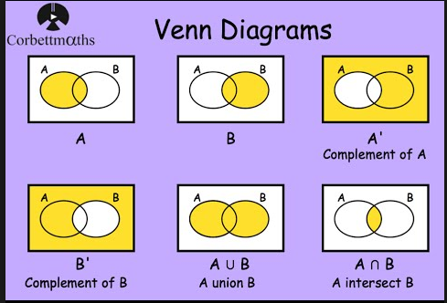

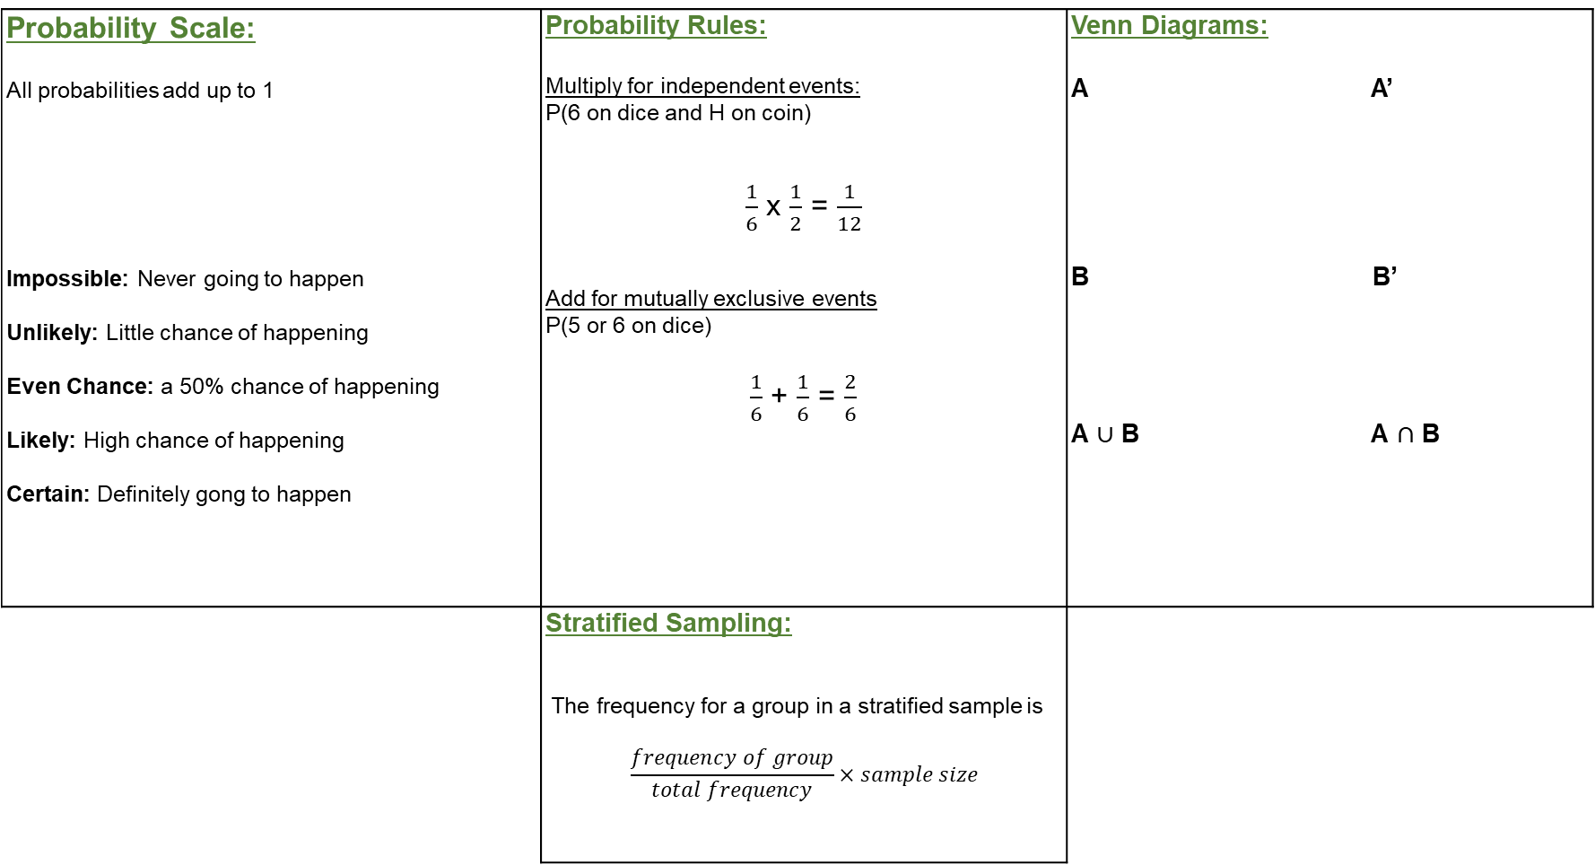
Probability Scale: All probabilities add up to 1 Impossible: Never going to happen Unlikely: Little chance of happening Even Chance: a 50% chance of happening Likely: High chance of happening Certain: Definitely gong to happen | Probability Rules: Multiply for independent events: P(6 on dice and H on coin) $\frac{1}{6}$ x $\frac{1}{2}$ = $\frac{1}{12}$ Add for mutually exclusive events P(5 or 6 on dice) $\frac{1}{6}$ + $\frac{1}{6}$ = $\frac{2}{6}$ | Venn Diagrams: A A’ B B’ A $∪$ B A $∩$ B
 | Stratified Sampling: The frequency for a group in a stratified sample is $$\frac{frequency of group}{total frequency}×sample size$$

Slide 6
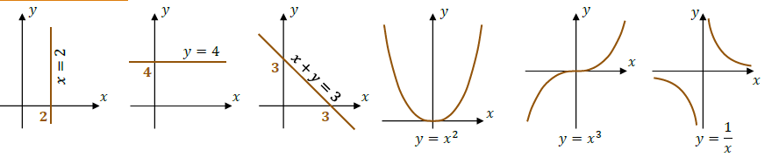
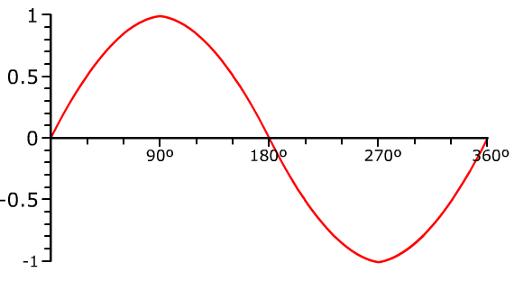
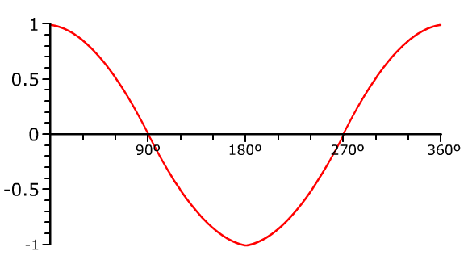
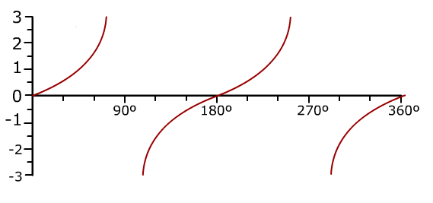
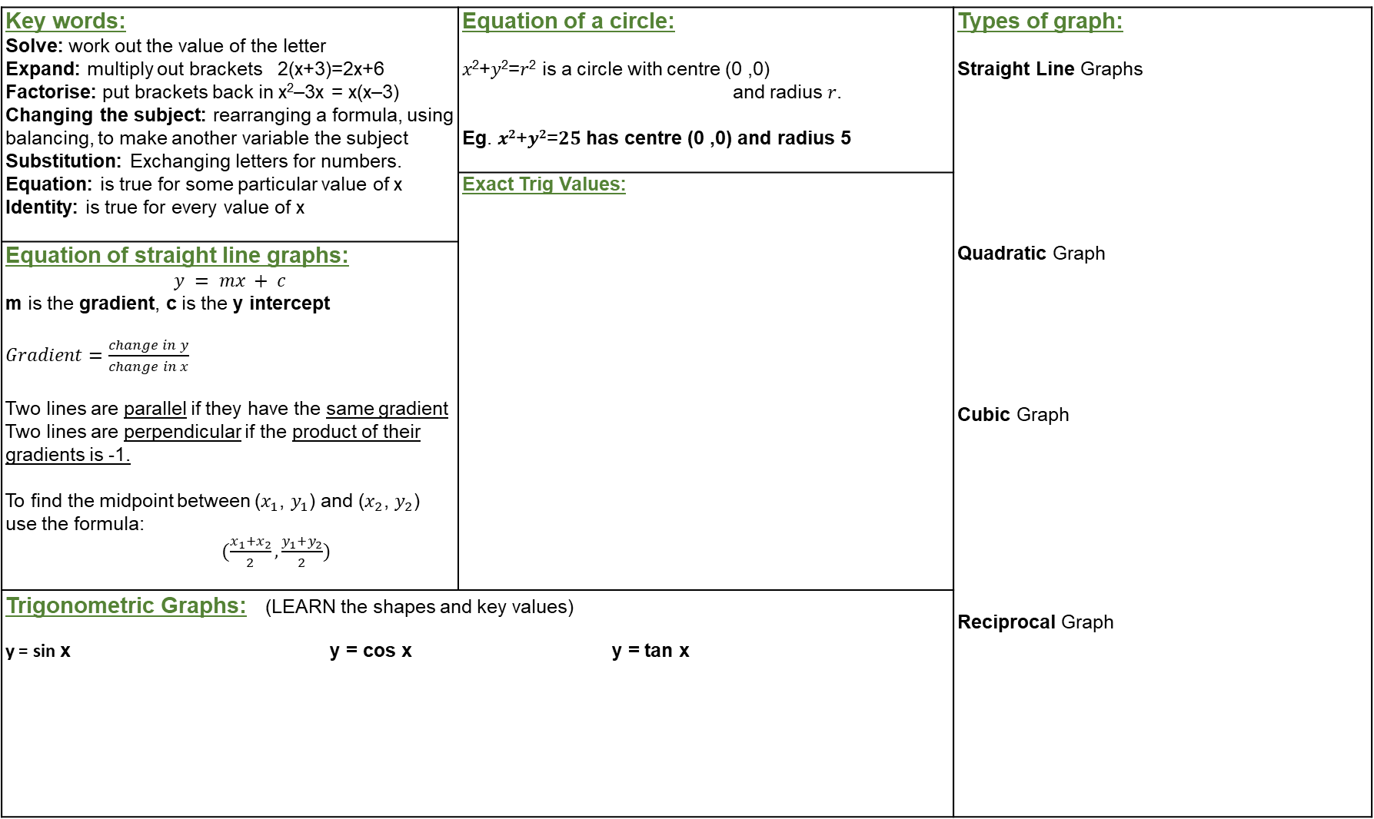
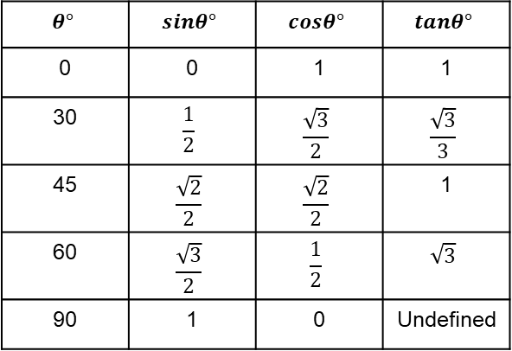
Key words: Solve: work out the value of the letter Expand: multiply out brackets 2(x+3)=2x+6 Factorise: put brackets back in x²–3x = x(x–3) Changing the subject: rearranging a formula, using balancing, to make another variable the subject Substitution: Exchanging letters for numbers. Equation: is true for some particular value of x Identity: is true for every value of x | Equation of a circle: 𝑥²+𝑦²=𝑟² is a circle with centre (0 ,0) and radius 𝑟. Eg. 𝒙^{𝟐}+𝒚^{𝟐}=𝟐𝟓 has centre (0 ,0) and radius 5 | Types of graph: Straight Line Graphs Quadratic Graph Cubic Graph Reciprocal Graph
 | Exact Trig Values:
Equation of straight line graphs: $$y = mx + c$$ m is the gradient, c is the y intercept $Gradient=\frac{change in y}{change in x}$ Two lines are parallel if they have the same gradient Two lines are perpendicular if the product of their gradients is -1. To find the midpoint between ($x_{1}$, $y_{1}$) and ($x_{2}$, $y_{2}$) use the formula: $(\frac{x_{1}+x_{2}}{2},\frac{y_{1}+y_{2}}{2})$
Trigonometric Graphs: (LEARN the shapes and key values) y = sin x y = cos x y = tan x
$$θ°$$ | $$sinθ°$$ | $$cosθ°$$ | $$tanθ°$$
0 | 0 | 1 | 1
30 | $$\frac{1}{2}$$ | $$\frac{\sqrt{3}}{2}$$ | $$\frac{\sqrt{3}}{3}$$
45 | $$\frac{\sqrt{2}}{2}$$ | $$\frac{\sqrt{2}}{2}$$ | 1
60 | $$\frac{\sqrt{3}}{2}$$ | $$\frac{1}{2}$$ | $$\sqrt{3}$$
90 | 1 | 0 | Undefined

Slide 7
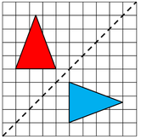
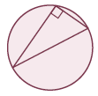
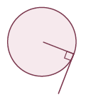
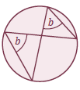
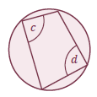
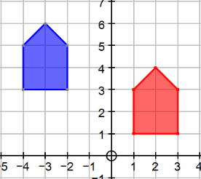

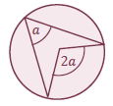
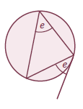
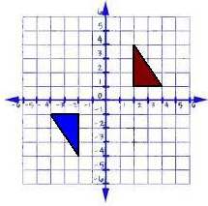
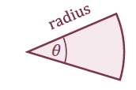
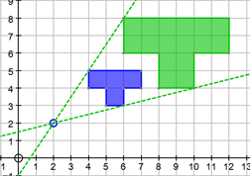

Circle Theorems: |  | Transformations: Reflection: Line of reflection Translation: Vector Rotation: Centre of rotation – a coordinate Angle of rotation Clockwise or anti clockwise Enlargement: Centre of enlargement – a coordinate Scale Factor (if the SF is less than 1 the shape will get smaller)
Area of a Sector: $$\frac{θ}{360°}×π×r^{2}$$ | Similar Shapes: Ratios in similar shapes and solids: Length/perimeter: 1:𝑛 𝑎:𝑏 Area: 1:𝑛² 𝑎²:𝑏² Volume: 1:𝑛³ 𝑎³:𝑏³
Arc Length: $\frac{θ}{360°}×π×$ d
Circle Theorems |  | Circle Theorems
Angle in a semicircle is 90° |  | Angle between radius and tangent is 90°
Angles in the same segment are equal |  | Opposite angles in a cyclic quadrilateral add up to 180°
Angle in the centre is double the angle at the circumference |  | Alternate Segment Theorem
180⁰
(0,0)
SF 2
(2,2)

Slide 8

Surds: Surds are numbers left in square root form that are used when detailed accuracy is required in a calculation. General Rules: $$\sqrt{a}×\sqrt{a}=a$$ $$\sqrt{a}×\sqrt{b}=\sqrt{a×b}$$ $$\frac{\sqrt{a}}{\sqrt{b}}=\sqrt{\frac{a}{b}}$$ | Simultaneous Equations: Linear Eg 2x + 3y = 1 Make y terms (or x) equal 3x – 5y = 11 Same Signs Subtract Different Signs Add Quadratic and Linear Make y (or x) the subject in the linear equation Substitute into the quadratic equation and solve Remember to work out the value of both letters | Functions: Domain is all values of x to which the function is applied. Range is all values of f(x) fg(x) means f(g(x)) i.e. apply g first followed by f. f ⁻¹(x) is the inverse function
Indices: Multiplying Indices: Add the powers $$y^{a}×y^{b}=y^{a+b}$$ Dividing Indices: Subtract the powers $$y^{a}÷y^{b}=y^{a−b}$$ Anything to the power 0: always equals 1 $$y^{0}=1$$ Indices within brackets ${(y}^{a})^{b}=y^{a×b}$ Negative indices $y^{−n}=\frac{1}{y^{n}}$ Fractional Indices $y^{\frac{a}{b}}=\sqrt[b]{y^{a}}$ | Solving Quadratics: First rearrange into ax² + bx + c = 0 then either: Factorise put into 2 brackets and one of the brackets must = 0 Use the Formula$x=\frac{−b±\sqrt{b^{2}−4ac}}{2a}$ | Transforming y = f(x): y = f(x + a ) is a translation $\left(\begin{matrix}−a \\ 0\end{matrix}\right)$ y = f(x) + a is a translation $\left(\begin{matrix}0 \\ a\end{matrix}\right)$ y = f(-x) is a reflection in the y-axis y = -f(x) is a reflection in the x-axis
 | Direct and Inverse proportion: If $x$ is directly proportional to $y^{n}$ then: $x∝y^{n}$ so $x=k ×y^{n}$ If $x$ is inversely proportional to $y^{n}$ then: $x∝\frac{1}{y^{n}}$so $x=\frac{k}{y^{n}}$ | Velocity-Time graph: Gradient = acceleration (you may need to draw a tangent to the curve at a point to find the gradient); Area under curve = distance travelled.
Difference of two squares: $$a^{2}−b^{2}=\left(a+b\right)\left(a−b\right)$$ Eg. $x^{2}−25=\left(x+5\right)(x−5)$

