Slide 1
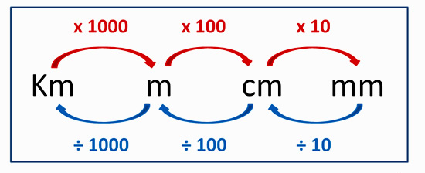

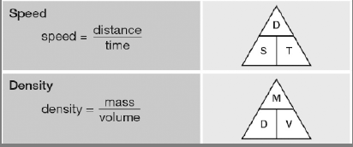

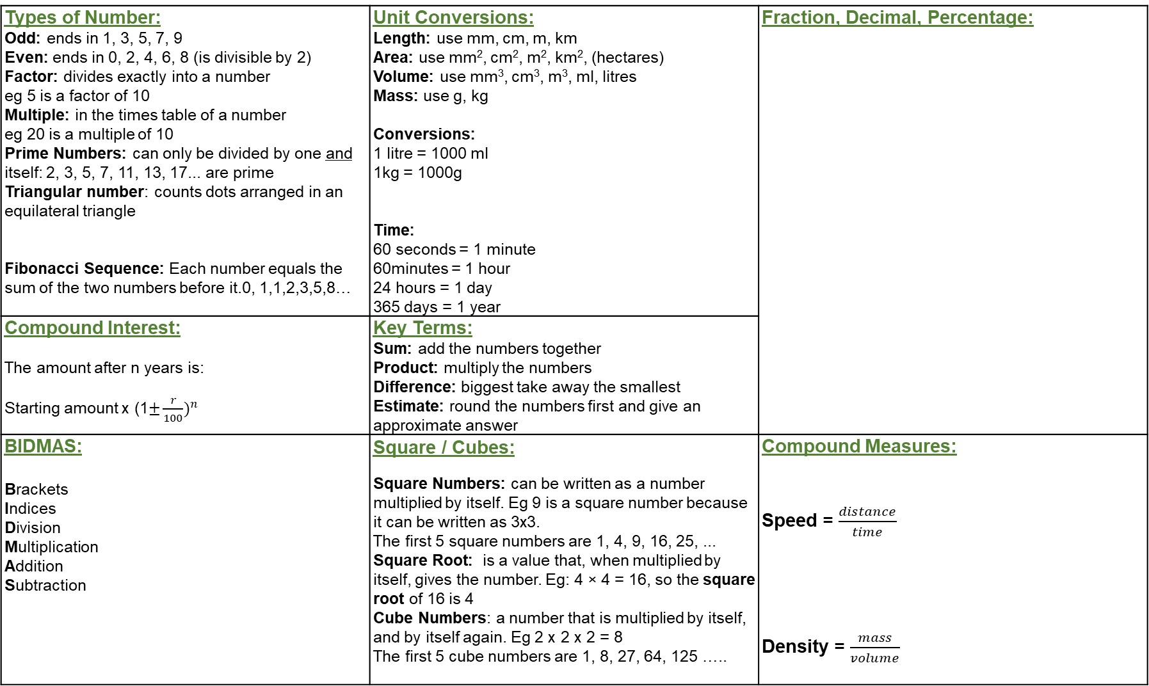
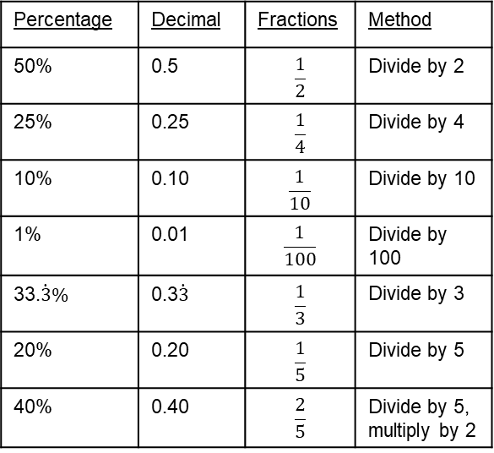
Types of Number: Odd: ends in 1, 3, 5, 7, 9 Even: ends in 0, 2, 4, 6, 8 (is divisible by 2) Factor: divides exactly into a number eg 5 is a factor of 10 Multiple: in the times table of a number eg 20 is a multiple of 10 Prime Numbers: can only be divided by one and itself: 2, 3, 5, 7, 11, 13, 17... are prime Triangular number: counts dots arranged in an equilateral triangle Fibonacci Sequence: Each number equals the sum of the two numbers before it.0, 1,1,2,3,5,8… | Unit Conversions: Length: use mm, cm, m, km Area: use mm², cm², m², km², (hectares) Volume: use mm³, cm³, m³, ml, litres Mass: use g, kg Conversions: 1 litre = 1000 ml 1kg = 1000g Time: 60 seconds = 1 minute 60minutes = 1 hour 24 hours = 1 day 365 days = 1 year | Fraction, Decimal, Percentage:
Compound Interest: The amount after n years is: Starting amount x (1$±\frac{r}{100})^{n}$ | Key Terms: Sum: add the numbers together Product: multiply the numbers Difference: biggest take away the smallest Estimate: round the numbers first and give an approximate answer
BIDMAS: Brackets Indices Division Multiplication Addition Subtraction | Square / Cubes: Square Numbers: can be written as a number multiplied by itself. Eg 9 is a square number because it can be written as 3x3. The first 5 square numbers are 1, 4, 9, 16, 25, ... Square Root: is a value that, when multiplied by itself, gives the number. Eg: 4 × 4 = 16, so the square root of 16 is 4 Cube Numbers: a number that is multiplied by itself, and by itself again. Eg 2 x 2 x 2 = 8 The first 5 cube numbers are 1, 8, 27, 64, 125 ….. | Compound Measures: Speed = $\frac{distance}{time}$ Density = $\frac{mass}{volume}$
Percentage | Decimal | Fractions | Method
50% | 0.5 | $$\frac{1}{2}$$ | Divide by 2
25% | 0.25 | $$\frac{1}{4}$$ | Divide by 4
10% | 0.10 | $$\frac{1}{10}$$ | Divide by 10
1% | 0.01 | $$\frac{1}{100}$$ | Divide by 100
33.$\dot{3}\%$ | 0.3$\dot{3}$ | $$\frac{1}{3}$$ | Divide by 3
20% | 0.20 | $$\frac{1}{5}$$ | Divide by 5
40% | 0.40 | $$\frac{2}{5}$$ | Divide by 5, multiply by 2

Slide 2
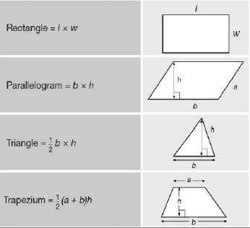
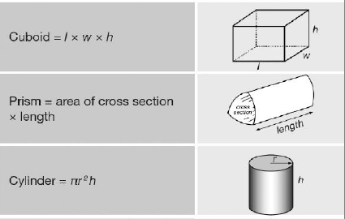
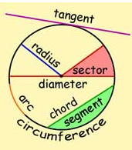
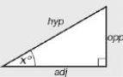
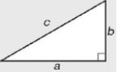
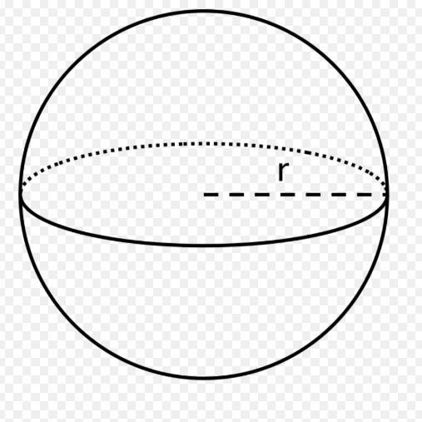
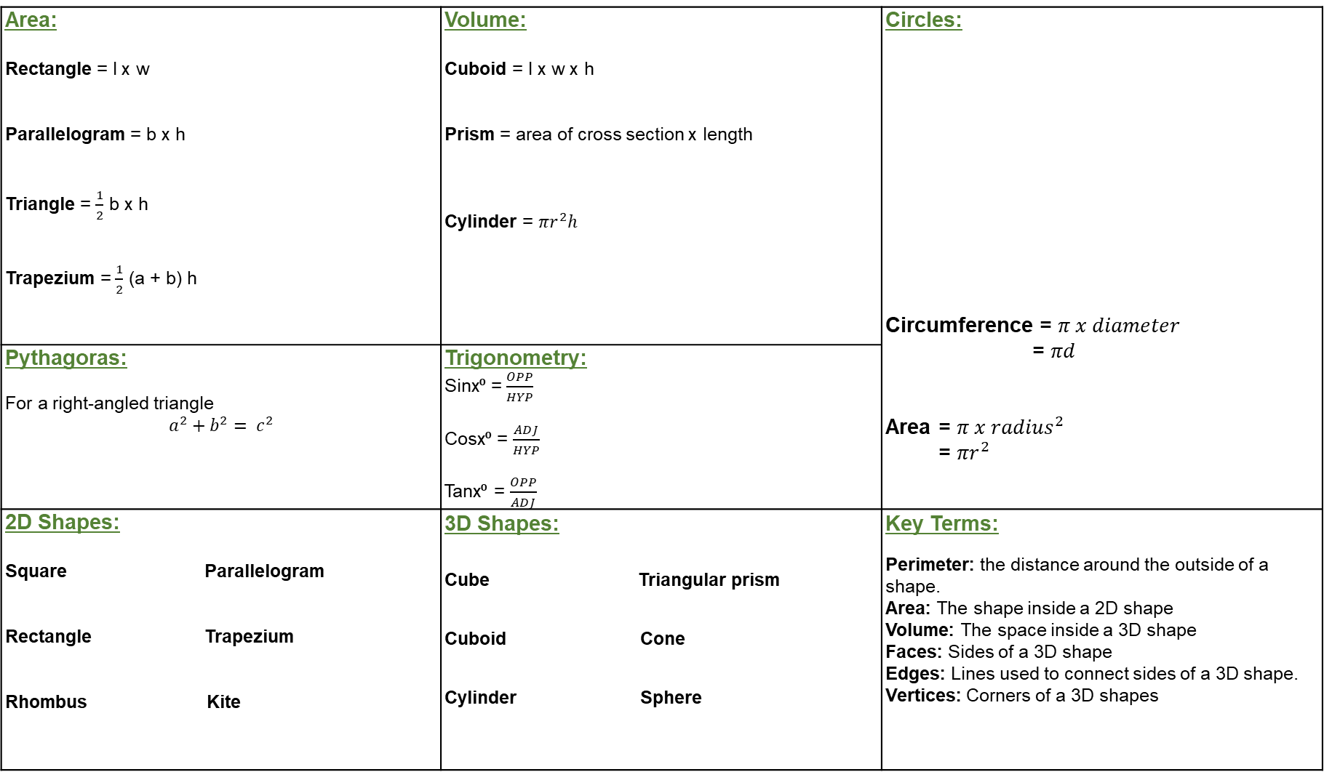
Area: Rectangle = l x w Parallelogram = b x h Triangle = $\frac{1}{2}$ b x h Trapezium = $\frac{1}{2}$ (a + b) h | Volume: Cuboid = l x w x h Prism = area of cross section x length Cylinder = $πr^{2}h$ | Circles: Circumference = $π x diameter$ = $πd$ Area = $π x {radius}^{2}$ = $πr^{2}$
Pythagoras: For a right-angled triangle $$a^{2}+b^{2}= c^{2}$$ | Trigonometry: Sinx⁰ = $\frac{OPP}{HYP}$ Cosx⁰ = $\frac{ADJ}{HYP}$ Tanx⁰ = $\frac{OPP}{ADJ}$
2D Shapes: Square Parallelogram Rectangle Trapezium Rhombus Kite | 3D Shapes: Cube Triangular prism Cuboid Cone Cylinder Sphere | Key Terms: Perimeter: the distance around the outside of a shape. Area: The shape inside a 2D shape Volume: The space inside a 3D shape Faces: Sides of a 3D shape Edges: Lines used to connect sides of a 3D shape. Vertices: Corners of a 3D shapes

Slide 3
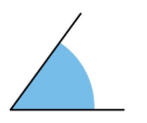
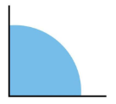
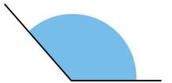

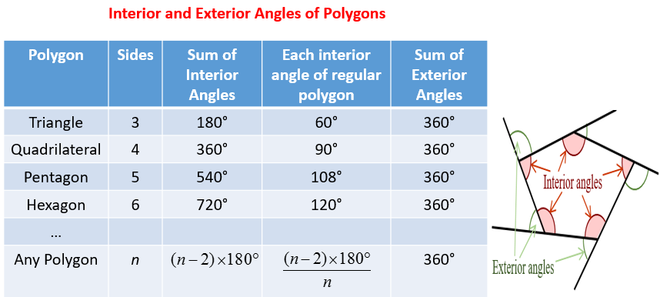
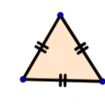
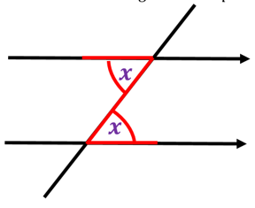

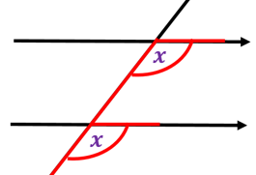

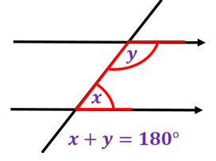
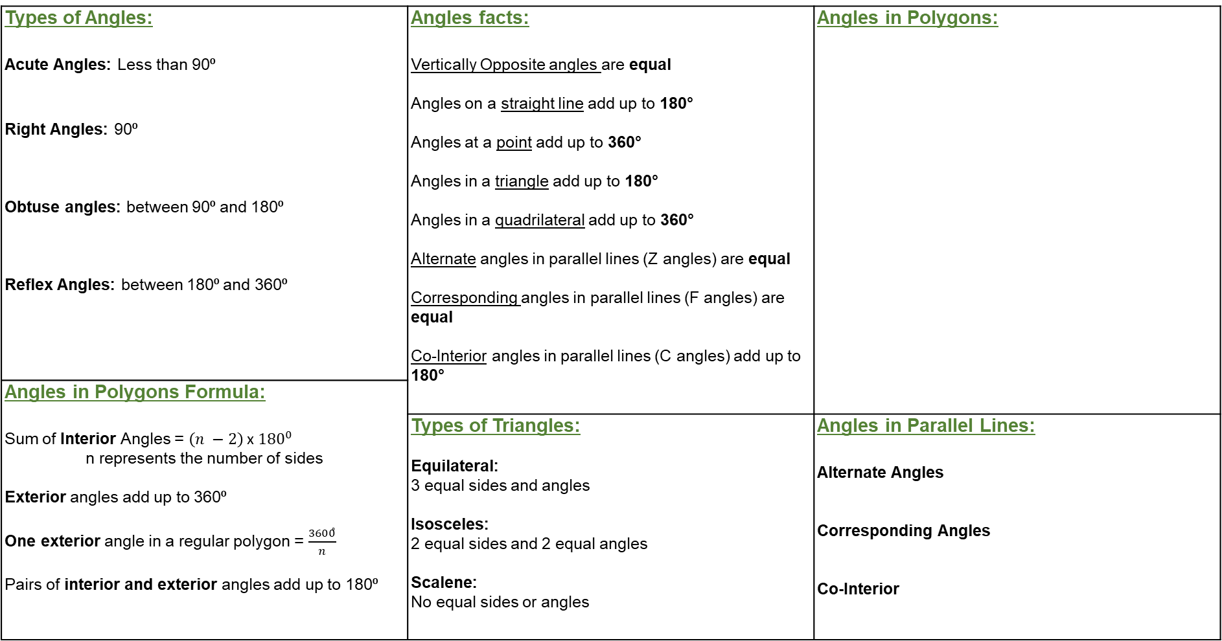
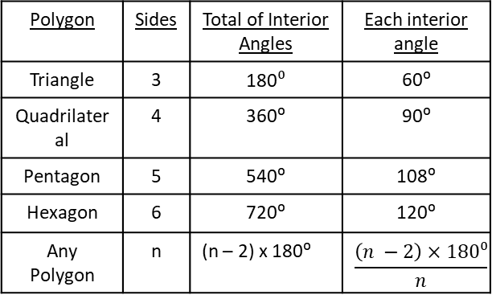
Types of Angles: Acute Angles: Less than 90⁰ Right Angles: 90⁰ Obtuse angles: between 90⁰ and 180⁰ Reflex Angles: between 180⁰ and 360⁰ | Angles facts: Vertically Opposite angles are equal Angles on a straight line add up to 180° Angles at a point add up to 360° Angles in a triangle add up to 180° Angles in a quadrilateral add up to 360° Alternate angles in parallel lines (Z angles) are equal Corresponding angles in parallel lines (F angles) are equal Co-Interior angles in parallel lines (C angles) add up to 180° | Angles in Polygons:
Angles in Polygons Formula: Sum of Interior Angles = $\left(n −2\right)$x${180}^{0}$ n represents the number of sides Exterior angles add up to 360⁰ One exterior angle in a regular polygon = $\frac{3600ͦ}{n}$ Pairs of interior and exterior angles add up to 180⁰
 | Types of Triangles: Equilateral: 3 equal sides and angles Isosceles: 2 equal sides and 2 equal angles Scalene: No equal sides or angles | Angles in Parallel Lines: Alternate Angles Corresponding Angles Co-Interior
Polygon | Sides | Total of Interior Angles | Each interior angle
Triangle | 3 | 180$⁰$ | 60⁰
Quadrilateral | 4 | 360⁰ | 90⁰
Pentagon | 5 | 540⁰ | 108⁰
Hexagon | 6 | 720⁰ | 120⁰
Any Polygon | n | (n – 2) x 180⁰ | $$\frac{\left(n −2\right)×180⁰}{n}$$

Slide 4
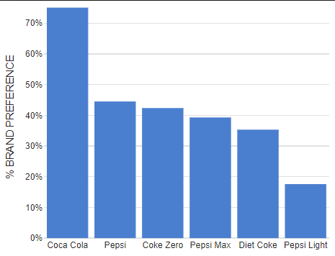
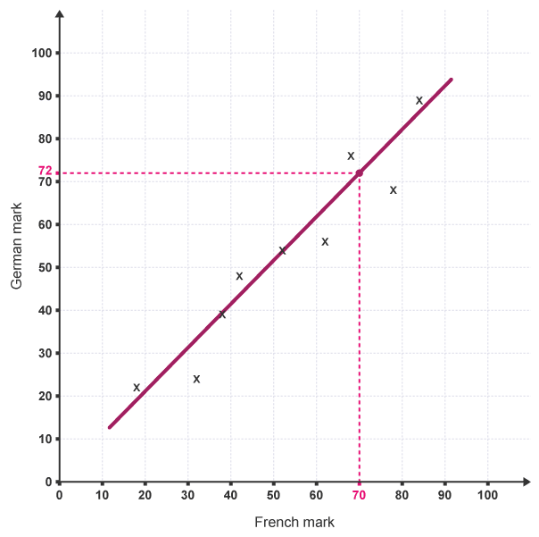
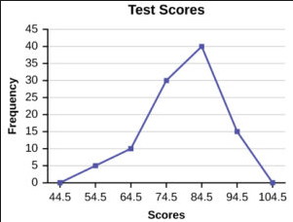
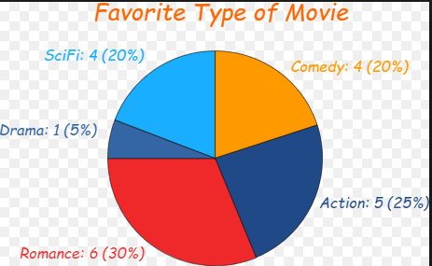
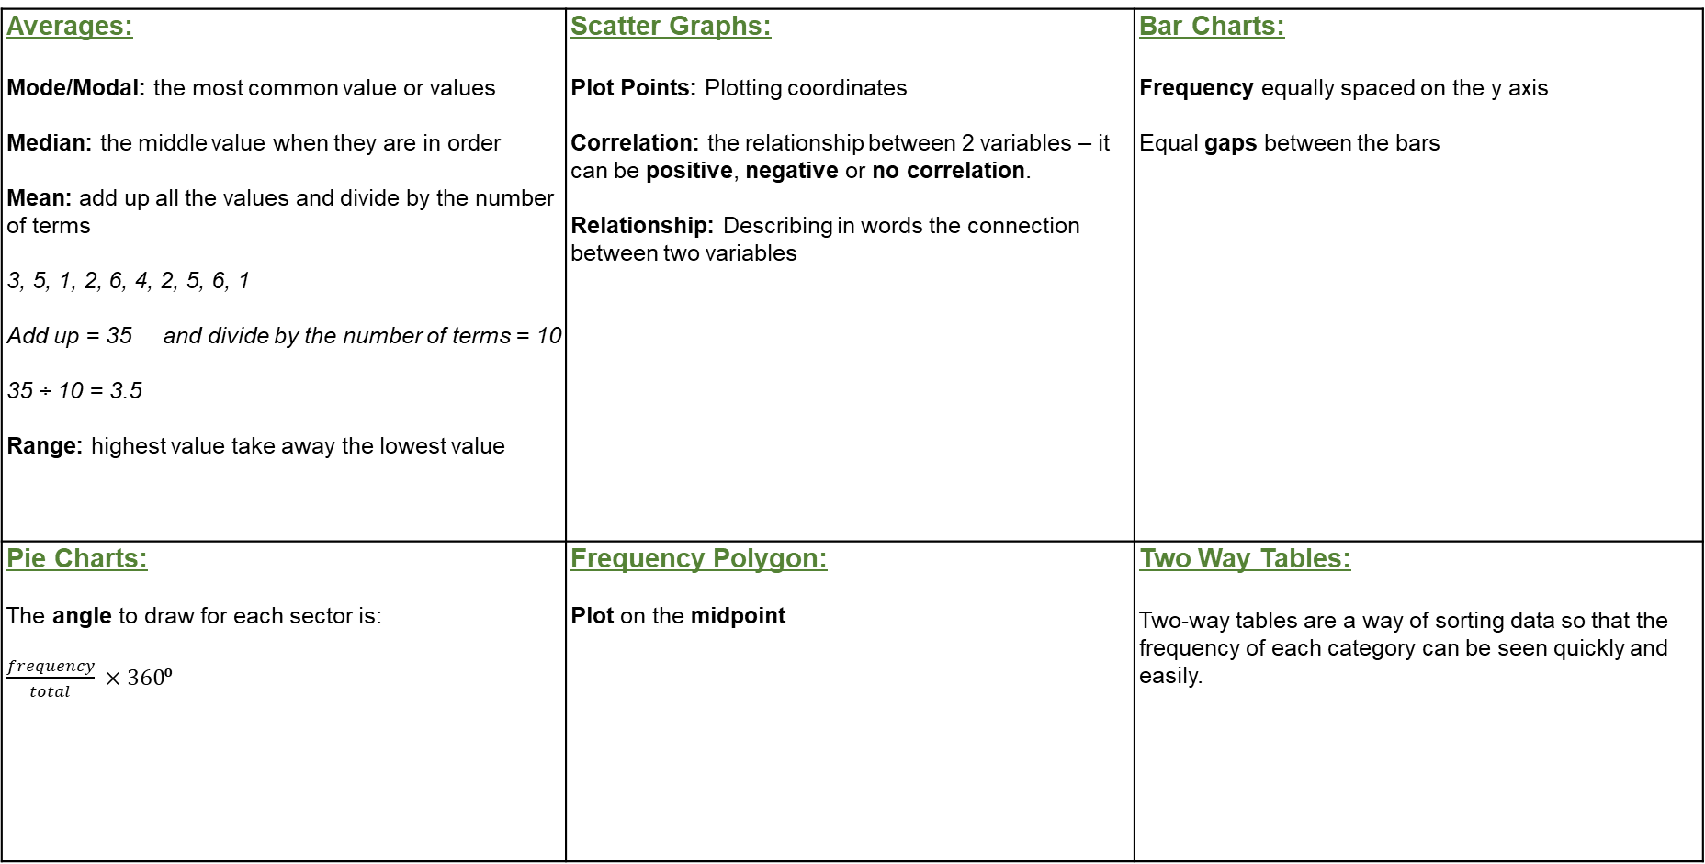
Averages: Mode/Modal: the most common value or values Median: the middle value when they are in order Mean: add up all the values and divide by the number of terms 3, 5, 1, 2, 6, 4, 2, 5, 6, 1 Add up = 35 and divide by the number of terms = 10 35 ÷ 10 = 3.5 Range: highest value take away the lowest value | Scatter Graphs: Plot Points: Plotting coordinates Correlation: the relationship between 2 variables – it can be positive, negative or no correlation. Relationship: Describing in words the connection between two variables | Bar Charts: Frequency equally spaced on the y axis Equal gaps between the bars
Pie Charts: The angle to draw for each sector is: $\frac{frequency}{total} ×360$⁰ | Frequency Polygon: Plot on the midpoint | Two Way Tables: Two-way tables are a way of sorting data so that the frequency of each category can be seen quickly and easily.
Categories equally spaced across the x axis.
Both axes labelled.
Line of Best Fit: a line that roughly through the middle of all the scatter points on a graph. The line of best fit does not have to go through the origin.
Estimate: Using the line of best fit to predict values when given one variable.
Connect points with a straight line
 | Walk | Bus | Total
Boys | 18
Girls |  | 22 | 57
Total |  |  | 100

Slide 5
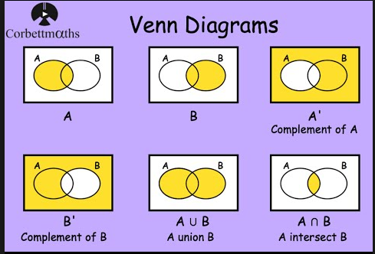

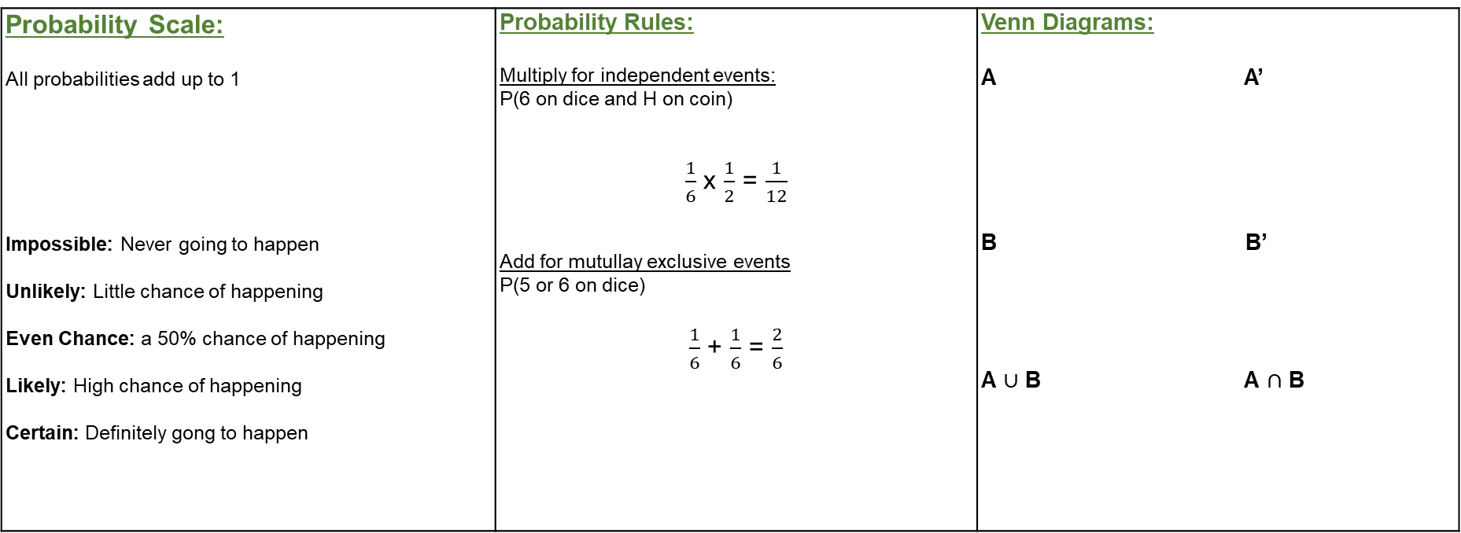
Probability Scale: All probabilities add up to 1 Impossible: Never going to happen Unlikely: Little chance of happening Even Chance: a 50% chance of happening Likely: High chance of happening Certain: Definitely gong to happen | Probability Rules: Multiply for independent events: P(6 on dice and H on coin) $\frac{1}{6}$ x $\frac{1}{2}$ = $\frac{1}{12}$ Add for mutullay exclusive events P(5 or 6 on dice) $\frac{1}{6}$ + $\frac{1}{6}$ = $\frac{2}{6}$ | Venn Diagrams: A A’ B B’ A $∪$ B A $∩$ B

Slide 6
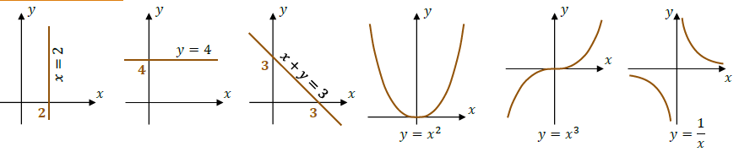
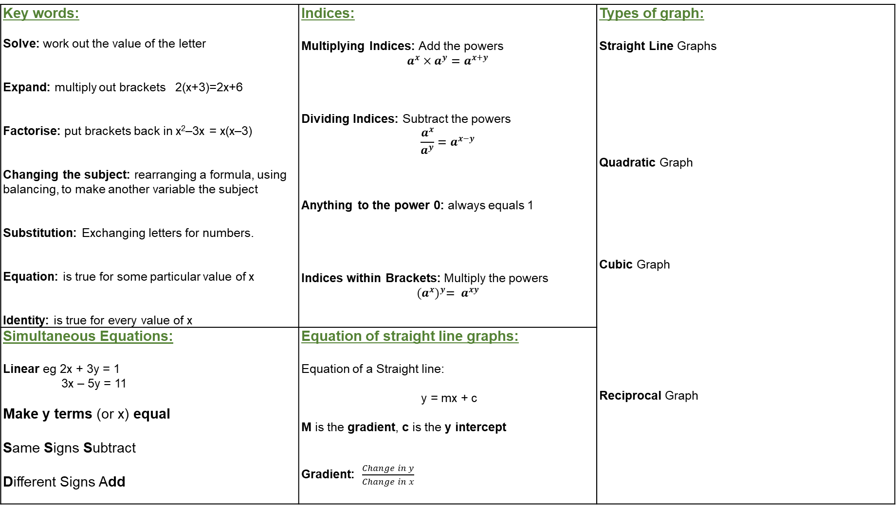
Key words: Solve: work out the value of the letter Expand: multiply out brackets 2(x+3)=2x+6 Factorise: put brackets back in x²–3x = x(x–3) Changing the subject: rearranging a formula, using balancing, to make another variable the subject Substitution: Exchanging letters for numbers. Equation: is true for some particular value of x Identity: is true for every value of x | Indices: Multiplying Indices: Add the powers $$a^{x}×a^{y}=a^{x+y}$$ Dividing Indices: Subtract the powers $$\frac{a^{x}}{a^{y}}=a^{x−y}$$ Anything to the power 0: always equals 1 Indices within Brackets: Multiply the powers $${(a^{x})}^{y}= a^{xy}$$ | Types of graph: Straight Line Graphs Quadratic Graph Cubic Graph Reciprocal Graph
Simultaneous Equations: Linear eg 2x + 3y = 1 3x – 5y = 11 Make y terms (or x) equal Same Signs Subtract Different Signs Add | Equation of straight line graphs: Equation of a Straight line: y = mx + c M is the gradient, c is the y intercept Gradient: $\frac{Change in y}{Change in x}$

