Slide 1
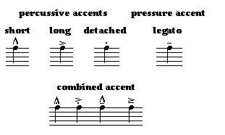
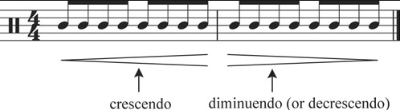
Theme & Variation
Keywords
Melody- main tune
Theme- the first tune
Variation- when the theme is repeated or altered (changed)
Ground Bass- repeated bass pattern
Basso Continuo- accompanying bass part e.g. piano, double bass, bassoon, harpsicord in baroque music
Baroque Music- period between 1600-1750
Drone- continual held note in bass (low pitch)
Retrograde- play the melody backwards (from end to start)
Inversion – flipping the melody- e.g. if melody goes down (descends) to invert it would mean it then goes up (ascends)
Ostinato -repeated rhythm or melody (classical tune)
Ornamentation – adding extra notes to ‘decorate’ the melody
Major- happy, bright sounding
Minor – darker, sad-sounding mood
Orchestration- what instruments are used in a piece of music
Texture- lots of instruments= thick texture; few instruments= thin texture; interweaving parts (like spaghetti on a plate)= polyphonic texture
Addition- when cell is repeated and new notes are added to the cell pattern
Subtraction – when cell is repeated and notes are removed
Augmentation – when note lengths are doubled
Diminution – when note lengths are halved
Suggested Listening
You can listen to Minimalist music by searching for the following composers and their pieces on YouTube:
Mozart- Twinkle, Twinkle 12 Variations
JS. Bach BWV 988-
Goldberg Variations Complete
Edward Elgar- Engima Variations
Mario Bros 9 Variations on the theme
What is Theme & Variation
In music, variation is a formal technique where material is repeated in an altered form. The changes may involve melody, rhythm, harmony, timbre, orchestration or any combination of these.
Tempo
Tempo- how fast or slow the music is
Allegro - fast
Andante- walking speed
Allegretto- a little bit joyful
Largo – slow speed
Dynamics
Dynamics- the volume of the music
Forte f- loud
Piano p - quiet
Crescendo- gradually getting louder
Diminuendo – gradually getting quieter
Performance Directions
Staccato – short, detached, ‘jaggy’ notes
Legato – smooth
Cantabile – in a singing style
Accented – emphasis on notes

