Slide 1
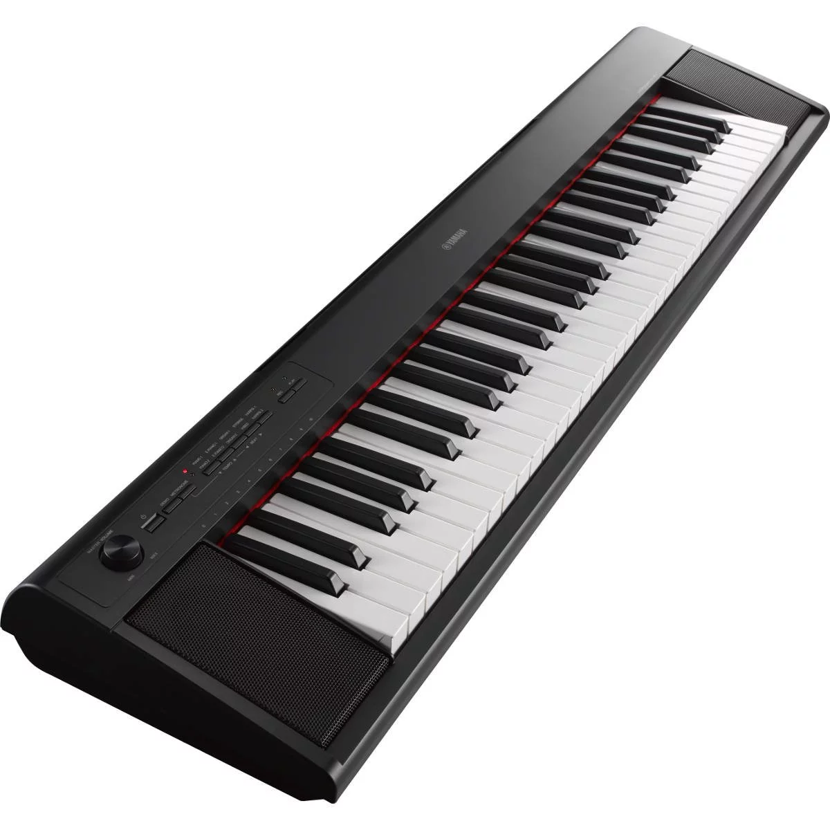
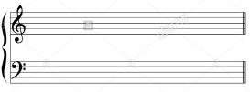

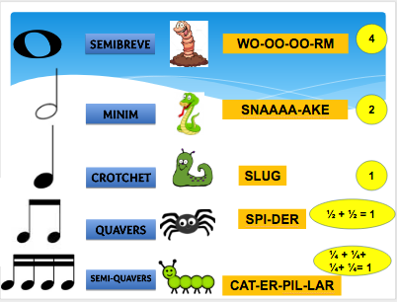
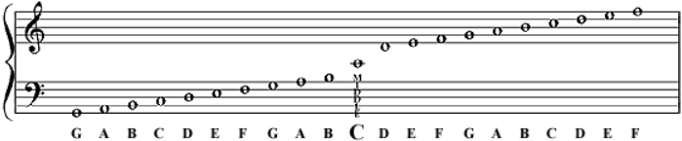
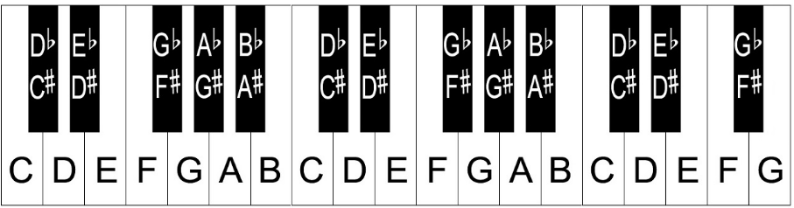
Keywords
Melody- the main tune in a piece of music
Chord- 2 or more notes which ‘fit’ together and sound good
Major- sounds happy
Minor – sounds sad
# - sharp sign- becomes a tiny step higher in pitch
- flat sign- becomes a tiny step lower in pitch
Keyboard Skills
The Stave
Stave- the 5 lines, 4 spaces where music is written:
Treble Clef- at the beginning of each stave. The treble clef means that notes are high in pitch and are found above Middle C. These notes are played with right hand.
Bass Clef- at the beginning of each stave. The bass clef means that notes are low in pitch and below Middle C. These notes are played with the left hand.
Rhythms
The Stave Notes
Layout of keyboard (piano)

