Slide 1
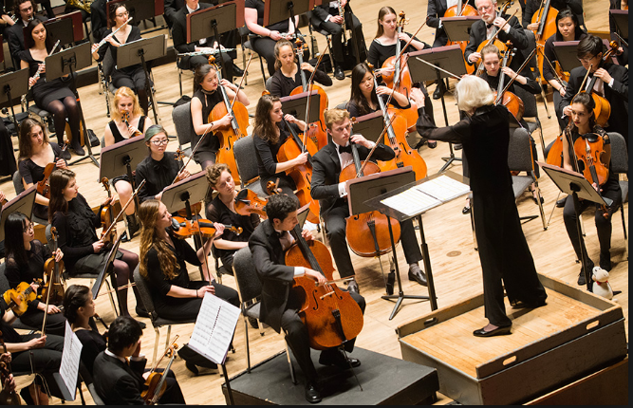
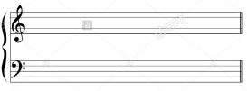
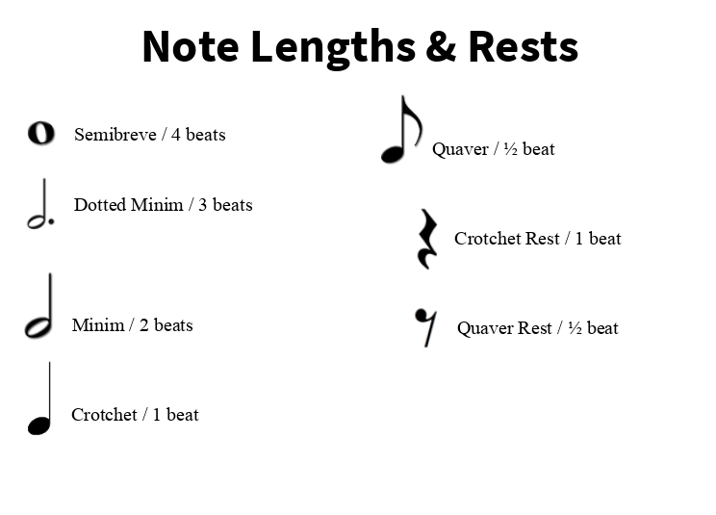
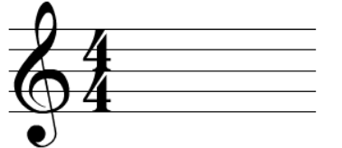
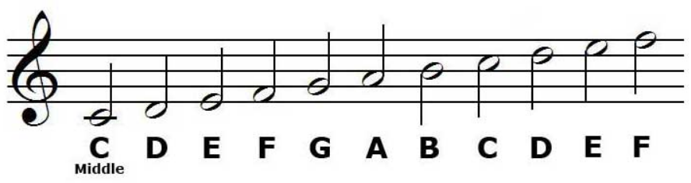
Elements of Music
Keywords
Pitch- highness or lowness in tone
Duration- how long notes last for
Dynamics- the variation in volume of the sound
Timbre- describes the tone or unique quality of the sound
Tempo- the speed of the sound; fast or slow
Rhythm- a pattern of notes which can be made up of notes of different lengths (duration)
Pulse- continual heart beat in the music
Chord- a group of notes which are played together at the same time
Composition- the created piece of music
Composing- the process of creating a piece of music
The Stave
Stave- the 5 lines, 4 spaces where music is written:
Time Signature – tells you how many beats there are in each bar
Top number- How many beats in each bar
The Stave Notes
Bottom number- what type of beat e.g. 4= crotchet 8= quaver 2=minim
Treble Clef

