Slide 1


Year 7
Knowledge
Organiser
Summer Term 2025
Yate Academy
A better chance of success

Slide 2
CONTENTS PAGE
SUBJECT | PAGE NUMBER
History | 3
French | 10
Spanish | 14
Geography | 18
RE | 24
PSHE | 34

Slide 3
Page ‹#›
History 7.3 Revising Rome and the Roman Empire
A | Rome and the Roman Empire key events
1 | 753 BC | Romulus founded the city of Rome.
2 | 1st and 2nd centuries BC | The Roman Empire expanded to include provinces such as Asia Minor and Africa.
3 | 0 | Jesus Christ was born.
4 | 323 AD | Emperor Constantine made Christianity the official religion of the Roman Empire.
5 | 410 AD | Rome was sacked by the Visigoths.
B | Rome and the Roman Empire key vocabulary
1 | To found | To start something.
2 | Historian | Someone who researches and writes about the past.
3 | Emperor | The ruler of an empire.
4 | Latin | The language of the Roman Empire.
5 | Province | A place controlled by the Roman Empire.
6 | Empire | A group of places ruled by one powerful place.
7 | Martyr | Someone who dies for their beliefs.
8 | Pagan | Non-Christian.
9 | Christianity | The religion of the followers of Jesus Christ.
10 | Christian | Someone who believes in Christianity.

Slide 4
History 7.3 Revising Constantinople and the Byzantine Empire
Page ‹#›
C | Byzantine Empire key individuals
1 | Empress Theodora | The empress of the Byzantine Empire in the 6th century.
2 | Emperor Justinian | The emperor of the Byzantine Empire in the 6th century.
3 | General Belisarius | The Byzantine general who won back Rome.
D | Byzantine Empire key vocabulary
1 | Coronation | A formal ceremony in which a new king, queen or emperor is crowned.
2 | Byzantine Empire | A Christian empire that replaced the eastern Roman Empire in the 5th century.
3 | Constantinople | The capital city of the Byzantine Empire.
4 | Riot | A violent uprising by a crowd of people.
5 | Taxes | Payments made by people to the government.
6 | Polytheism | A religion with many gods.
7 | Cathedral | A large Christian church.
8 | Altar | The table that is the focus of worship in Christian churches.
9 | General | A leader of the army.
10 | Hagia Sophia | The great cathedral in Constantinople.

Slide 5
History 7.3 History Vocabulary
E | Key vocabulary
1 | To trade | To exchange goods.
2 | To migrate | To move to another place permanently.
3 | Claim to the throne | A set of reasons why someone should be the next king.
4 | To rebel | To fight against the king / government.
5 | Rebellion | A fight against the king / government.
6 | To cause | To make something happen.
7 | Source | Things from the past that have survived like diaries, newspapers, photographs, and physical remains.
8 | Evidence | Information that historians take from sources to support their arguments.
9 | Century | A period of 100 years.
10 | Decade | A period of 10 years.
11 | Merchant | Someone who makes a living by trading.
12 | Migrant | Someone who moves to another place permanently.
13 | Empire | One place ruling lots of other places.
14 | Noble | Someone born into a powerful family.
15 | To invade | To take over a place using force.

Slide 6
Page ‹#›
History 7.3 Middle Ages Timeline
F | Middle Ages mental timeline
The Middle Ages
The Han Dynasty
Roman Empire
The Byzantine Empire
5th century
Collapse of the Western Roman Empire
1066
The Battle of Hastings
1140s
Matilda and Stephen fight for the English throne
Vikings
Normans
Anglo-Saxons

Slide 7
History 7.3 Revising Medieval England
Page ‹#›
G | 1066 key people
1 | Edward the Confessor | The English king who died without an heir in 1066.
2 | Harold Godwinson | The English nobleman who claimed the throne in 1066 but was killed at the Battle of Hastings.
3 | William of Normandy | The Duke of Normandy who claimed the throne in 1066.
4 | Harald Hardrada | The Viking king who claimed the throne of England in 1066 but was killed at the Battle of Stamford Bridge.
H | 1066 key vocabulary
1 | To inherit | To have something passed down from your parents.
2 | Normandy | A kingdom in northern France.
3 | Anglo-Saxons | A group of migrants from central Europe who settled in the British Isles after the 5th Century.
4 | Vikings | A group of from Scandinavia who invaded England in the 9th century.
5 | Scandinavia | Part of northern Europe, including Norway, Sweden and Denmark.
6 | Heir | The person in line to be the next king or queen.
7 | Claim to the throne | A set of reasons why someone thinks they should be king or queen.
8 | Noble | A wealthy individual from a powerful family.
9 | Strategy | Plan.

Slide 8
History 7.3 Revising Medieval England
Page ‹#›
I | Using sources key vocabulary
1 | Sources | Things that have survived from the past that historians can get evidence from, like diaries and newspapers.
2 | Evidence | Information that helps historians answer a question.
3 | Interpretation | A historian’s view on what happened in the past.
4 | Eyewitness | Someone who sees an event themselves.
5 | Ambiguous | Not having a clear and obvious meaning.
6 | To contradict | To disagree with.
7 | To corroborate | To support.
8 | To exaggerate | To make something seem better / more important than it really is.
J | Peasants key vocabulary
1 | Peasant | a poor farmer who rented their land.
2 | Agriculture | Farming.
3 | Manor | An area of land owned by a noble.
4 | Lord of the Manor | The noble who owned a manor.
5 | Monastery | A large religious building where monks lived and worked.
6 | Monks | Men who gave up their whole lives to worshipping God.
7 | Doom painting | A painting in a church showing what heaven and hell were like.
8 | Good works | Caring and helpful actions motivated by belief in God.
9 | Pilgrimage | A religious journey that brings the traveller closer to God.
10 | Indulgence | A certificate that Christians could buy from the Church to have their sins forgiven.

Slide 9
History 7.3 Revising Han China
Page ‹#›
K | China and the Han dynasty key events
1 | 184 AD | Yellow Turban Rebellion against the Han Dynasty.
2 | 190 AD | The warlord Dong Zhou murdered the child emperor Liu Bian and replaced him with his 6 year old brother.
3 | 208 AD | Battle of the Red Cliffs (Cao Cao defeated by an alliance of Liu Bei and Sun Quan).
4 | 220 AD | The end of the Han dynasty and the founding of the Three kingdoms.
L | China and the Han dynasty key individuals
1 | Liu Bian | Child Emperor of the Han Dynasty in the late 2nd Century.
2 | Zhang Jue | Religious man, leader of the Yellow turban rebellion.
3 | Cao Cao | Powerful warlord from the north with ambitions of conquering all of China. His son, Cao Pi, founded the Wei kingdom.
4 | Liu Bei | A warlord of the south east with ambitions to restore the golden age of the Han. Founder of the Shu-Han kingdom.
5 | Sun Quan | Warlord of the South east of a once powerful family with ambitions to regain lost power and territory. Founder of the Wu kingdom.
M | China and the Han Dynasty key vocabulary
1 | Dynasty | The succession of rulers from the same family.
2 | Merchant | Someone who buys, sells or trades products.
3 | Emperor | The ruler of an empire or dynasty.
4 | Silk Roads | An ancient network of roads in Asia from the 1st C BC till the 15th C AD.
5 | Warlord | A ruler of an area within the Han dynasty.
6 | Golden Age | A term used to describe a period of time in which many scientific and technological advances were made.
7 | Corruption | Dishonest or abusive use of power for personal gain.
8 | Rebellion | An armed resistance to the ruling power or leader.
9 | Han | The ruling dynasty in China from the 2nd C BC till the early 3rd C AD.
10 | Navy | Soldiers who fight on ships at sea.

Slide 10
French: Knowledge Organiser 7.9: School
School description Décris-moi ton collège Describe your school to me Qu’est-ce qu’il y a dans ton collège? What is there in your school? School rules Est-ce que tu es d’accord avec les règles dans ton collège? Do you agree with the rules in your school?
Mon école s’appelle … My school is called … | c’est un grand collège it’s a big secondary school c’est un petit collège it’s a small secondary school c’est une école primaire it’s a primary school c’est un lycée it’s a sixth form college | qui se trouve which is located (which finds itself) | dans le nord de l’Angleterre in the north of England dans l’ouest de la France in the west of France dans le sud du Canada in the south of Canada dans l’est des États-Unis in the east of the United States dans le sud-ouest de l’Angleterre in the south-west of England |  | à la campagne in the countryside à la montagne in the mountains au bord de la mer at the seaside au centre-ville in the town centre
Dans mon collège In my school Dans mon lycée In my sixth form college Dans mon école primaire In my primary school | il y a there is/are nous avons we have on a we have | beaucoup de lots of plein de plenty of tellement de so many trop de too many | professeurs / profs teachers (d’)élèves pupils (d’)étudiants students (d)examens exams salles de classe classrooms cours / leçons lessons règles rules clubs clubs terrains de sport sports fields/pitches cours de récréation playgrounds
 | il faut we have to il est interdit de (d’) it’s forbidden to (we’re not allowed to) | porter l’uniforme scolaire wear school uniform faire ses devoirs do our homework respecter les autres respect others arriver à l’heure / en retard arrive on time / late manger en classe eat in class utiliser son portable en classe use our phone in class manquer les cours miss/skip lessons |  | je suis d’accord car I agree because c’est juste it’s fair c’est important it’s important je ne suis pas d’accord car I don’t agree because c’est injuste it’s unfair c’est trop sévère / strict it’s too strict

Slide 11
French: Knowledge Organiser 7.10: School
School subjects Quelles matières est-ce que tu étudies? What subjects do you study? Qu’est-ce que tu as étudié hier? What did you study yesterday? Qu’est-ce que tu vas étudier demain? What are you going to study tomorrow?
Le lundi On Mondays Le mardi On Tuesdays Le mercredi On Wednesdays Le jeudi On Thursdays Le vendredi On Fridays Tous les jours Every day Chaque jour Every day | j’étudie I study nous étudions we study | ma matière préféréé ce qui est… my favourite subject which is… l’art art le français French le théâtre drama le sport sport l’anglais English l’histoire history la technologie DT la musique music la religion RE les maths maths les sciences science les langues languages | à neuf heures at nine o’clock à neuf heures et quart at quarter past nine à neuf heures et demie at half past nine à dix heures moins le quart at quarter to ten | je trouve ça I find it je pense que c’est I think that it’s à mon avis c’est in my opinion it’s | génial great intéressant interesting passionnant exciting utile useful pratique practical facile easy différent different difficile difficult nul rubbish ennuyeux boring dur hard / difficult inutile useless fatigant tiring
Hier Yesterday Le mois dernier Last month La semaine dernière Last week L’année dernière Last year | j’ai étudié I studied |  |  | c’était it was
Demain Tomorrow Le mois prochain Next month La semaine prochaine Next week L’année prochaine Next year | je vais étudier I’m going to study |  |  | ce sera it will be

Slide 12
French: Knowledge Organiser 7.11: Holidays
Holiday destination Où vas-tu d’habitude en vacances? Where do you usually go on holiday? Travel Comment est-ce que tu voyages? How do you travel? Accomodation Où est-ce que tu restes? Where do you stay? Activities Qu’est-ce que tu fais pendant les vacances ? What do you do during the holidays?
Normalement Normally D’habitude Usually Quelquefois Sometimes Parfois Sometimes De temps en temps From time to time Souvent Often | je vais (en vacances) I go (on holiday) | à Paris to Paris à Londres to London à Québec to Québec à Madagascar to Madagascar en Angleterre to England en France to France en France d’Outre-mer to overseas France en Martinique to Martinique en Algérie to Algeria en Espagne to Spain en Afrique to Africa en Amérique to America en Asie to Asia en Europe to Europe au Royaume-Uni to the UK aux États-Unis to the USA |  |  |  | avec ma famille with my family avec mes parents with my parents avec mes grands-parents with my grandparents avec mes copains with my friends avec mes amis with my friends avec mon collège with my school seul(e) alone
 | je voyage I travel nous voyageons we travel | en voiture by car en car by coach en train by train en bateau by boat |  | en avion by plane en bus by bus en metro by metro/ underground/ tube à pied on foot | parce que…because c’est rapide it’s fast c’est confortable it’s comfortable c’est loin it’s far c’est proche it’s near c’est mieux pour l’environnement it’s better for the environment
 | je reste I stay nous restons we stay | dans un hôtel in a hotel dans un camping in a campsite dans une tente in a tent dans un appartement in an apartment / a flat dans un logement in an accommodation |  |  | près de la plage near to the beach loin de la plage far from the beach au centre-ville in the town centre au bord de la mer at the seaside à la campagne in the countryside à la montagne in the mountains
S’il fait beau If it’s nice weather S’il fait mauvais If it’s bad weather S’il fait chaud If it’s cold S’il fait froid If it’s cold | je fais I do nous faisons we do |  | du vélo cycling du shopping shopping du tourisme tourism de la natation swimming de la lecture some reading de la danse dancing une visite en bateau a boat trip |  | à l’hôtel at the hotel à la plage at the beach à la piscine at the swimming pool à la campagne in the countryside à la montagne in the mountains au centre-ville in the city centre au bord de la mer at the seaside

Slide 13
French: Knowledge Organiser 7.12: Holidays
Dream holiday Comment seraient les vacances de tes rêves? What would your dream holiday be like?
Pour les vacances de mes rêves For my dream holiday Si j’avais le choix If I had the choice Si j’avais l’occasion If I had the opportunity Si j’avais assez d’argent If I had enough money Si j’avais le temps If I had the time Si je pouvais If I could Si j’étais riche If I were rich Si je devais choisir If I had to choose | je voudrais aller I would like to go j’irais I would go | à Paris to Paris à Londres to London à Québec to Québec en Afrique to Africa en Amérique to America en Asie to Asia en Europe to Europe | avec ma famille with my family avec mes parents with my parents avec mes grands-parents with my grandparents avec mes copains with my friends avec mes amis with my friends avec mon collège with my school seul(e) alone
 | je voudrais voyager I would like to travel je voyagerais I would travel | en avion privé by private plane en voiture de luxe by luxury car en bateau de pirates by pirate ship en train à grande vitesse / TGV by high-speed train
 | je voudrais rester I would like to stay je resterais I would stay | dans un hôtel de luxe in a luxury hotel dans un château in a castle dans une ferme on a farm dans un logement cinq étoiles in a 5-star accommodation
 | je voudrais passer mes vacances I would like to spend my holiday je passerais mes vacances I would spend my holidays | près de la plage near to the beach loin de la plage far from the beach au centre-ville in the town centre au bord de la mer at the seaside à la campagne in the countryside à la montagne in the mountains sur une île on an island
Il ferait beau It would be nice weather Il ferait chaud It would be hot Il y aurait du soleil It would be sunny | je voudrais faire I would like to do je ferais I would do | du vélo cycling du shopping shopping du tourisme tourism de la natation swimming de la lecture some reading de la danse dancing une visite en bateau a boat trip

Slide 14
Spanish: Knowledge Organiser 7.9: School
School description Describe tu colegio Describe your school ¿Qué hay en tu colegio? What is there in your school? School rules ¿Estás de acuerdo con las reglas en tu insti? Do you agree with the rules in your school?
Mi colegio se llama… My school is called … Mi instituto se llama… My school is called … | es un colegio grande it’s a big secondary school es un colegio pequeño it’s a small secondary school es una escuela primaria it’s a primary school es un bachillerato it’s a sixth form college | que está which is | en el norte de Inglaterra in the north of England en el oeste de España in the west of Spain en el sur de Argentina in the south of Argentina en el este de Peru in the east of the Peru en el suroeste de Inglaterra in the south-west of England |  | en el campo in the countryside en las montañas in the mountains en la costa at the seaside en el centro in the town centre
En mi insti In my school En mi colegio In my school | hay there is/are tenemos we have | mucho/a(s) lots of poco/a(s) few demasiados/a(s) too many bastante(s) enough | profesores teachers alumnos pupils estudiantes students examines exams salles de classe classrooms clases lessons reglas / normas rules clubs clubs equipos de deporte sports teams asignaturas subjects
 | hay que we have to está prohibido it’s forbidden to | llevar uniforme escolar wear school uniform hacer deberes do homework respetar los otros respect others llegar a tiempo / tarde arrive on time / late comer en clase eat in class escuchar en clase listen in class usar su móvil en clase use our phone in class estudiar lenguas study languages aprobar examines pass tests |  | estoy de acuerdo porque… I agree because… es justo it’s fair es importante it’s important es educativo it’s educational no estoy de acuerdo porque… I don’t agree because… es injusto it’s unfair es demasiado estricto it’s too strict

Slide 15
Spanish: Knowledge Organiser 7.10: School
School subjects ¿Cuáles asignaturas estudias? What subjects do you study? School subjects (past) ¿Qué estudiaste ayer? What did you study yesterday School subjects (future) ¿Qué vas a estudiar mañana? What are you going to study tomorrow?
Los lunes On Mondays Los martes On Tuesdays Los miércoles On Wednesdays Los jueves On Thursdays Los viernes On Fridays Todos los días Every day Cada día Every day | etudio I study estudiamos we study | mi asignatura favorita es… my favourite subject which is… (el) arte (el) dibujo (el) francés (el) español (el) alemán (el) inglés (la) informática (la) educación física (la) historia (la) tecnología (la) geografía (la) música (la) religión (las) matemáticas (las) ciencias | a las nueve at nine o’clock a las nueve y cuarto at quarter past nine a las nueve y media at half past nine a las nueve menos cuarto at quarter to ten | me parece que es (son) I find it pienso que es (son) I think that it’s en mi opinion es (son) in my opinion it’s | divertido/a(s) fun emocionante(s) exciting interesante(s) interesting útil(es) useful increíble(s) incredible fácil(es) easy útil(es) useful educativo/a(s) educational cansado/a(s) tiring inútil(es) useless aburrido/a(s) boring terrible(s) terrible difícil(es) difficult
Ayer Yesterday El mes pasado Last month La semana pasada Last week El año pasado Last year | estudié I studied |  |  | fue(ron) it was
Mañana Tomorrow El mes pasado Next month La semana pasada Next week El año pasado Next year | voy a estudiar I’m going to study |  |  | será(n) it will be

Slide 16
Spanish: Knowledge Organiser 7.11: Holidays
Holiday destination ¿Adónde vas de vacaciones normalmente? Where do you usually go on holiday? Travel ¿Cómo viajas? How do you travel? Accomodation ¿Adónde te alojas? Where do you stay? Activities ¿Qué haces durante las vacaciones? What do you do during the holidays?
Normalmente Normally Generalmente Usually A veces Sometimes De vez en cuando From time to time A menudo Often | voy a I go to | Barcelona Barcelona Buenos Aires Buenos Aires Madrid Madrid Medellín Medellín Bolivia Bolivia Ecuador Ecuador |  | España Spain Francia France Alemania Germany Venezuela Venezuela Reino Unido United Kingdom las Islas Baleares The Balearic Islands las Islas Canarias The Canary Islands |  | con mi familia with my family con mis hermanos with my siblings con mis padres with my parents con mis amigos with my friends con mi colegio with my school solo / sola alone
 | viajo I travel viajamos we travel | en coche by car en metro by tube en avión by plane en autobús by bus | en tren by train en barco by boat en bicicleta by bike a pie on foot |  | porque es… because it is…. rápido fast lento slow cómodo comfortable incómodo uncomfortable divertido fun aburrido boring
 | me alojo I stay nos alojamos we stay | en un hotel in a hotel en un camping in a campsite en un piso in a flat en una caravana in a caravan en una villa in a villa |  |  | en el centro in the town centre en el campo in the countryside en la capital in the capital en la costa on the coast en las montañas in the mountains
Si hace buen tiempo If it’s nice weather Si hace mal tiempo If it’s bad weather Si hace frio If it’s cold Si hace calor If it’s hot | hago I do hacemos we do | ciclismo cycling compras shopping turismo tourism natación swimming baile dancing un viaje en barco a boat trip |  |  | en el barrio the neighbourhood en el café the cafe en el castillo the castle en el centro comercial the shopping centre en el estadio the stadium en el jardín the garden en el mercado the market en el museo the museum en el parque the park en el pueblo the town en el puente the bridge en el restaurante the restaurant |  | en la ciudad the city en la piscina the pool en la playa the beach en la plaza the square los monumentos the monuments las tiendas the shops

Slide 17
Spanish: Knowledge Organiser 7.12: Holidays
Dream holiday ¿Cómo serían las vacaciones de tus sueños? What would your dream holiday be like?
Para las vacaciones de mis sueños For my dream holiday Si tuviera mi elección If I had the choice Si tuviera la oportunidad If I had the opportunity Si tuviera más dinero If I had more money Si pudiera If I could Si fuera rico/a If I were rich Si fuera posible If it were possible | me gustaría ir I would like to go iría I would go | a Barcelona to Barcelona a Buenos Aires to Buenos Aires a Medellín to Medellin a África to Africa a Latinoámerica to Latin America a Asia to Asia a Europa to Europe | con mi familia with my family con mis padres with my parents con mis abuelos with my grandparents con mis amigos with my friends con mi colegio with my school solo/a alone
 | me gustaría viajar I would like to travel viajaría I would travel | en avión privado by private plane en coche de lujo by luxury car en barco by boat en tren by train
 | me gustaría alojarme I would like to stay me alojaría I would stay | en un hotel de lujo in a luxury hotel en un castillo in a castle en una habitación indivdual in a single room en un barrio histórico in a historic neighbourhood
 | me gustaría pasar mis vacaciones I would like to spend my holiday pasaría mis vacaciones I would spend my holidays | cerca de la playa near to the beach lejos de la playa far from the beach en el centro in the town centre en la costa on the coast en el campo in the countryside en las montañas in the mountains en una isla on an island
Haría buen tiempo It would be nice weather Haría calor It would be hot Haría sol It would be sunny | me gustaría hacer I would like to do haríá I would do | ciclismo cycling compras shopping turismo tourism natación swimming baile dancing un viaje en barco a boat trip

Slide 18
Geography: Population
A | Global population
1 | Population | The number of people living on Earth. Currently 8 billion.
2 | Population density | The number of people living in an area.
3 | Population distribution | The spread of people across the world.
4 | Birth rate | Number of babies born per 1000 people per year.
5 | Death rate | The number of deaths per 1000 per year.
6 | Migration | Permanent move of people from one area to another.
B | Demographic transition model
 |  | Birth rate | Death rate | Population | Level of development
1 | Stage 1 | High birth rate | High death rate | Low population | LIC – Low development
2 | Stage 2 | High birth rate | Rapidly decreasing death rate | Rapidly increasing population | LIC – Low development
3 | Stage 3 | Rapidly decreasing birth rate | Death rate continues to decrease | Population continues to increase | NEE – Increasing development
4 | Stage 4 | Decreasing birth rate | Slowly decreasing death rate | Population increases slowly | HIC – Highly developed
5 | Stage 5 | Birth rate continues to decrease | Death rate starts to increase | Population starts to decrease | HIC – Highly developed
C | Population Pyramid
1 | Population Pyramid | A graph that shows the age and gender of a specific population.
2 | Demographic | The structure of the population.
3 | Young population | Majority of the population are aged below 15.
4 | Aging population | Majority of the population are aged over 60.
5 | Life expectancy | Average age someone can expect to live to.
6 | Dependency ratio | The number of people that are economically active to those that are not economically active.

Slide 19
Geography: Population
D | China’s One Child Policy
1 | When did it start? | Introduced in 1979.
2 | Why did it start? | The population was increasing rapidly and there were fears of a famine.
3 | What were the benefits? | Rent/own larger homes. 5-10% pay rise. Longer maternity leave. Better child care.
4 | What were the sanctions? | Could be fined 4X your yearly wage. 10% cut in your pay. You would have to pay for the health care and education of your family.
5 | What were the positive results? | Country did not go into famine. Kept population growth to a reasonable rate.
6 | What were the negative results? | Gender imbalance as boys were preferred over girls. Aging population with fewer young to care for the elderly.
E | Kerala's population control
1 | Educating women | In Kerala 85% of women are literate. Better educated women are more likely to keep their children healthy. Therefore infant mortality has dropped. This has led to a drop in birth rates.
2 | Status of women | Women are no longer seen as a burden – they are regarded as an asset. Traditionally in India when a woman gets married the family have to pay money to the bridegroom’s family. This is called a dowry. However, in Kerala, it is the bridegroom’s family who pay a dowry to the bride’s family.
3 | Adult education | The Government has provided adult literacy classes in towns and villages. With improved education comes an understanding of the benefits of smaller families.
4 | Health care | Improving child health through vaccination programmes has led to a decrease in infant mortality so people no longer need to have as many children.
5 | Higher age of marriage | Encouraging a higher age of marriage means families tend to be smaller as children are born later.
F | Aging populations
1 | Impact on education | As there are few children born few school are needed so some may close down and teachers lose their jobs.
2 | Impact on health care | More pressure to provide care for the elderly. There may not be enough people to provide this.
3 | Impact on the economy | There will be fewer people of a working age to pay taxes that supports development of a country.
4 | Impact on pensions | With fewer taxes but more claiming pensions there may not be enough money for the pensions and age of retirement must increase.

Slide 20
Geography: Population
G | France Pronatalist policies
1 | cash incentive of £675 monthly (nearly the minimum wage) for a mother to stay off work for one year following the birth of her third child.
2 | 'carte famille nombreuse' (large family card), giving large reductions on train fares.
3 | income tax based on the more children the less tax to pay.
4 | three years paid parental leave, which can be used by mothers or fathers.
5 | government-subsidised day care for children under the age of three, and full time school places for over threes paid for by the government.
H | Migration
1 | Migration | The permanent movement of people from one area to another.
2 | National migration | The permanent movement of people from one area to another within a country.
3 | International migration | The permanent movement of people from one country to another.
4 | Immigrant | A person who has entered a new country to live.
5 | Emigrant | A person who has left a country to live elsewhere.
6 | Push factors | Things that make people want to leave a place.
7 | Pull factors | Things that make people want to live in a place.
I | Advantages and disadvantages of migration
1 | Host country | The country people have moved to.
2 | Source country | The country people have left.
3 | Advantages to the host country | Diverse culture. Increase in people able to work. Can fill jobs others don’t want to do.
4 | Disadvantages to the host country | Overcrowding. May face discrimination. Increased pressure on services e.g. health care.
5 | Advantages to the source country | Money sent home by migrant. Decreased pressure on resources. May bring home new skills.
6 | Disadvantages to the source country | Brain drain – Most skilled workers leave. Workforce is reduced reducing taxes. Mainly men who leave causing a gender imbalance.

Slide 21
Geography Knowledge Organiser 7: Microclimates
A | Key Terms and definitions
Key word | Definition
Microclimates | When a small area has a different climate to the general climate of its surroundings.
Temperature | The degree of hotness or coldness of an object.
Vegetation | Plants found in a particular ecosystem.
Precipitation | Rain, snow, sleet or hail which falls to the ground.
Climate | The weather in an area over a long period of time (usually 30 years).
Interception | When water does not reach the soil but is absorbed by vegetation instead.
Temperate | When an area has mild temperatures all year.
Key word | Definition
Primary data | Data that is collected by yourself.
Secondary data | Data that is collected by someone else.
Anomaly | Something that does not fit the general trend: an exception.
B | How to measure microclimates
Equipment | What it measures | Unit of measurement
Thermometer | A thermometer is used to measure air temperature. The lower the number the cooler the temperature. | Degrees Celsius (⁰C)
Anemometer | An anemometer is used to measure wind speed. | Miles per hour (mph)
Rain gauge | A rain gauge is used to collect rainwater to measure the amount. | Millimetres (mm)
Barometer | A barometer is used to measure the air pressure the higher the number the higher the pressure. | Millibars (mb)
Weather vane | A weather vane is used to find out the direction the wind is blowing from. | North, South, East, West

Slide 22
Geography Knowledge Organiser 7: Microclimates
C | Features affecting microclimates
Feature | How it affects Microclimates
Buildings | Buildings give off heat this can increase the temperature surrounding them. Buildings can also change the wind speed and direction.
Physical features | Trees provide shade making the area cooler. The temperature is also cooler surrounding lakes.
Aspect | Aspect is the direction a place faces. If the aspect is south facing the area is generally warmer while north facing aspects are generally cooler.
Shelter | Trees, hedges, walls, buildings and even hills can all provide shelter from the wind and amount of precipitation.
Surface | The surface of the ground can also affect the temperature. Darker surfaces absorb more heat making the temperature warmer. Lighter coloured surfaces can reflect the heat so are generally cooler.

Slide 23
Geography Knowledge Organiser 7: Microclimates
D | How to complete a fieldwork enquiry?
Step 1 | When carrying out fieldwork you need to have an aim and question that you are trying to answer. Example aim – To investigate microclimates at Yate Academy. Example question - How do microclimates around Yate Academy vary?
Step 2 | Selecting a location When selecting a location you need to asses the cost and benefit of the location by considering the following points: Distance – Is it easy to get to, how long will it take? Cost – Will transport need to be paid for? Safety – Are there any hazards that students need to be made aware of e.g. crossing the road. Time/date – will when the fieldwork is carried out have an impact on the results?
Step 3 | Data collection method When collecting data there are two types of data primary and secondary. Primary data is collected by yourself. Secondary data is collected by someone else. The purpose of collecting any data should be to help you answer your enquiry question. To make the data purposeful you need to consider the following: Primary Which locations will you select and why? What equipment will you use? Do you know how to use the equipment accurately to ensure reliability? Secondary Is it from a reliable source? Is it relevant to your fieldwork?
Step 4 | Data Presentation Once your data has been collected it needs to be presented clearly so that it is easier to read and understand. Remember bar graphs are used for precipitation and line graphs for temperature.
Step 5 | Conclusion Once you have presented your data you can start to interpret that data to write a conclusion. Look out for any trends or anomalies within your data that may or may not support your data. Try to give reasons for what you find in your data. See example.
Step 6 | Evaluation Once the fieldwork is complete you need to evaluate your fieldwork. You need to ask the three following questions: What went well with my fieldwork? What could I improve on? What would I do differently next time?

Slide 24
RE: Knowledge Organiser 7.3 The origins of Religion
A | Key terms
1 | Abrahamic religions | The name given to Judaism, Christianity and Islam because of their shared history.
2 | Covenant | An agreement.
3 | Exodus | The liberation of the people of Israel from slavery in Egypt, under the leadership of Moses.
4 | Annunciation | The announcement by the angel Gabriel to the Virgin Mary that she would conceive through the Holy Spirit and become the mother of Jesus.
5 | Incarnation | Taking on flesh e.g When God became human and divine.
6 | Crucifixion | When Jesus was killed on Good Friday.
7 | Resurrection | When Jesus rose from the dead on Easter Sunday.
8 | Denomination | A sub group within a religion.
9 | The Night of Power | Is the name given to the night when the Angel Jibril first appeared to Muhammad and began revealing the Qur’an.
10 | Schism | A split or division between strongly opposed sections or parties, caused by differences in opinion or belief.
B | Abrahamic religions
1 | All Abrahamic religions believe that God initially created two people, Adam and Eve. They disobeyed God by eating the forbidden fruit from the Tree of Knowledge of Good and Evil. This event is called The Fall. However, the Abrahamic religions differ in what they believe the consequences of the Fall were.
2 | Jewish View: Jews do not believe that Adam and Eve’s actions affected future human beings. Jews believe humans are born innocent and free of sin. Therefore any moral evil is an individual choice, caused by people turning away from God.
3 | Christian View: Christians believe the relationship between humans and God was broken because of The Fall as it led to original sin. God had to come to Earth (incarnation) to atone for original sin so that humans could be reconciled with God. Humans must continue to work to redeem themselves and protect themselves from future personal sin.
4 | Muslim View: Muslims reject the idea that all humans are born with sin because of he Fall. They believe that after eating the forbidden fruit, Adam asked Allah (God) for forgiveness and received it. This is because Allah is beneficent and merciful. The perfect relationship between humans and God was not broken.

Slide 25
RE: Knowledge Organiser 7.3 The origins of Religion
C | Abrahamic religions
1 | The birth of Jesus: All Abrahamic religions agree that in modern-day Palestine, a Jewish baby, called Jesus is born. He ministers about monotheism, forgiveness and compassion. He attracts many followers who become known as Christians. They disagree on whether Jesus was simply a man, a prophet or the Messiah.
2 | Jewish view: Jews do not believe that Jesus that Jesus of Nazareth was the messiah or prophet nor do they believe he was the Son of God. This is because they believe that God is a singularity and cannot be divided as the Holy Trinity suggests. Some Jews believe he was simply a wise man preaching good messages. Others believe he was blasphemous (disrespectful for claiming to be the son of God).
3 | Christian view: Jesus is the messiah, God on earth, and the saviour that the prophets spoke of in the Old Testament. Jesus is God in human form. Jesus came to restore the broken relationship between God and His creation after The Fall. He took on the sins of humankind (atoned) and died for humanity on the cross, so humans could be reconciled with God. As a result, humans can reach heaven if they have faith and follow his teachings.
4 | Muslim view: Jesus (or Isa) is the second to last prophet before Prophet Muhammad. Therefore he is important as he received a message from Allah. Jesus is not God the Son, the messiah or saviour. Allah is one and indivisible. He is not God in human form, but Allah does bless him with the power to do miracles. Isa actually preached about the final prophet (Muhammad) but the message was corrupted over time. They also believe that Jesus was not actually crucified, but brought up to Heaven by Allah before he could be captured.

Slide 26
RE: Knowledge Organiser 7.3 The origins of Religion
D | History of Judaism
1 | For Jews, Abraham is known as the founder or first patriarch of Judaism and the father of all 3 Abrahamic religions. He is vital to Jewish history as the first point of contact between God and the Jews.
2 | Abram called by God and was the recipient of the first covenant (agreement) with God. God appeared to Abram in a dream (special revelation) and said that he would promise Abram protection and land to Abram and his descendants, if he was to promise to leave his home land of Ur (Iraq) and spread the belief that there was only one God (monotheism). This was huge as Abram was childless and 75 at the time and everyone was polytheistic. This is where the term ’chosen people’ comes from as Jews were chosen to receive the first covenant with God.
3 | The covenant was sealed through his circumcision. Jewish people still carry out the circumcision on the eighth day after a boy’s birth as a sign of this covenant today.
4 | Abram travelled from Ur to Canaan (Israel - the promised land) and preached monotheism. As a result of keeping his end of the covenant - Abram’s wife, Sarah (90), gave birth to their son, Isaac. God also changed Abram's name to Abraham meaning father of all nations.
5 | Isaac is known as the second patriarch of Judaism as taught the meaning of sacrifice. In the Jewish faith it is believed that Abraham was asked to sacrifice his son Isaac as a show of obedience and loyalty to God. Abraham told Isaac of God’s request and that Isaac went willingly to the place he was going to be killed. However, at the last minute God replaced Isaac with a ram and he was saved. Because of Abraham's unwavering faith, God renewed His promise to bless Abraham and his descendants. He promised that through his offspring, all nations would be blessed.
6 | The call of Moses is found in the book of Exodus in the Old Testament and takes place over 1000 years after the call of Abraham. At the time, the Israelites (Jews) were enslaved in Egypt under the Pharaoh.
7 | Moses was called by God to help the Israelites (who were Jewish) escape from Egypt. God helped Moses set the Israelites free by sending 10 plagues. The 10th plague was to kill all Egyptian first born sons, whilst protecting Israelite first born sons. This is remembered in the Jewish faith today as the Passover.
8 | The Israelites escaped with Moses and were helped on their journey by God - the same God who had promised Abraham that He would look after the Jewish people. God parted the Red Sea to help them escape the Pharaoh army that was chasing after them. When they reached safety on Mount Sinai, in present day Egypt, God gave Moses the 10 commandments or Decalogue. The rules which all Jews are to live by e.g. ‘Thou shalt not kill’.

Slide 27
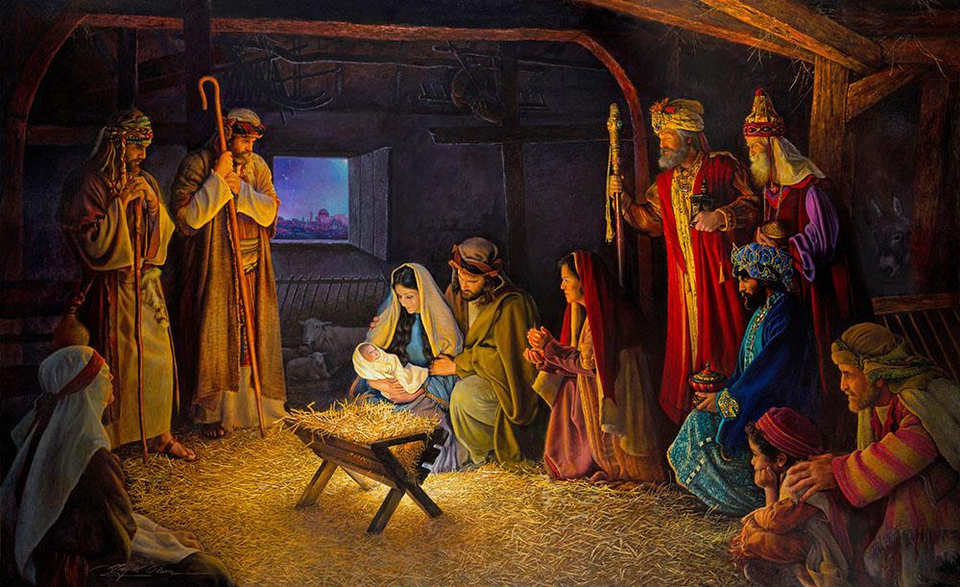
RE: Knowledge Organiser 7.3 The origins of Religion
E | History of Christianity
1 | Christians believe that God had to come to earth (incarnated) to atone for human sin and reconcile humans with God after The Fall. Jesus was born a Jew.
2 | Incarnation: Christians believe that God was incarnated (became flesh) in human form as Jesus Christ, “The word became flesh. This is belief is what starts the religion, Christianity. Christians believe that the birth of Jesus was announced by Angel Gabriel (The Annunciation). Mary was impregnated by the Holy Spirit and gave birth as a virgin. Jesus was born in Bethlehem in Israel. Jesus is 100 % divine and 100% human. Christmas is the festival that celebrates the incarnation.
3 | Baptism: At 30 Jesus was baptised by John the Baptist in the River Jordan. This leads all Christians to believe they should be baptised. The Holy Trinity was present at Jesus' baptism. The baptism marks the start of Jesus’ three year ministry, where he performs 37 miracles and teaches people the rules of the faith e.g Decalogue and how to behave towards others e.g with compassion and forgiveness.
4 | Jesus’ temptation in the desert: After his baptism, Jesus went to the desert to think about and prepare for his ministry. He spent forty days and forty nights in the desert where he was tempted on three occasions by the Devil. Jesus fasted in the desert. He was hungry. The devil tried to tempt him to use his miraculous powers for selfish reasons. Jesus refused and went hungry. The devil took Jesus to the top of a temple and asked Jesus to throw himself off to prove that he was the son of God as no harm would come to him. Jesus refused as he didn't want to test God but have faith . The devil tempted Jesus to use his powers to achieve all he wanted for himself. Jesus refused and said “Worship the Lord your God and serve only Him.”

Slide 28
RE: Knowledge Organiser 7.3 The origins of Religion
F | Ministry (spreading the Good news)
1 | Jesus taught agape love - encouraging people to love others unconditionally, even when it was difficult to do so, ‘Love your neighbour as yourself.’
2 | The Good Samaritan: In this parable, a Samaritan man helps a Jewish man even though the two groups did not like each other. The Jewish man had been beaten and robbed and many other religious people have walked by and ignored him. The Samaritan not only pays for the Jewish man’s care but also says he will return to pay more if needed. This teaches that people should not only show agape to people within their own community but also to their enemies ‘love thy enemy’ and the Golden rule, ‘do unto others as you would like done to you’.
3 | The Parable of the Sheep and Goat: In this parable Jesus teaches that we must help people in need, as by doing so we are mirroring him, ‘I was hungry and you fed me’. Those that help the vulnerable are the sheep, the righteous and will be rewarded with Heaven. Those who ignore people less fortunate than themselves are the Goats, the sinners who will be punished in Hell.
4 | The Sermon on the Mount: In this sermon, Jesus taught his followers the Lord’s Prayer, forgiveness and compassion.

Slide 29
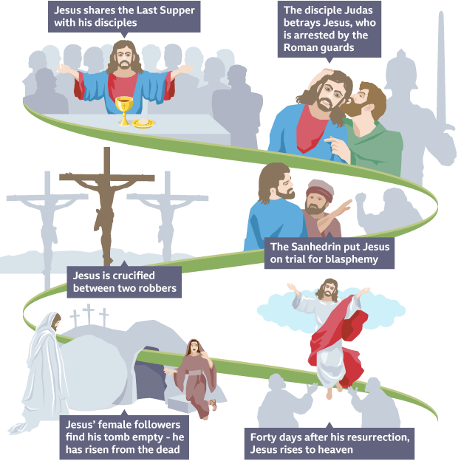
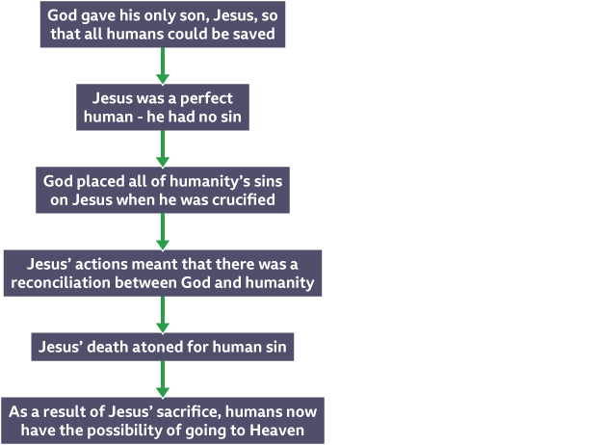
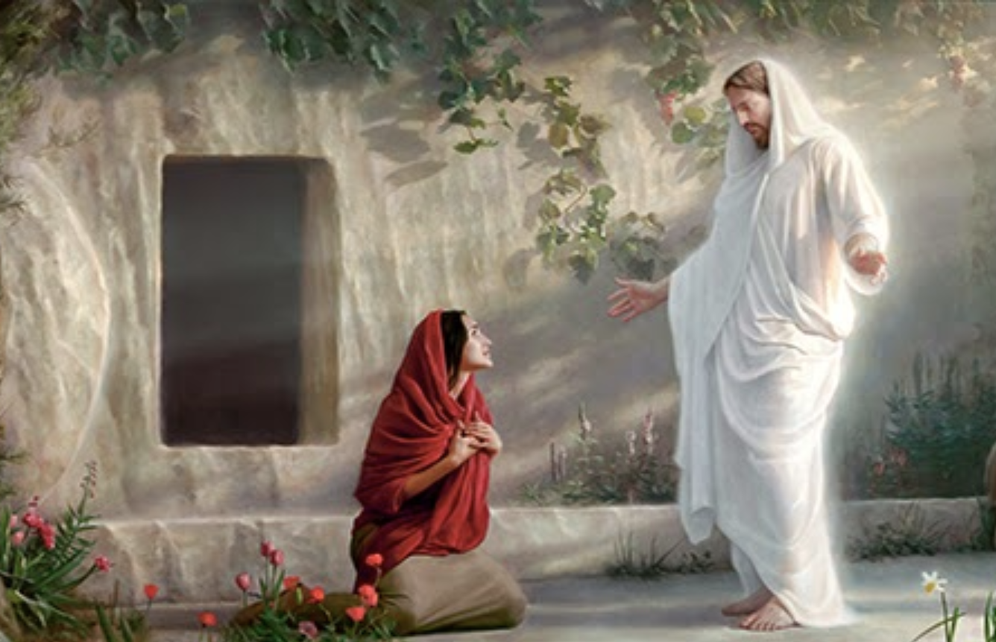
RE: Knowledge Organiser 7.3 The origins of Religion
G Crucifixion
Jesus was arrested for blasphemy (claiming to be the son of God) by the Romans and Sanhedrin (Jewish council).
He is ordered to walk to Golgotha to be crucified on Good Friday.
Jesus’ crucifixion was the ultimate act of omnibenevolence. He died to atone for human sin, so that humans and God could be reconciled.
Jesus taught forgiveness even when dying ‘ Forgive them Father, for they do not know what they do’.
H Resurrection
For Christians, the resurrection is the belief that Jesus came back to life three days after he died on the cross (Easter Sunday).
Jesus was resurrected for 40 days.
Jesus resurrection proves to Christians that Jesus has power over death, that he is omnipotent and that he is the Messiah.

Slide 30
RE: Knowledge Organiser 7.3 The origins of Religion
I | How did Christianity spread after Jesus’ death
1 | Jesus met his disciples after his resurrection. His last words, before he ascended to heaven, became known as The Great Commission. It commanded them to convert everyone to Christianity. “Go and make disciples of all nations, baptising them in the name of the Father and of the Son and of the Holy Spirit, and teaching them to obey everything that I have commanded you.”
J | How did Christianity spread after Jesus’ death?
2 | 36 AD- Individuals: Saul was a pharisee (Jewish leader) who attacked followers of Jesus. Saul was travelling from Jerusalem towards Damascus when he has a special revelation and hears Jesus speak to him through blinding light. Saul converts to a being a Christian. He becomes an evangelist - spreading the message of Jesus to others through words. He writes 14 chapters of the New Testament. He becomes a martyr dies for his new found Christian beliefs.
K | How did Christianity spread after Jesus’ death?
3 | 312 AD: Christians were still being persecuted/ attacked by the Romans. However, Emperor Constantine had a vision of a cross in the sky and converted to Christianity as a result. Emperor Constantine gave everybody in the empire freedom to be Christian and appointed some Christians to high-ranking professions. He called the meeting that led to the Nicene Creed being written which turned Christianity into a religion and became their statement of faith.
L | How did Christianity spread after Jesus’ death
4 | Christianity was spread all over the world due to colonisation, trade and war e.g. the Crusades and British Empire.
M | Denominations - Catholics
1 | The various groups or branches within Christianity are referred to as denominations e.g. Catholics, Anglicans, Protestants, Quakers etc.
2 | Catholicism: According to Catholics, the Catholic church was the first Christian church, established when Jesus said to his disciple, Peter "Thou art Peter, and upon this rock I will build My Church, and even the gates of Hell shall not prevail against it. Behold, I give you the keys to the kingdom of Heaven." . Peter was therefore the first leader of the Roman Catholic Church. The Pope is now seen as the successor of Saint Peter and is regarded as the head of the Roman Catholic Church and God's voice on Earth. Catholics believe that there are seven sacraments that need to be followed and practiced to achieve entry into heaven. Catholics do not allow women to be leaders of the church.
3 | The Great Schism of 1054: This is the breakup of the Christian church into two sections—the Western and the Eastern sections. These two sections were to turn into the Roman Catholic Church and the Eastern Orthodox Church. The divide remains today. The west led the church in Latin, the east in Greek.

Slide 31
RE: Knowledge Organiser 7.3 The origins of Religion
N | Denominations, Protestants, Anglicans and Quakers.
1 | The Reformation - ‘Reform’ means to change something for the better. The Reformation is the name given to the split between Catholics (those that remained loyal to the Pope) and those who followed the ideas of Protestant reformers such as Martin Luther and John Calvin. Protestants protested that the Bible, not the Pope, should be the ultimate source of authority, that the Bible should be in English and not Latin so it was accessible to all and that churches should not be wealthy and highly decorated. Protestants also said that faith is more important than strict practices e.g sacraments.
2 | The Church of England was officially formed in the 1530s by Henry VIII. It is influenced by both the traditional nature of the Catholic Church, but also by the radical changes from the Reformation. Followers of the Church of England are called Anglicans. The Anglican church was formed because Henry’s first wife Catherine of Aragon had only bore him one girl, Mary, in 23 years of marriage. He wanted a male heir. To have a male heir he needed to remarry. The Catholic church does not allow divorce. He set up the Church of England and passed an Act of Supremacy made him the head of the Church of England. He could now give himself a divorce. Today, the King or Queen is still the head of the church. However, the Archbishop of Canterbury has the real authority. The Church of England values the Bible over any human leader and allows women to be leaders.
3 | Quakers: Started in the 17th century. Believe that we ought to tremble (quake) in the presence of God - not out of fear, but out of awe and admiration. George Fox set up the Quaker moment and recruited people who believed that we each have a personal relationship with god and so don’t need the power of a church authority. Do not meet in churches, but meeting rooms instead. Do not ask for donations. Sit in silence meditating, until overtaken by the holy spirit. Whoever is taken over by the Holy spirit, then ministers.

Slide 32
RE: Knowledge Organiser 7.3 The origins of Religion
O | Islam- Who was Muhammad?
1 | Prophet Muhammad lived from 570-632.
2 | Born in Mecca in Saudi Arabia into a middle class family.
3 | He was an orphan.
4 | During Prophet Muhammad's childhood, people worshiped many idols and God’s.
5 | Muhammad was different as he believed and worshipped one God.
6 | As he grew up, he became known as ‘The Trustworthy’.
P | How did Islam begin?
1 | Muhammed believed in one God, Allah.
2 | On one night, in 610, now known as The Night of Power, Angel Jibril appeared to Muhammad and commanded that he recite the words he could see before him. ‘Recite, Recite, Recite’.
3 | These words became the Quran, the infallible words of Allah (is God’s actual words and contains no errors).
4 | This was a miracle because Muhammad had never been taught to read but found he could recite the words over and over again without being able to forget or change a single word.
5 | For Muslims, the Night of Power is the most important event in history.
6 | Prophet Muhammad is the last Prophet that there will ever be and so is known as the Seal of all Prophets.
7 | This is because the Quran is the perfect message from Allah , containing all that Muslims need to know e.g. Sharia Law, the 5 Pillars etc.
Q | How did Islam spread?
1 | Islam spread through military conquests, pilgrimages & trade. Now it is the 2nd biggest global religion.

Slide 33
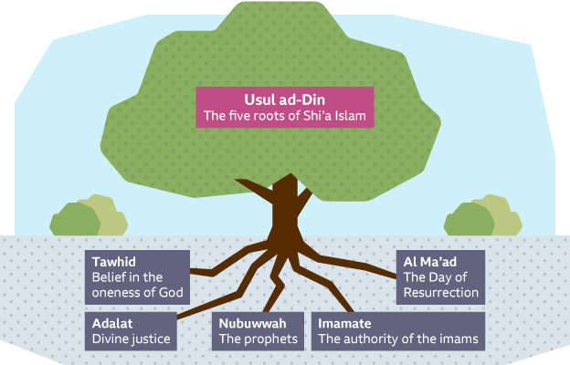

RE: Knowledge Organiser 7.3 The origins of Religion
R | The split
1 | When Prophet Muhammad died in 632 he left no named successor. This led to a Muslims splitting into two groups: Sunni and Shia.
S | Sunni Muslims
2 | Believe that after Muhammad died, his close friend, Abu Bakr, should be the next rightful leader. Abu Bakr was the first convert of Islam (outside of Muhammed’s family). He fought alongside Muhammed in battle. Knew Muhammed and his teachings very well. Sunni Muslims believed he should be given the title caliph (which means God’s rightful leader on Earth). The role of the caliph is not to interpret the Quran as it’s the infallible words of Allah.
3
T | Shia Muslims
1 | Believe that after Muhammed died that he ‘did’ choose a successor, Ali. They believed Ali was the rightful successor because he was a blood relative, the first male to convert to Islam and he fought in many battles with Muhammed. They believed that once Ali was appointed he should be called an ‘Imamate’. The role of the Imam is to interpret the Quran as Allah has given them authority to do this.
2
Shia Muslims believe in the
5 Roots of Usul ad-Din
Sunni Muslims believe in the Six Articles of Faith.

Slide 34
PSHE support links
Useful telephone numbers
NSPCC (Childline) confidential helpline for children and young people: 0800 1111 (24 hrs)
Family Lives: 0808 800 2222
The Mix: 0800 8084994
CAMHS CRISIS LINE 0300 3031320
Avon/ Wiltshire Mental Health Service Crisis Line: 0800 9531919 (This is all day every day!)
24hr Domestic Violence Helpline: 0808 2000 247
National sexual health helpline: 0300 123 7123
YoungMinds: https://youngminds.org.uk, 0808 802 5544 (Weekdays 9.30am – 4pm), Parent Email: parents@youngminds.org.uk
Me and my Identity
http://www.mind.org.uk/information-support/guides-to-support-and services/children-and-young-people/#.Wt259pWG_IU
http://www.unicef.org.uk/what-we-do/un-convention-child-rights
http://www.equalityhumanrights.com/en
Peer Pressure and belonging
http://youngpeople.nyas.net/
http://thenayj.org.uk/
Online Safety
http://www.childline.org.uk/info-advice/bullying-abuse-safety/online-mobile-safety/sexting
ttp://www.childline.org.uk/info-advice/bullying-abuse-safety/online-mobile-safety/staying-safe-online/
http://www.thinkuknow.co.uk/
www.gov.uk/report-terrorism
www.iwf.org.uk
www.saferinternet.org.uk
www.ceop.police.uk/safety-centre
https://www.nspcc.org.uk/what-is-child-abuse/types-of-abuse/online-abuse/
https://www.gloucestershire.police.uk/advice/advice-and-information/
Stereotypes, prejudice, discrimination, Hate crimes,
http://unicefstories.org/2016/10/20/breaking-gender-stereotypes-a-young-girl-reminds-women-and-girls-of-their-rights
http://www.amnesty.org/en/latest/education/2016/03/three-education-activities-for-young-people-to-challenge-discrimination
https://www.gov.uk/guidance/equality-act-2010-guidance
http://www.equalityhumanrights.com/en/equality-act/protected-characteristics
https://www.stonewall.org.uk/lgbt-britain-hate-crime-and-discrimination
Human rights, Social Justice and Social Inequality
http://unicef.org.uk/what-we-do/un-convention-child-rights
http://www.libertyhumanrights.org.uk/
http://www.un.org/en/sections/issues-depth/human-rights
http://www.equalityhumanrights.com/en/human-rights/what-are-human-rights
https://ff.hrw.org/london
http://www.gov.uk/guidance/equality-act-2010-guidance
Support for Bullying
https://www.nspcc.org.uk/
https://www.kidscape.org.uk/
https://www.childline.org.uk/
http://unicef.org.uk/what-we-do/un-convention-child-rights
www.anti-bullyingalliance.org.uk
www.disrespectnobody.co.uk
Government structure, Law and the judiciary
https://assets-learning.parliament.uk/uploads/2019/12/KS3-Booklet-Get-to-know-your-UK-Parliament.pdf
https://www.parliament.uk/
https://www.judiciary.uk/

Slide 35
PSHE support links
Healthy and Puberty
http://www.nhs.uk/pages/home.aspx
https://www.nhs.uk/live-well/
http://www.talktofrank.com/
www.healthforteens.co.uk/growing-up/puberty
www.nhs.uk/conditions/ivf
LGBTQ+
https://www.stonewall.org.uk/
www.galop.org.uk
https://www.childline.org.uk/info-advice/your-feelings/sexual-identity/sexual-orientation/
Bereavement, grief and Loss
http://www.sueryder.org/how-we-can-help/someone-close-to-me-has-died/advice-and-support/supporting-young-people-with-grief
http://www.nhs.uk/conditions/stress-anxiety-depression/bereavement-and-young-people
https://www.childbereavementuk.org/
First/Emergency Aid
www.redcross.org.uk
www.get-licensed.co.uk
www.emergency-live.com
Gambling and Finances
www.begambleaware.org/NGTS.html
https://www.moneyadviceservice.org.uk/en/articles/how-to-help-teenagers-manage-their-money
www.citizensadvice.org.uk
https://natwest.mymoneysense.com
Support for mental health and coping strategies and managing stress and anxiety
http://www.youngminds.org.uk/
www.kooth.com
https://www.otrbristol.org.uk
http://www.mentalhealth.org.uk/your-mental-health/getting-help
http://www.nhs.uk/conditions/stress-anxiety-depression/reduce-stress
https://www.gov.uk/government/publications/children-and-young-peoples-mental-health-peer-support
http://www.youngpeopleshealth.org.uk/wp-content/uploads/2016/03/resilience-resource-15-march-version.pdf
www.themix.org.uk
http://www.mind.org.uk/
http://www.mentalhealth.org.uk/
http://www.centreformentalhealth.org.uk/
http://www.childrenssociety.org.uk/
www.getselfhelp.co.uk

Slide 36
PSHE support links
Support for unhealthy/abusive relationships:
Child Sexual Exploitation, Child Criminal Exploitation, Coercive control, Grooming, Radicalisation, and FGM
https://www.nspcc.org.uk/what-is-child-abuse/types-of-abuse/grooming/
https://www.nspcc.org.uk/what-you-can-do/report-abuse/dedicated-helplines/protecting-children-from-radicalisation/
https://www.childrenssociety.org.uk/what-we-do/our-work/help-us-stop-child-sexual-exploitation-cse
https://www.nspcc.org.uk/what-is-child-abuse/types-of-abuse/child-sexual-abuse
http://www.womensaid.org.uk/information-support/what-is-domestic-abuse/coercive-control
https://www.nspcc.org.uk/preventing-abuse/keeping-children-safe/staying-safe-away-from-home/gangs-young-people/
https://karmanirvana.org.uk/
www.nationaldomesticbiolencehelpline.org.uk
http://www.actionaid.org.uk/about-us/what-we-do/violence-against-women-and-girls vawg
www.childline.org.uk/info-advice/bullying-abuse-safety/abuse-safety/female-circumcision-fgm-cutting
Consent, law and sexual Health
http://www.consentiseverything.com/
https://www.healthforteens.co.uk/sexual-health
https://www.nhs.uk/live-well/sexual-health/where-can-i-get-sexual-health-advice-now/
www.nhs.uk/live-well/sexual-health
https://www.nhs.uk/conditions/sexually-transmitted-infections-stis
http://www.eufic.org/en/healthy-living/article/tips-for-a-healthier-you-video
http://www.nspcc.org.uk/
www.nhs/conditions/contraception
https://www.thinkuknow.co.uk/
https://lawstuff.org.uk/at-what-age-can-i/
https://parentzone.org.uk/article/how-old-does-your-child-have-be
https://fullfact.org/law/legal-age-limits
https://www.brook.org.uk/
https://www.nhs.uk/live-well/sexual-health/are-you-ready-for-sex/https://www.childline.org.uk/info-advice/friends-relationships-sex/sex-relationships/healthy-unhealthy-relationships/
https://www.familylives.org.uk/advice/teenagers/sex/healthy-relationships/
https://www.relate.org.uk/relationship-help/help-young-adults
Drugs, substances and the law
www.talktofrank.com
http://www.nhs.uk/pages/home.aspx
https://www.nhs.uk/live-well/
http://www.drinkaware.co.uk/
http://www.askthe.police.uk/content/@1.htm

