Slide 1
Year 9 Options
2025

Slide 2
What are they?
Opportunity for students to decide what courses they would like to study in Year 10 & Year 11 (Key Stage 4)
Narrow the number of subjects they are studying compared to Year 7 – 9
Opportunity to learn in more depth about each subject they choose
Notes:
Steph

Slide 3
What’s the process?
Options Assembly – Today
Options Booklets – Today
Options Online Information Evening – Today 17:00 – 17:30
Option Evening (in person) – Wednesday 26th February - 16:00 – 18:30
Choices Deadline – Friday 7th March
Notes:
Steph

Slide 4
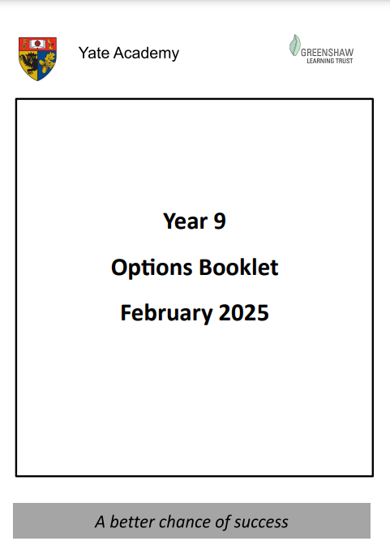
Options Booklet
Notes:
Steph

Slide 5
Core Offer
GCSE Maths
GCSE English Language
GCSE English Literature
GCSE Combined Science
PSHE / Philosophy & Ethics / Core PE (not examined)
Notes:
Steph

Slide 6
Triple Science

Slide 7
Option Pathways & Subjects
 | Option 1 | Option 2 | Option 3 | Option 4
EBacc Pathway (English Baccalaureate) | History / Geography | Language (French / Spanish) | Free Choice | Free Choice
Academic Pathway | History / Geography | Sport / Health | Free Choice | Free Choice
Notes:
Steph

Slide 8
Option Pathways & Subjects
GCSE Geography
GCSE History
GCSE Religious Education
GCSE French
GCSE Spanish
GCSE Art
GCSE Photography
BTEC Sport Studies
BTEC Health & Social Care
Hospitality & Catering
Music
Music Tech
Notes:
Steph

Slide 9
Option Pathways & Subjects
 | Option 1 | Option 2 | Option 3 | Option 4
EBacc Pathway (English Baccalaureate) | History / Geography | Language (French / Spanish) | Free Choice | Free Choice
Academic Pathway | History / Geography | Sport / Health | Free Choice | Free Choice
Notes:
Steph

Slide 10








Why choose a GCSE in Spanish or French?
1) Academic skills
5) Understanding other cultures
2) Give yourself more choice
3) Social skills
4) Build self-esteem
Notes:
Learning languages has so many benefits which will advantage your child in future studies and work:
1. Improved academic skills (cognitive benefits- problem solving, memory, improves your English) Basically the skills you learn in languages help in all other subjects!
2. Gives you choice (will make you stand out in uni/job applications- using a language at work can increase your salary by up to 20%, many top universities require a language GCSE Edinburgh/UCL)
3. Cultivates social skills (communication, public speaking, listening and pronunciation skills)
4. Boosts self-esteem (accept constructive criticism, builds confidence and growth mindset)
5. Introduces you to other cultures (promotes intercultural understanding, we live in a world of global trade, travel and communication, leaving EU will impact our students’ futures best way to mitigate this is to give them the skills necessary to bridge cultural and linguistic gaps, see their personal identity in relation to the wider world) Increased era of globalisation begin to think of themselves as citizens of the world as well as of the United Kingdom.” promoting intercultural understanding

Slide 11
Option Pathways & Subjects
 | Option 1 | Option 2 | Option 3 | Option 4
EBacc Pathway (English Baccalaureate) | History / Geography | Language (French / Spanish) | Free Choice | Free Choice
Academic Pathway | History / Geography | Sport / Health | Free Choice | Free Choice
Notes:
Steph

Slide 12
What are good reasons for choosing a subject?
You are good at the subject
You think you will enjoy the course
It goes well with your other choices
You are interested in the knowledge and skills it develops
It will give you plenty of choice in the future
You think that you might want to continue studying it after Year 11
Notes:
Steph

Slide 13
What are bad reasons for choosing a subject?
Your friends are doing it
People say it is easy
You think it is a good course for a boy or for a girl
Someone else thinks that it is a good idea
You like the teacher you have now
You did not have time to research your options properly
Notes:
Steph

Slide 14
How do students choose their options?
Choose 4 options and a reserve choice
Submit their choices on Options evening on Wednesday 26th February.
Alternatively parents can email options@yateacademy.co.uk
Deadline: Friday 7th March 2025
Notes:
Steph

Slide 15
Will students get what they choose?
Hopefully, most people do!
Not everyone will get all of their choices
Students must pick a reserve!
Notes:
Steph

Slide 16
What should students be doing now?
Talk to their teachers & parents!
Read the options booklet
      What will I be learning about?
      How will I be assessed?
      What qualification do I gain?
      Where can the subject take me in the future?
Notes:
Steph

