Slide 1

Paper Two
Human Geography
5th June 2024
Question 1- Urban Environments
Question 2- Economic World
Question 3- Resource management
Question 4- Food
Name:

Slide 2
Question 1- Urban Environments

Slide 3
Section A Question 1 - Urban Environments Quiz Questions
Question | Answer
Define rural to urban migration migration
Define natural increase
Define urbanisation
Define counter urbanisation
Give one reason why the natural increase is high in LIC/NEE cities
Name THREE push factors for rural areas (things which make a person want to leave the countryside)
Name THREE pull factors for urban areas (things which make a person want to move to a city)
What is megacity? Give an example

Slide 4
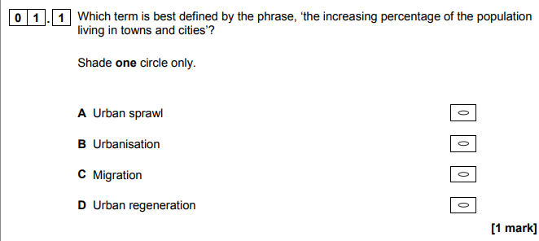
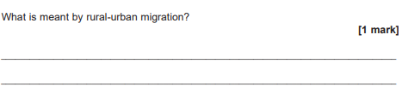
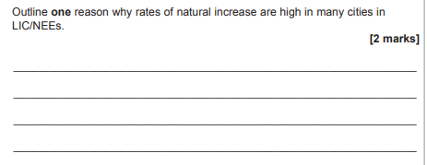
Exam practice- short answer questions
Name and explain the reason

Slide 5
Section A Question 1 - Urban Environments Quiz Questions
LIC/NEE city case study- Mumbai India
Question | Answer
Give THREE reasons why Mumbai is an important city | Regional- National- Global-
Name THREE opportunities in Mumbai | 1. 2. 3.
Name THREE challenges in Mumbai | 1. 2. 3.
Name THREE ways urban planning is trying to improve the life of the urban poor (HINT- slum improvements) | 1. 2. 3.

Slide 6
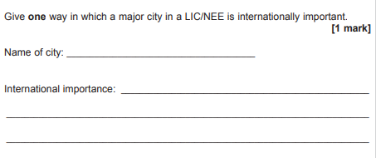
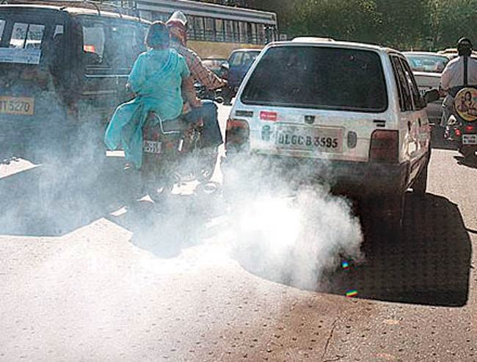
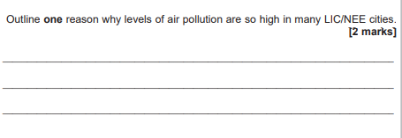
Exam practice- short answer questions

Slide 7
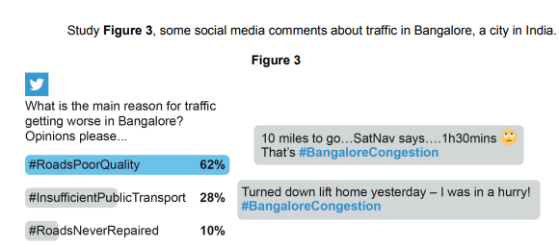
Exam practice- 4/6 markers
Mumbai- NEE= people are not able to afford newer cars= older cars release more pollution (do not have catalytic convertors)
Mumbai- rural to urban migration= rapidly increasing population= road network unable to cope with extra people.
There is not enough busses and trains so people have to use their own cars = more congestion and more pollution
Question- Use Figure 3 and a case study of a city in a LIC or NEE to suggest why managing traffic congestion and air pollution may be challenging. [6 marks]
Figure 3 shows that there is insufficient publics transport which means…… ________________________________________________________________________________________________________________________________
As a result_______________________________________________________
_______________________________________________________________
In Mumbai which is an NEE people are unable to afford newer cars. This means____________________________________________________________________________________________________________________________As a result_______________________________________________________
_______________________________________________________________
Also due to rural to urban migration in LIC/NEE cities like Mumbai it means… ____________________________________________________________________________________________________________________________________________________________________________________________________________________________________

Slide 8
Exam practice- 9 markers
Challenges in Mumbai | Opportunities in Mumbai
Many people living in Dharavi are working in unregulated jobs with low wages e.g. ragpickers 1 toilet per 500 people= waste from long drop privies ends up in the river= contaminated water= waterborne diseases Only 2 hours of water per day= water rationed= forced to drink contaminated water = cholera Air pollution= old cars= no catalytic convertors= congestion= | 80% of waste is recycled = less waste to landfill= job opportunities Job opportunities= e.g. construction or at the ports= higher wages= higher taxes= improved quality of life Better access to education= 89% literacy rate= job opportunities= higher wages= higher taxes= improved quality of life
linked
linked
Question- To what extent has urban growth in LIC/NEE’s created challenges
Use a case study of a city in an LIC/NEE. [9 marks] [+ 3 SPaG marks]
To some extent urban growth has created challenges in Mumbai .
A challenge in the Dharavi slums is___________________________________________
_________________________________________________________________________________This means_______________________________________________________________
_________________________________________________________________________________As a result ________________________________________________________________
_________________________________________________________________________________However there are opportunities such as ____________________________________________________________________________________________________________________________________________________________________________________________________________________________________________________________________________________________________________________________________
In contrast another challenge is____________________________________________________
______________________________________________________________________________________________________________________________________________________________________________________________________________________________________________________________________________________________________________________________________________________________Overall there are significant challenges in Mumbai which can affect the quality of life however there are opportunities to improve quality of life of the population and the development od the country of India.

Slide 9
Exam practice- 9 markers
Slum improvements
Question- To what extent has urban planning improved the live of the urban poor
Use a case study of a city in an LIC/NEE. [9 marks] [+ 3 SPaG marks]
To some extent urban planning has improved the lives of the urban poor in Mumbai.
One improvement scheme in the Dharavi slums is________________________________________
_________________________________________________________________________________This improves lives becase____________________________________________________________
_________________________________________________________________________________As a result ________________________________________________________________
_________________________________________________________________________________However the scheme was not without problems such as__________________________________
________________________________________________________________________________________________________________________________________________________________________________________________________________________________________________________________________________________________
Another improvement was________________________
__________________________________________________________________________________________________________________________________________________________________As a result ________________________________________________________________
_________________________________________________________________________________However the scheme was not without problems such as__________________________________
__________________________________________________________________________________________________________________________________________________________________
Overall the schemes did improve some lives but there were many issues which meant there were not significant improvements in the quality of life.

Slide 10
Section A Question 1 - Urban Environments Quiz Questions
HIC city- Bristol
Question | Answer
Give reasons why Bristol is an important city | National Global
Name THREE opportunities in Bristol | 1. 2. 3.
Explain why these challenges have created problems in Bristol | 1. Increased migration in to the city has caused problems because….. 2. As Bristol's population continues to grow there is pressure to build more homes which has created urban sprawl. This causes problems because…
List THREE urban regeneration projects in Bristol Harbourside | 1. 2. 3.

Slide 11
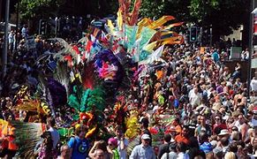
Exam practice- short answer questions
Outline one way that national migration has led to change in the character of a named UK city. [2 marks]
____________________________________________________________________________________________________________________________________________________________________________________________________________________________________________________________________________________________________________________________________________
Suggest reason(s) for inequalities in education in urban areas in the UK. [4 marks]
________________________________________________________________________________________________________________________________________________________________________________________________________________________________________________________________________________________________________________________________________________________________________________________________________________________________________________________________________________________________________________________________________________________________________________________________________________________________________________________________________________________

Slide 12
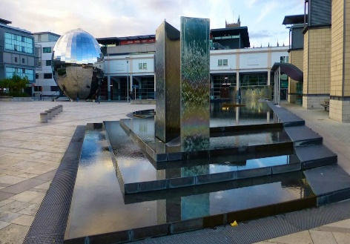
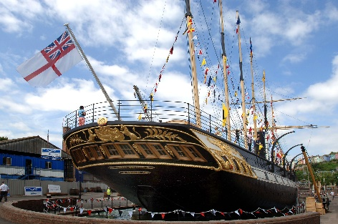
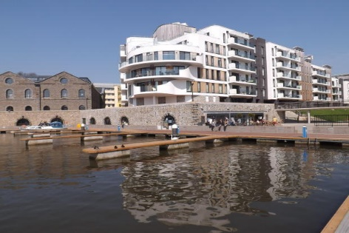
Exam practice
To what extent has regeneration can helped to solve urban problems? [6 marks]
________________________________________________________________________________________________________________________________________________________________________________________________________________________________________________________________________________________________________________________________________________________________________________________________________________________________________________________________________________________________________________________________________________________________________________________________________________________________________________________________________________________________________________________________________________________________________________________________________________________________________________________________________________________________________________________________________________________________________________________________________________________________________________________________________________________________________________________________________________________________________________________________________________________________________________________________________________________________________________________________________________

Slide 13
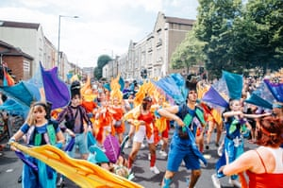
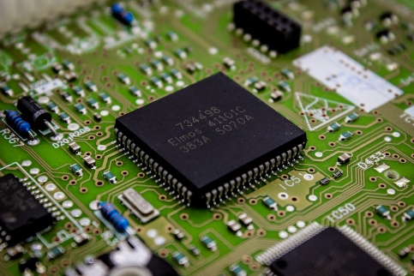
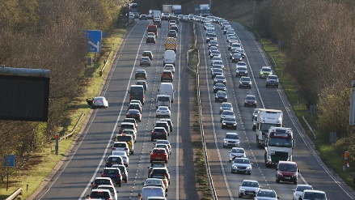


Exam practice
To what extent has urban change created social and economic opportunities in a UK city you have studied? [9 marks] [+3 SPaG marks]
________________________________________________________________________________________________________________________________________________________________________________________________________________________________________________________________________________________________________________________________________________________________________________________________________________________________________________________________________________________________________________________________________________________________________________________________________________________________________________________________________________________________________________________________________________________________________________________________________________________________________________________________________________________________________________________________________________________________________________________________________________________________________________________________________________________________________________________________________________________________________________________________________________________________________________________________________________________________________________________________________________

Slide 14
Exam practice- longer answers
Building on greenfield sites helps to meet the national housing shortage but can be opposed by those wishing to prevent urban sprawl.
Bradley Stoke was built in the 1980s to the north of Bristol. It is now an established commuter settlement with thousands of people commuting into Bristol to work every day. Further housing developments are planned at nearby Harry Stoke. Concerns include:
Traffic congestion, noise and air pollution
Loss of habitats
Loss of recreational space
Strain on community services
Flood risk
Suggest how urban sprawl and the growth of commuter settlements have impacts on the rural-urban fringe. [6 marks]
_________________________________________________________________________________________________________________________________________________________________________________________________________________________________________________________________________________________________________________________________________________________________________________________________________________________________________________________________________________________________________________________________________________________________________________________________________________________________________________________________________________________________________________________________________________________________________________________________________________________________________________________________________________________________________________________________________________________________________________________________________________________________________________________________________________________________________________________________________________________________________________________________________________________________________________________________________________________________________

Slide 15
Section A Question 1 - Urban Environments Quiz Questions
HIC city- Bristol – Improving urban problems
Question | Answer
Give TWO ways Bristol has tried to solve the challenge of congestion | 1. 2.
Give ONE way Bristol has tried to solve the challenge of waste disposal | 1.
Give ONE way Bristol has tried to solve the challenge of lost green space and reducing biodiversity | 1.
List THREE ways living could be made more sustainable | 1. 2. 3.

Slide 16
Exam practice- longer answers
Explain why creating green space is important for sustainable urban living. [4 marks]
________________________________________________________________________________________________________________________________________________________________________________________________________________________________________________________________________________________________________________________________________________________________________________________________________________________________________________________________________________________________________________________________________________________________________________________________________________________________________________________________________________________________________________________________________________________________________________________________________________________________________________________________________________________________________

Slide 17
Question 2- Economic World

Slide 18
Section B Question 2 – Economic world Quiz Questions
Question | Answer
What is development?
What is the development gap?
Name FOUR single measures of development | 1. 2. 3. 4.
Name one composite measure of development
Name ONE physical, economic and historical cause of uneven development | Physical- Historical- Economic -
What does the DTM stand for?
What happens to the death rate in stage 2 of the DTM? Give a reason for this
What happens to the birth rate in stage 3 of the DTM? Give a reason for this

Slide 19
Section B Question 2 – Economic world Quiz Questions
Question | Answer
What is development?
What is the development gap?
Name FOUR single measures of development | 1. 2. 3. 4.
Name one composite measure of development
Name ONE physical, economic and historical cause of uneven development | Physical- Historical- Economic -
What does the DTM stand for?
What happens to the death rate in stage 2 of the DTM? Give a reason for this
What happens to the birth rate in stage 3 of the DTM? Give a reason for this
Name THREE ways to reduce the development gap

Slide 20
Section B Question 2 – Economic world Quiz Questions
Question | Answer
Name an example of an rea where tourism has been used to reduce the development gap
Name TWO ways tourism can increase the economic growth of a country | 1. 2.
Give TWO ways tourism ahs not been successful in improving the development of a country | 1. 2.
What are primary industries?
What are secondary industries?
What are tertiary industries?
Which sector do most [people in India work in?
What is a TNC?
Give one reason why TNCs located in NEE/s

Slide 21
Section B Question 2 – Economic world Quiz Questions
Question | Answer
Give THREE advantages of a TNC in India | 1. 2. 3.
Give THREE disadvantages of a TNC in India | 1. 2. 3.
Give ONE reason why India requires aid
What are the disadvantages of aid in India?
What is the difference between top down and bottom up aid?
Give TWO ways India is changing its relationship with the wider world
Give one way economic development is improving the lives of people
Give one way economic development is improving the environment

Slide 22
Section B Question 2 – Economic world Quiz Questions
Question | Answer
What jobs did most people in the UK have in the pre-industrial times?
What jobs did most people in the UK have in the industrial times?
What jobs did most people in the UK have today?
What are science or business parks? Give an example
Give THREE impacts of industry on the physical environment | 1. 2. 3.
Give an example of a rural area in decline
Give a reason for rural decline
Give an example of a rural area with an increasing population
Give a reason for rural population growth

Slide 23
Section B Question 2 – Economic world Quiz Questions
Question | Answer
What is the north- south divide in the UK?
Give two causes of the divide | 1. 2.
What is the Northern Power House?
What are Enterprise Zones?
Outline a UK transport scheme to improve the network

Slide 24
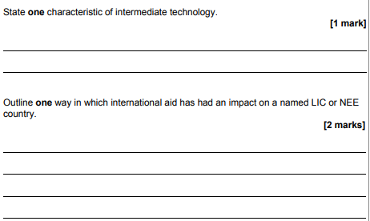
Exam practice- short answer questions
Explain how fairtrade can reduce the development gap. [4 marks]
________________________________________________________________________________________________________________________________________________________________________________________________________________________________________________________________________________________________________________________________________________________________________________________________________________________________________________________________________________________________________________________________________________________________________________________________________________________________________________________________________________________________________________________________________________________________________________________________________________________________________________________________________________________________________

Slide 25
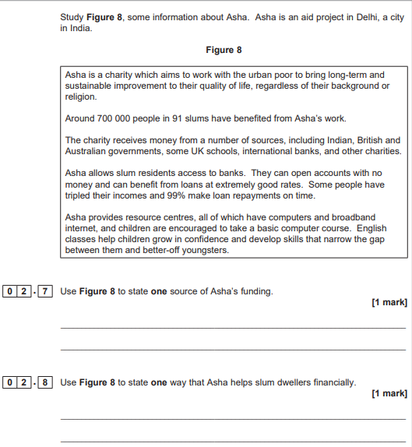
Exam practice- short answer questions

Slide 26
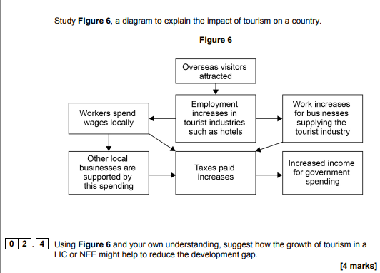
______________________________________________________________________________________________________________________________________________________________________________________________________________________________________________________________________________________________________________________________________________________________________________________________________________________________________________________________________________________________________________________________________________________________________________________________________________________________________________________________________________________________________________________________________________________________________________________________________________________________________________________________________________________________

Slide 27
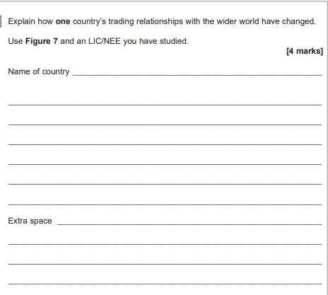
Exam practice- shorter answer questions

Slide 28

Exam practice- longer answer questions
____________________________________________________________________________________________________________________________________________________________________________________________________________________________________________________________________________________________________________________________________________________________________________________________________________________________________________________________________________________________________________________________________________________________________________________________________________________________________________________________________________________________________________________________________________________________________________________________________________________________________________________________________________________________________________________________________________________________________________________________________________________________________________________________________________________________________________________________________________________________________________________________________________________________________________________________________________________________________________________________________________________________________________________________________________________________________________________________________________________________________________________________________________________________________________________________________________________________________________________________________________________________________________________________________________________________________________________________

Slide 29
Exam practice- longer answer questions
Using a case study of a LIC/NEE, evaluate the effects of economic development on the population’s quality of life. [9 marks]
____________________________________________________________________________________________________________________________________________________________________________________________________________________________________________________________________________________________________________________________________________________________________________________________________________________________________________________________________________________________________________________________________________________________________________________________________________________________________________________________________________________________________________________________________________________________________________________________________________________________________________________________________________________________________________________________________________________________________________________________________________________________________________________________________________________________________________________________________________________________________________________________________________________________________________________________________________________________________________________________________________________________________________________________________________________________________________________________________________________________________________________________________________________________________________________________________________________________________________________________________________________________________________________________________________________________________________________________

Slide 30
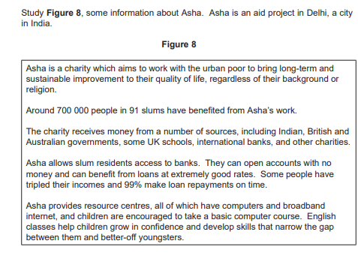
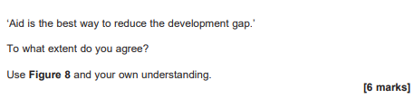
Exam practice- longer answer questions
______________________________________________________________________________________________________________________________________________________________________________________________________________________________________________________________________________________________________________________________________________________________________________________________________________________________________________________________________________________________________________________________________________________________________________________________________________________________________________________________________________________________________________________________________________________________________________________________________________________________________________________________________________________________

Slide 31
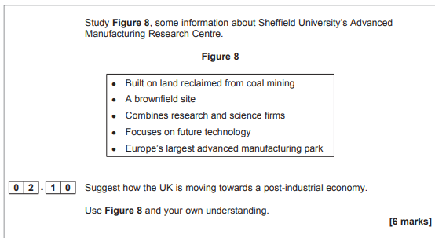
Exam practice- longer answer questions
______________________________________________________________________________________________________________________________________________________________________________________________________________________________________________________________________________________________________________________________________________________________________________________________________________________________________________________________________________________________________________________________________________________________________________________________________________________________________________________________________________________________________________________________________________________________________________________________________________________________________________________________________________________________

Slide 32
Exam practice- longer answer questions
Evaluate the success or likely success of one or more strategies to resolve regional differences in the UK. [9 marks]
____________________________________________________________________________________________________________________________________________________________________________________________________________________________________________________________________________________________________________________________________________________________________________________________________________________________________________________________________________________________________________________________________________________________________________________________________________________________________________________________________________________________________________________________________________________________________________________________________________________________________________________________________________________________________________________________________________________________________________________________________________________________________________________________________________________________________________________________________________________________________________________________________________________________________________________________________________________________________________________________________________________________________________________________________________________________________________________________________________________________________________________________________________________________________________________________________________________________________________________________________________________________________________________________________________________________________________________________

Slide 33
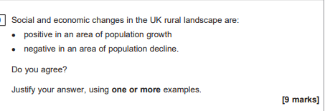
Exam practice- longer answer questions
____________________________________________________________________________________________________________________________________________________________________________________________________________________________________________________________________________________________________________________________________________________________________________________________________________________________________________________________________________________________________________________________________________________________________________________________________________________________________________________________________________________________________________________________________________________________________________________________________________________________________________________________________________________________________________________________________________________________________________________________________________________________________________________________________________________________________________________________________________________________________________________________________________________________________________________________________________________________________________________________________________________________________________________________________________________________________________________________________________________________________________________________________________________________________________________________________________________________________________________________________________________________________________________________________________________________________________________________

Slide 34
Exam practice- longer answer questions
Assess the importance of transport improvements to the UK economy. [9 marks]
____________________________________________________________________________________________________________________________________________________________________________________________________________________________________________________________________________________________________________________________________________________________________________________________________________________________________________________________________________________________________________________________________________________________________________________________________________________________________________________________________________________________________________________________________________________________________________________________________________________________________________________________________________________________________________________________________________________________________________________________________________________________________________________________________________________________________________________________________________________________________________________________________________________________________________________________________________________________________________________________________________________________________________________________________________________________________________________________________________________________________________________________________________________________________________________________________________________________________________________________________________________________________________________________________________________________________________________________

Slide 35
Question 3- Resource management
Question 4- Food

Slide 36
Section C Question 3 – The challenge of resource management - Quiz Questions
Question | Answer
Give TWO effects of malnourishment on people (NOT DEATH)
What are seasonal foods?
What us organic farming?
Name THREE ways food demand in the UK has changed | 1. 2. 3.
What are food miles and carbon footprint?
Name TWO ways to reduce the carbon footprint of the food we eat | 1. 2.
What is water surplus and deficit? | Surplus Deficit
Which areas of the UK have water surplus and which has deficit | Surplus Deficit
Give TWO ways the UK has tried to meet the increasing demand for water

Slide 37
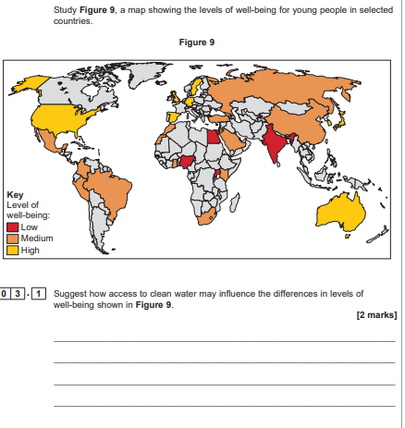
Exam practice- map skills
HINT
Forced to drink contaminated water
Increase in water borne diseases e.g. cholera
Lack of water
Forced to walk long distances to access clean water = mainly girls given the job
Girls miss school= lower literacy rate
India

Slide 38
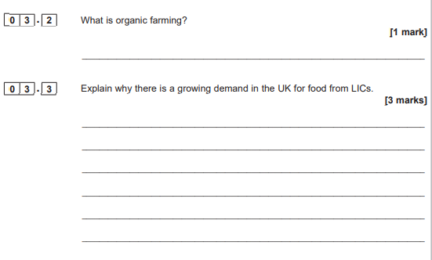
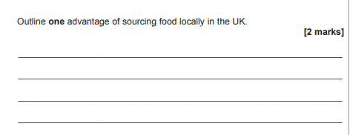
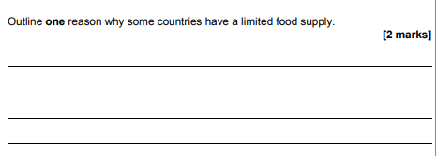
Exam practice- short answer questions
HINT-
Climate
Demand for seasonal food
Low wages for farmers
HINT-
Carbon footprint
HINT-
Climate
Conflict

Slide 39
Forced to drink contaminated water
Increase in water borne diseases e.g. cholera
Lack of water
Forced to walk long distances to access clean water = mainly girls given the job
Girls miss school= lower literacy rate
Rising food prices
Malnutrition and social unrest (riots)
Lack of food
Widespread famine
Unable to work, loss of earnings and potential death
Not enough power for factories
Less products made= less income generated
Lack of energy
Less electricity for homes
Health problems caused by a lack of heating or cooling in houses
Suggest how inequalities in the consumption of resources influence well-being. [3 marks]
________________________________________________________________________________________________________________________________________________________________________________________________________________________________________________________________________________________________________________________________________________________________________________________________________________________________________

Slide 40
Section C Question 3 – The challenge of resource management - Quiz Questions
Question | Answer
Traditionally where did the UK get most of its energy supply?
Give TWO reasons for the decline in traditional energy supplies
What is fracking?
Give an advantage and disadvantage of fracking
Name THREE types of renewable energy

Slide 41
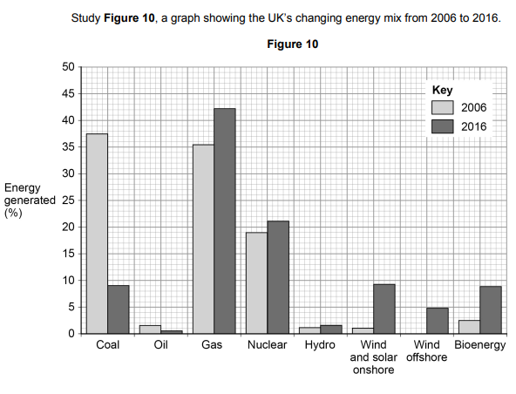
Exam practice- longer answers
Nuclear waste is expensive to dispose of = energy is more expensive to buy
Releases methane= greenhouse gas= contribute to climate change
Renewable energy = unreliable and expensive to build = energy is more expensive
Remember to quote data from the figure
Using Figure 10 and your own understanding box , discuss the issues arising from the UK’s changing energy mix. [6 marks]
________________________________________________________________________________________________________________________________________________________________________________________________________________________________________________________________________________________________________________________________________________________________________________________________________________________________________________________________________________________________________________________________________________________________________________________________________________________________________________________________________________________________________________________________________________________________________________________________________________________________________________________________________________________________________________________________________________________________________________________________________________________________________________________________________________________________________________________________________________________________________________________________________________________________________________________________________________________________________________________

Slide 42
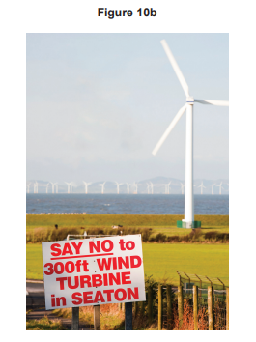
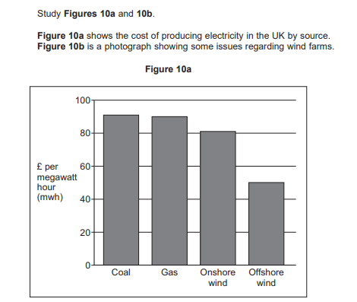
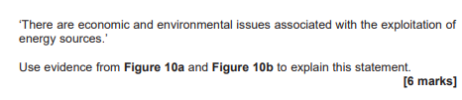
Exam practice- longer answers
________________________________________________________________________________________________________________________________________________________________________________________________________________________________________________________________________________________________________________________________________________________________________________________________________________________________________________________________________________________________________________________________________________________________________________________________________________________________________________________________________________________________________________________________________________________________________________________________________________________________________________________________________________________________________________________________________________________________________________________________________________________________________________________________________________________________________________________________________________________________________________________________________________________________________________________________________________________________________________________

Slide 43
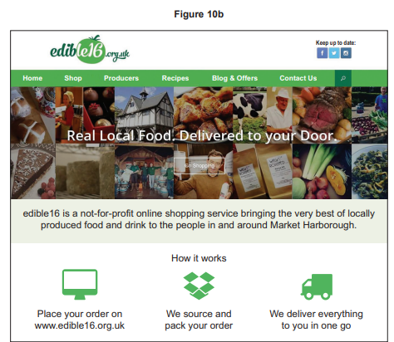
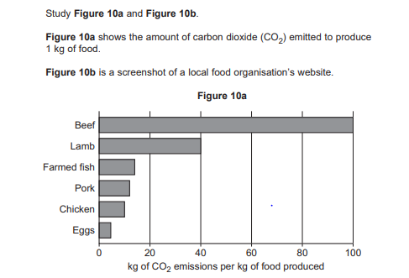

________________________________________________________________________________________________________________________________________________________________________________________________________________________________________________________________________________________________________________________________________________________________________________________________________________________________________________________________________________________________________________________________________________________________________________________________________________________________________________________________________________________________________________________________________________________________________________________________________________________________________________________________________________________________________________________________________________________________________________________________________________________________________________________________________________________________________________________________________________________________________________________________________________________________________________________________________________________________________________________

Slide 44
Section C Question 4 – Food- Quiz Questions
Question | Answer
Name TWO physical causes of food insecurity | 1. 2.
Name TWO human causes of food insecurity | 1. 2.
Name THREE impacts of food insecurity | 1. 2. 3.
Name THREE ways to increase food supplies | 1. 2. 3.
Give an example of a large scale agribusiness
Give an example of a local sustainable farming method

Slide 45
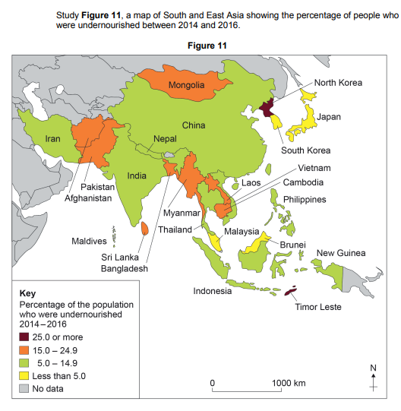
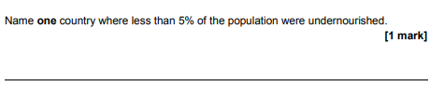
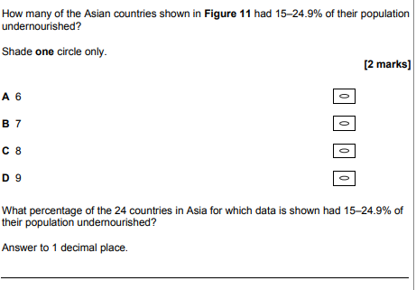
Exam practice- map skills

Slide 46
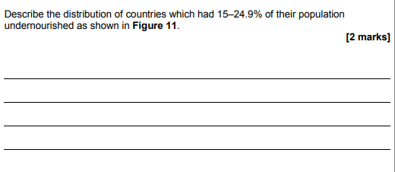
Exam practice- map skills

Slide 47
Aeroponics and hydroponics allowing plants to get nutrients without growing in soil, =nutrient supply, direct to the plants, without soil.= increases food supply and yield | Biotechnology Genetically engineering crops to improve productivity, including have higher yields, resistant to drought, disease or pests, higher nutritional value | The New Green Revolution improves food supply using a mixture of biotechnology and sustainable farming techniques = increases food supply, by using high yield and GM varieties, including varieties with pest and disease resistance. | Irrigation process of artificially watering the land =increases food supply by making dry areas more productive=- higher yields
Expensive, and only used for high value crops | GM plants may interbreed with wild plants and pass on their genes or disrupt ecosystems. | Reduced biodiversity as only a few crops are relied on instead of a variety. | Water is usually extracted from rivers, underground stores, so can cause the depletion of water in other areas and stores.
To what extent strategies to increase food supplies sustainable . [6 marks]
To some extent food supplies can be made more sustainable .
One example is__________________. This works by________________________________________________________________________________An advantage of this technique is______________________________
__________________________________________________________________________________However____________________________________________________________________________________________________________________________________________________________Another example is__________________. This works by________________________________________________________________________________An advantage of this technique is______________________________
__________________________________________________________________________________However______________________________________________________________________________________________________________________________________________________________________________________________________________________________________________Overall these techniques can increase food supplies but can be more expensive to set up which make it more difficult for LIC countries to use them.

Slide 48
What they did | Advantages of the project | Disadvantages if the project
Huge number of greenhouses, made from polythene and plastic. In fact it has the largest concentration of green houses in the world, covering over 30,000 hectares., producing over 2.7 million tonnes of produce each year. They grow the plants using hydroponics, plants are grown in bags and water and nutrients fed into the base of the plant via drip irrigation | It provides hundreds of jobs for the local area > increase wages > increase in standard of living > increase in GDP Get 2 crops a year > increase in profits= Generates over $1.5 billion every year. Less water used by drip irrigation and hydroponics > no use of soil > less soil erosion > keeping soil rich for future generations | Almeria uses many immigrant workers for labour from North Africa, Eastern Europe and South America > low wage and work in poor conditions > many work illegally and enter the country through dangerous methods Lots of litter has been left in the area including chemical containers and plastic has been dumped into the sea.
‘A large scale agricultural development can bring both advantages and disadvantages.’ Explain this statement using an example you have studied. [6 marks]
Name of development ________________________________________
__________________________________________________________________________________________________________________________________________________________________________________________________________________________________________________________________________________________________________________________________________________________________________________________________________________________________________________________________________________________________________________________________________________________________________________________________________________________________________________________________________________________________________________________________________________________________________________________________________________________________________________________________________________________________________________________________________________________________________________________________________________________________________________________________________________________________________________________________________________________________________________________

