Slide 1
Paper 2: Section A: Question 1 Urban issues and challenges
A | Key terms
1 | Urban | A built-up place, e.g. a town or city.
2 | Rural | An area of countryside.
3 | Urbanisation | the growth in the proportion of a country’s population living in urban areas.
4 | Counter-urbanisation | People moving from urban areas to rural areas
5 | Rural-urban migration | the movement of people from rural to urban area.
6 | Megacities | cities with more than 10 million people living there
7 | Deprivation | Lacking the basic necessities
8 | Degradation | When an area becomes run down and even abandoned
9 | Regeneration | When an area of degradation/deprivation is improved
C | What causes rural-urban migration?
1 | Pull factors -things that encourage people to move to an area | More jobs in urban areas that are often better paid Access to better health care and education, People think they will have improve their quality of life and standard of living
2 | Push Factors- things that encourage people to leave | Less well paid jobs, in agriculture Mechanisation of agriculture – farms require fewer workers shortage of services (education, water and power). Other push factors include: Natural disasters, Desertification, Conflict / War
3 | Natural increase | Birth rate is higher than death rate so population growth. This tends to happen where urban areas have high population of people at reproductive age. Also, as health care is better in urban areas death rate decreases
B | Global rates of urbanisation
1 | HIC’s have very slow rates of urbanisation | Why? Urbanisation has already happened which means most of the population live in urban areas Counter urbanisation is happening as people desire a better quality of life
2 | NEE’s have very rapid rates of urbanisation | Why? Industrialisation (growth of manufacturing) attracts people to urban areas in search of jobs.
3 | LIC’s have fast rates of urbanisation | Why? People are starting to move away from jobs in farming (rural areas) to urban areas.

Slide 2
Paper 2: Section A: Urban issues and challenges
Case Study- An urban area in an NEE- Mumbai, India
F | Opportunities and challenges
1 Opportunities | A major city of learning and education. Mumbai has a world renowned university and many other important educational and research institutions. Literacy rates are high (89.7%)=better job prospects= higher income= better quality of life It is the centre of the Hindi movie industry (Bollywood) with many media companies which employs huge numbers of people. It has the best city transport system in India- Mumbai Corridor provides links to other major cities (e.g. Dehli) and the Pacific Rim allowing a range of industries to develop. | 80% of Mumbai's waste is recycled in Dharavi which means less waste goes to landfill
2 Challenges | In Dharavi, water pipes often run close to sewer lines. Leakages lead to contamination of water and the spread of diseases. In Dharavi there is a lack of basic sanitation with only 1 toilet per 1000 people. It has a large, unskilled and informal self-employed workforce. These are often unregulated workers. Mumbai has severe water shortages. Water is rationed and pipes often come on for two hours a day at 5:30am and are shared with many people. Crime rates are high. Nearly 1/3 of the population have been victims of crime. | Air pollution is high as old cars emit dirty and harmful fumes and there is little regulation of emissions from factories.
D | Location and key facts
1 | Mumbai, located in the country of India, in the state of Maharashtra on the north west coast of India.
2 | Wealthiest city in India
3 | Mumbai is a megacity
4 | Dharavi is a name of a slum/Squatter settlement in Mumbai
5 | Slum/Squatter settlement - An area of makeshift housing, often unplanned and built illegally.
E | Why is Mumbai important?
1 | National Importance | Commercial and Financial capital of India 60% of India’s sea trade 3million people commute each day to the city. Growth in hi tech industry (call centres, online banking) Contributes 40% of the total income of state
2 | Global Importance | Most globalised city in SE Asia. It has the largest number of TNCs (E.G. Walt Disney) Busiest port and airport in India Home to Bollywood film industry

Slide 3
Paper 2: Section A: Urban issues and challenges
Case Study- An urban area in an NEE- Mumbai, India
Exam phrase- Urban planning - improving the quality of life for the urban poor
G | Project 1- The Mumbai slum sanitation project
1- what is it? | The project aims to improve sanitation facilities for up to one million slum dwellers. So far 300 community toilet blocks have been built, housing more than 5100 individual toilets, with separate facilities for men and women.
2- why is it successful? | Improves quality of life by reducing spread of waterborne diseases
3- what are the problems | Membership fees. People had to pay per use or buy a monthly pass. The vast majority are unwilling to pay or can’t pay. Access to toilet blocks can be an issue so maintaining and repairing are unreliable. Women do not feel safe going to the communal toilet blocks on their own.
H | Project 2- The Mumbai slum resettlement scheme
1- what is it? | A slum area next to the railway line has been cleared to improve transport. Residents have been moved to a new housing area in a different part of the city. Residents have moved out of their tin shacks next to the railway line and into new apartment blocks with a water supply and proper drains.
2- why is it successful? | Improves quality of life Better quality housing Improves sanitation = less disease
3- what are the problems | New flats are not big enough to home the large families Traditional businesses such as pottery making are lost Only the bottom floor of the new flats are available to the slum dwellers – not enough to meet demand People do not want to leave are area their family have lived in for generations
I | Project 3- Incremental housing strategies (Self Help Schemes)
1- what is it? | The project aims to develop informal slums into permanent residential areas by making gradual improvements. Families are given the right to the land on which their home is built and a grant which can be used for improvements. They work with an architect to design their home . The local community is involved in the design and layout of the area and individual residents make decisions about their own home.
2- why is it successful? | Improves quality of life Better quality housing Community has control over what is built
3- what are the problems | Very slow change Has only benefitted a few Developers still want to clear the land for offices and apartments Funding is limited Government policy on land ownership is unclear and there can be disputes over who owns the land.

Slide 4
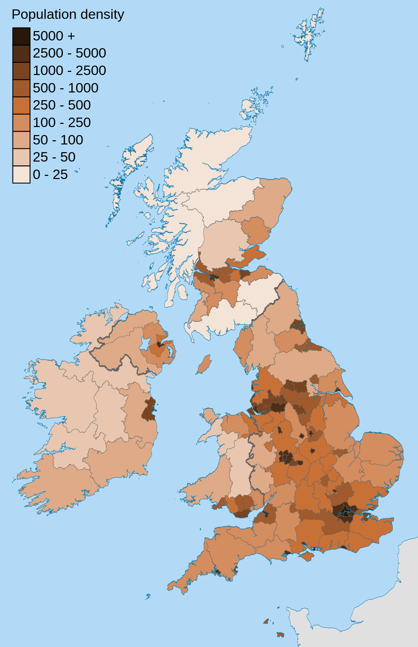
Paper 2: Section A: Urban issues and challenges
Overview of the distribution of population and the major cities in the UK.
J | Key terms
1 | Population Density | a measurement of the number of people in an area
2 | Distribution | just means the way in which something is spread over an area
3 | Sparsely populated | not many people in an area
4 | Densely populated | lots of people in an area
K | Key facts
1 | The United Kingdom is a country with a high level of urbanisation. It has no megacities. London, the capital, with by far the biggest population at over 8 million inhabitants.
2 | The population is very unequally distributed over the four parts of the UK: England makes up about 84 per cent of the total population, Wales around 5 per cent, Scotland roughly 8.5 per cent, Northern Ireland less than 3 per cent.

Slide 5
Paper 2: Section A: Urban issues and challenges
Case Study- a major city in the UK, Bristol
L | Location and key facts
1 | located in the South West of England, located on the River Avon.
2 | It is the largest city in the South West of the UK.
N | A city of migration
1 | Bristol is going through urban change because of national migration and international migration which changes the city 3 factors at play influencing the overall size and rate of growth of Bristol’s population;
2 | 1. Internal (within the UK) migration has been mostly from students moving to Bristol for university. While many only stay for the duration of their course many chose to stay in Bristol permanently due to the availability of many post graduate jobs in the city.
3 | 2. International migration to Bristol is mostly from Poland followed by Somalia and India. Bristol has a long history of migration with the St Pauls carnival celebrating the afro Caribbean culture and Bristol’s multicultural society. Therefore, the population is becoming ethically more diverse.
4 | 3. Natural Change has been positive, so births have been above deaths and this has boosted the population size. More of the population is under 16 than of pensionable age.
M | Bristol important?
1 | National Importance | Bristol has two universities – UWE and University of Bristol Bristol is located near the M4 and M5 which allows easy access to both London and the North of the UK Bristol is the UK’s 8th most popular tourist city this generated employment and GDP for the city.
2 | Global Importance | Bristol airport connects to many major international cities Direct investment – Bristol has international companies located there such as Airbus, BMW and Siemens. Bristol’s universities also have international importance taking in 5000 international students

Slide 6
Paper 2: Section A: Urban issues and challenges
Case Study- a major city in the UK, Bristol
O | Opportunities
 | What are the opportunities? | What positive impacts will this have on Bristol? | Are there any negative impacts?
1 Cultural | People are able to watch a variety of live performances in numerous venues and carnivals. e.g. Bristol Old Vic, St Pauls Carnival, O2 Academy | Provides jobs for local people Attracts tourists to visit and spend money Promotes diversity and builds a strong community | Overcrowding during large events which could increase crime Congestion around the venues
2 Leisure and recreation | There are many activities unique to Bristol for people to do such as the Bristol to Bath cycle path. Two professional football teams, City and Rovers and HQ Gloucestershire cricket ground. Bristol harbourside offers many different activities such as We The Curious and Aquarium. | Improves health and quality of life Creates job opportunities | Overcrowding during large events which could increase crime Congestion around the venues
3 Economic and employment | Unemployment in Bristol is below UK average and employment growth higher than UK as a whole. Increase in high tech companies, 50 micro electronic and silicon design businesses, largest outside California Silicon valley. It is also home to Aardman Animations, Hewlett-Packard and Toshiba Cabot Circus 3900 full time jobs | This has created managerial, professional roles, > which earn more money Also, Bristol has two major shopping centres, Cribbs Causeway and Cabot Circus. With hundreds of shops, restaurants and cinemas, it provides hundreds of jobs for people living in and around Bristol | Some jobs given to those who live outside of Bristol High competition between shopping venues has resulted in the closure of some shops in certain venues.

Slide 7
Paper 2: Section A: Urban issues and challenges
Case Study- a major city in the UK, Bristol
P | Challenges | Solutions to the challenges
1.Social and Economic | Urban deprivation - occurs in Bristol where the poorest people live as they have low wages they have low standard of living. This is because the prices of many things are more expensive in a city like Bristol especially rents. This means the poorest cannot access the opportunities or fit for purpose housing which reduces QoL Housing- House prices and rents are higher in Bristol than surrounding areas. More people in Bristol rent than own their house. Rent prices are high so the poorest people tend to live in council housing which are sometimes not fit for purpose. Education - People in poorer areas achieve lower GCSE results than those in richer areas. This is because they can’t afford extra tuition and many people around them have disengaged with education. This leads to limited opportunities and poorer incomes. This continues the cycle of poverty. Health - The people in wealthy areas tend to live longer than those in the poorer areas of Bristol. In poorer areas rich people have moved out which leaves behind the poorest. They tend to have poorer diets and unhealthy lifestyles (overeating, alcohol, smoking and drug use) this leads to poor health and lower life expectancies 73yrs compared to 83yrs | Urban deprivation - Bristol is continually trying to increase the number of jobs available for all. This has been achieved through regenerating areas that had become deprived. Housing - Bradley stoke has been built to reduce pressure on housing. It has many different house sizes, local parks, schools and shopping centre. However this was built on a greenfield site and can increase congestion into Bristol. It also can causes the poorest to be left in areas of deprivation as they can’t afford to move to Bradley Stoke. Education - The Bristol Education Partnership brings together 13 schools, a collage and the two universities to help increase opportunities for those that are disadvantaged and improve their outcomes. Health - Incredible edible bristol has created a route that people can follow around the city to get exercise while also finding out about and collect food grown in the city. There are also many bike hire locations that people can use to cycle instead of driving.
2. Environmental | Waste disposal - Growing population = more waste for landfill. The city produces over half a million tonne of waste a year and is one of the worst cities in the country in terms of how much food waste it produces. More landfill means a loss of greenspace and increase in contribution to Global Climate change. Congestion: e.g. M32= People are late for work = loss of earnings. Longer journey times = more CO2 released = air pollution = poorer health. | Waste disposal - Bristol has committed to reducing waste and increasing recycling. The size of black bins for general waste have been reduced while the number of recycling boxes/bins have been increased. Congestion - The metro system is a integrated transport system that increases the number of bus lanes and to reduce commuter times and those taking cars thus reducing pollution as not only are there fewer vehicles but the buses run on biofuel.

Slide 8
Paper 2: Section A: Urban issues and challenges
Case Study- a major city in the UK, Bristol
Q | Regeneration of Bristol Harbourside
1. Why was the regeneration needed? | Bristol's dockland areas went into decline following the arrival of large cargo ships that could no longer navigate the small channels of the Avon River and new docks at Avonmouth. This caused the closure of several industries around Bristol docks such as tobacco factories and a sand dredging industry. This caused huge unemployment. Lots of derelict land and unused brownfield sites meant the area was completely avoided by locals.
2. How was it regenerated? | he first development involved the SS Great Britain - a historic vessel built in Bristol returned for restoration that attracted large numbers of visitors. This demonstrated that the docks could become a valuable environment for redevelopment. Lloyds TSB relocated their headquarters to the docklands area. This acted as a great spur for investment. Over the past thirty years the area has undergone major changes culminating in the opening of the new Aquarium, We The Curious science museum and the Millennium Square. The area is now one of the largest redevelopment projects in Europe.
3. Successes of the regeneration | Many historical buildings such as the tobacco factory have been preserved rather than fall into further degradation. The water is regularly tested in the area to monitor water quality and if it does not meet safety standards public notices will be displayed. Over 3000 jobs have been created. Various festivals such as 'The Harbour Festival’ New homes have been built to help meet the housing demand with an additional 165 planned for 2020 which reduces housing demand.
4. Problems of the regeneration | New houses are very expensive and above average house price so it is unaffordable to those most in need of new housing Not all of the new venues were a success such as the Wildwalk and Imax cinema which closed with in 10 years of opening as they could not finance themselves. There can be anti-social behaviour in the evening from the drinkers in the many bars which increases noise level. Some criticism of the Millennium Square in that it is feature less The regeneration has done little to improve traffic congestion in the area

Slide 9
Paper 2: Section A: Urban issues and challenges
Features of Sustainable Urban Living
R | How to make a home sustainable | Benefits | Issues
1. Energy Conservation | Having solar panels on roofs to help generate electricity and heating. Using energy saving lighting and appliances e.g. washing machine | People save money on their energy bills Less reliance on fossil fuels means a reduction in co2 emissions and helps to reduce the enhanced greenhouse effect. | Installing solar panels can be expensive. Wind and solar farms can be inefficient during parts of the year meaning they would have to resort back to fossil fuels.
2. Water Conservation | Using rainwater harvesting instead of transporting water from other places. Installing water meters so people pay for the water they use. Water efficient appliances e.g. toilets | Using less water can reduce the water bill. Helps to protect other environments as it reduces the need for water transfer. | People have more disposable income so paying more may not be a problem for the richest people Only new houses or people who can afford new toilets have dual flush systems Water companies waste 130 litres per day
3. Waste Conservation | Demolition waste recycling uses the old materials of previous constructions in the new builds instead of sending them to landfill. Recycling collection for each household. | Reducing the amount that goes to landfill can help to reduce the amount of methane landfill produces. Reducing landfill saves space protecting green spaces. Recycling also saves resources instead of creating new ones. | Less than half, 43% of the UK waste is recycled inefficient 2 week collections Incineration rates have increased to prevent landfill being used, this produces huge amounts of air pollution.
4. Environmental conservation | Creating gardens and communal allotments for people to use. Preserving green spaces and creating parks when building new homes. | Helps protect biodiversity by creating habitats. Improves air quality. People tend to be physically and mentally healthier with access to green paces. | Limited space,. With the growing housing crisis it is difficult to set land aside, and can cause prices of houses to go up In 2017 ‘London Garden Bridge’ was scrapped due to cost.

Slide 10
GCSE Paper 2- Question 2 Changing Economic World - Knowledge Organiser
Question 2 – Changing Economic World
A | Key terms
1 | Development | The process of a country improving over time
2 | Development Gap | The difference in affluence between nations
3 | Development Indicators | Data that shows a country’s level of health, wealth and education
4 | Demographic Transition Model | A graph that indicates how a countries population might change over time
5 | Post industrial economy | A period of growth due to the increased importance of the services industry while the importance of manufacturing decreases.
6 | Trans National Corporations | TNCs are companies that are located in more than one country.
7 | Primary sector | The sector of employment that deals with the exploitation of raw materials e.g. mining
8 | Secondary sector | The sector of employment that deals with the manufacturing of raw materials e.g. factory worker.
9 | Tertiary Sector | The sector of employment that deals with the providing of services e.g. retail
10 | Quaternary sector | The sector of employment that deals with research e.g. scientist.

Slide 11
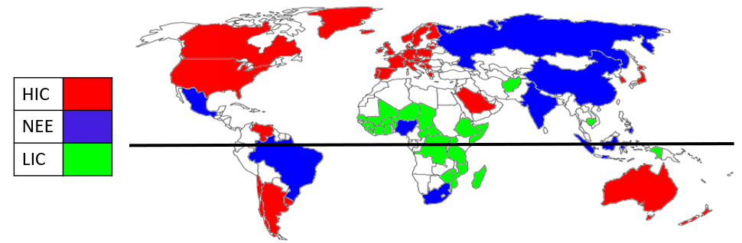
GCSE Paper 2- Question 2 Changing Economic World - Knowledge Organiser
B |  | Classifying Countries
1 | High Income Countries (HICs) | In these countries the GNI per head is high, most people have a very good quality of life. For example: UK, USA, Canada, France
2 | Low Income Countries (LICs) | These are the poorest countries, here the GNI per head is very low and most people have a very low quality of life. For example: Afghanistan, Somalia, Uganda and Nepal
3 | Newly Emerging Economies (NEEs) | These places are getting richer as they move from economies based on primary products ( agriculture) to secondary (manufacturing). Quality of life is getting better. The BRIC economies are: Brazil, Russia, India and China
C |  | Development Indicators
1 | GNI | Gross national income. Total value of goods and services produced by a country.
2 | Life expectancy | Average age you can expect to live to in a country
3 | Infant mortality | The number of babies that die before their first birthday
4 | Birth rate | Number of births per 1000 people per year
5 | Death rate | Number of deaths per 1000 people per year
6 | Literacy rate | The % of people that can read and write
7 | People per doctor | The average number of people to one doctor
8 | Access to safe water | The % of people that have clean and safe drinking water
9 | HDI | Human development index is calculated using life expectancy, literacy rate and GNI.
D | Issues with development indicators
1 | Single measures are an average. This means they can hide the difference between the top and bottom end.
2 | Urban areas are likely to have better standards of living which can then hide what it is like in rural areas.
3 | Death rate can be high in both LICs and HICs due to an aging population not poor health care.
4 | A single measure of development only shows one aspect. For example GNI only looks at income and ignores social developments such as education.

Slide 12
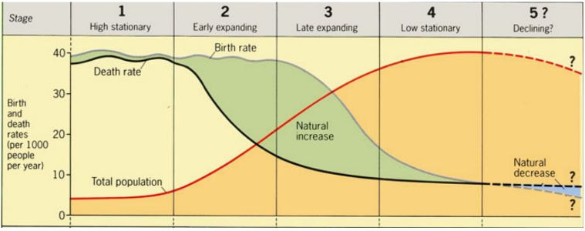
GCSE Paper 2- Question 2 Changing Economic World - Knowledge Organiser
E |  | Demographic Transition Model
 |  | Stage 1 | Stage 2 | Stage 3 | Stage 4 | Stage 5
1 | Birth rate | High due to a lack of contraception | High due to a lack of contraception and social norms | Starting to drop due to access to contraception | Low and stable due to women working and waiting to have children/having fewer | Decreasing. People chose not to have children e.g. costly
2 | Death rate | High due to a lack of health care | Starting to drop because of vaccinations | Continues to drop as healthcare continues to improve | Low and stable due to better health care | Increasing due to an aging population
3 | Population | Low because the births are counteracted by the deaths | Increasing as there are more births than deaths | Still increasing as birth rate is above the death rate | High and slowly increasing as birth rate is just above the death rate | Starts to decrease as birth rate has gone below the death rate
4 | Level of development | Low e.g. remote tribes | Low e.g. Afghanistan (LIC) | Increasing e.g. China (NEE) | High e.g. UK (HIC) | High e.g. Japan

Slide 13
GCSE Paper 2- Question 2 Changing Economic World - Knowledge Organiser
F |  | Factors affecting development
1 | Historical | Colonisation – Raw materials and slaves are taken from the colonised country to earn a profit for the invading country. When the colonised country gains independence they are often left without the resources to properly govern and can result in conflict further limiting development.
2 | Economic | Debt – Countries may take out large loans to invest in health care and education. However the repayments can become too costly. Therefore the money a country earns is spent repaying the debt rather than investing in development.
3 | Physical | Natural disasters – They limit development as money is spent repairing damage rather than improving. Landlocked – If a country has no coastline they have fewer trade routes and the ones they do have can be more costly. This makes importing and exporting difficult and limits how much money a country can make.
G |  | Impacts of uneven development
1 | Widening inequality | The gap between HICs and LICs is increasing. The gap between the rich and poor is wider then ever before. The richest 85 people have the same wealth as the poorest 50% of the worlds population.
2 | Migration | As people are more aware of the gap in wealth people move to HICs to find a better quality of life e.g. North Africa to Europe. This causes a brain drain in the country they have left as it is often those of a working age and with skills that are the first to leave.
H |  | Strategies to reduce the development gap
 |  | Advantages | Disadvantages
1 | Aid | Money or resources is given to improve quality of life e.g. building schools | Aid can make countries too reliant so when the aid stops they are in a worse position than before
2 | Fair trade | Farmers get paid a fair price for their goods and better working conditions | The poorest farmers can not afford the fair trade standards. Not having the logo could make it difficult to sell their products and they go out of business.
3 | Debt relief | Cancelling or reducing a debt so the money saved can be spent investing in the country | This could encourage countries to take out more debt in the hopes it is cancelled or reduced again.
4 | Micro financing | Small loans to people in LICs to help them start a business | If the business fails they are in more debt than before.
5 | Industrial development / investment | TNCs will invest in the country by building factories which provide higher paying jobs and improving infrastructure e.g. roads | The working conditions can be very poor and while the wage is higher than farming
6 | Intermediate technology | Equipment that is appropriate to their needs i.e. not costly or difficult to repair. | Small scale so the technology does not reach everyone that needs it

Slide 14
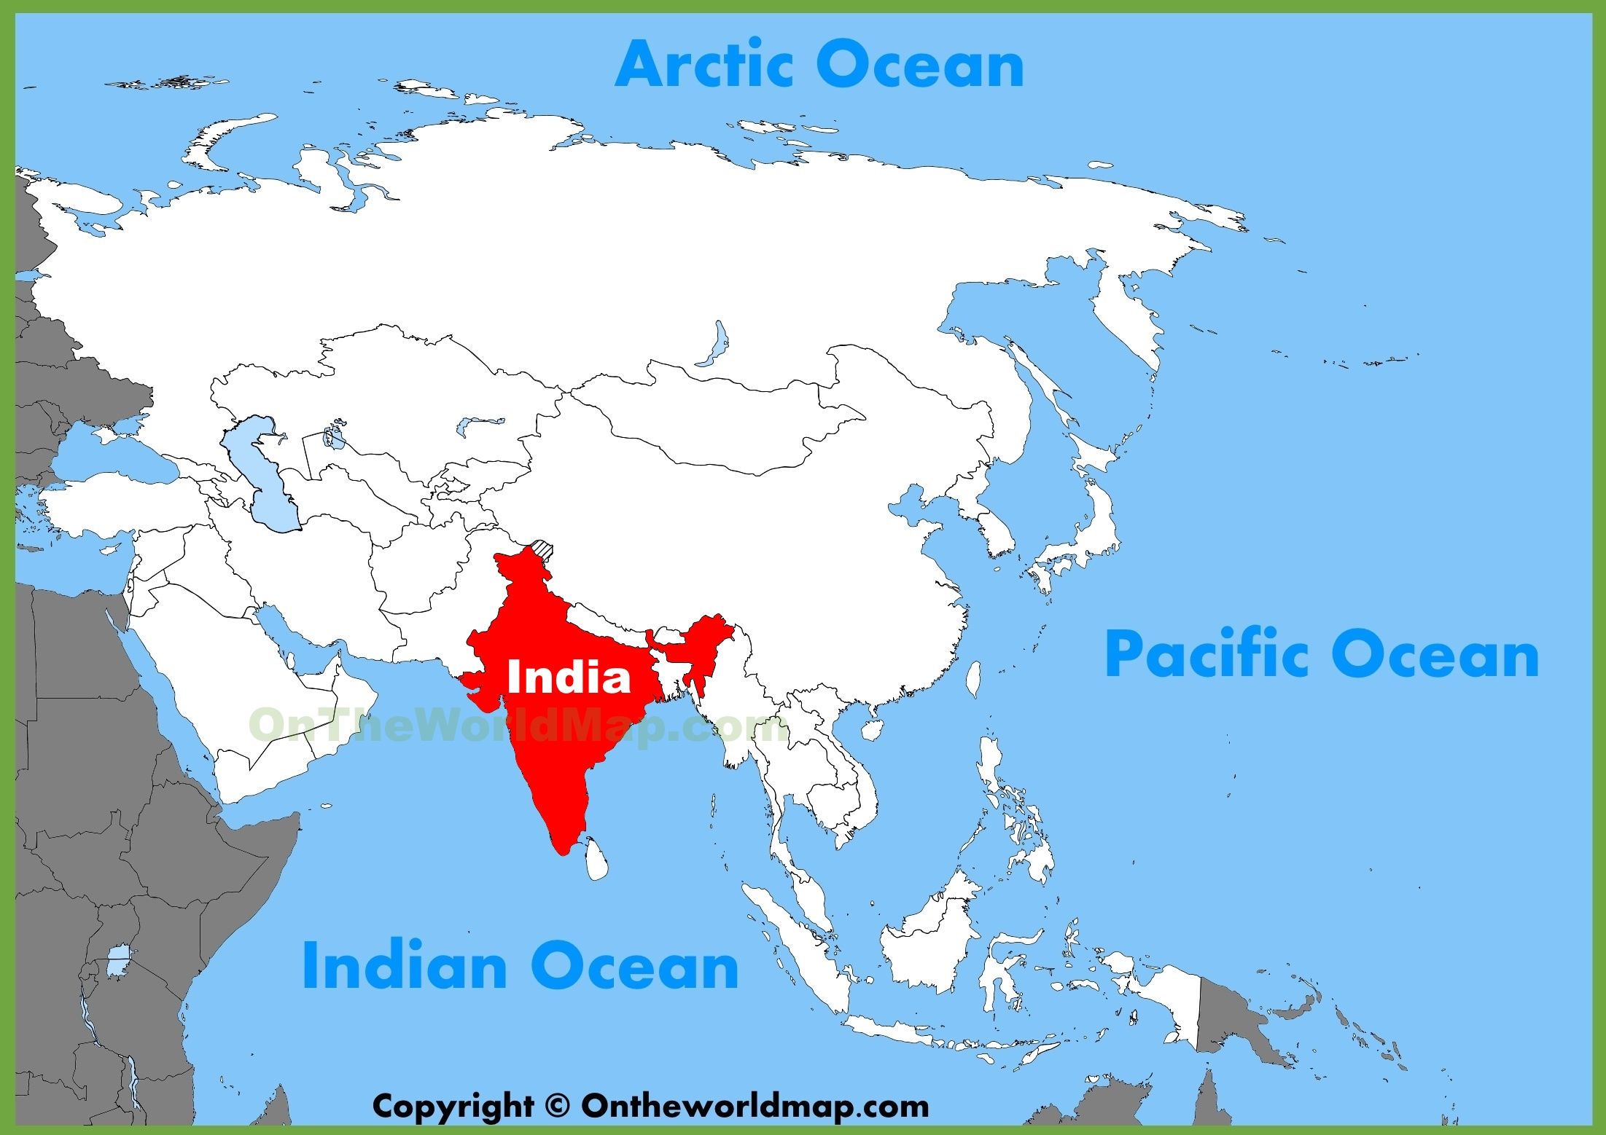
GCSE Paper 2- Question 2 Changing Economic World - Knowledge Organiser
I |  | How tourism is closing the development gap in Kenya
1 | How Kenya has increased tourism | In 2009 visa fees were cut by 50% and free for under 16s Landing fees of aircraft were reduced resulting in cheaper flights Promoted the safaris and tribal culture of the Maasai Mara
2 | Benefits of tourism | Contributes 12% of Kenya’s GDP 600,000 jobs created either directly or indirectly Kenya’s HDI has increased from 0.45 to 0.55 24 national parks that charge an entry fee. This fee goes back into protecting the environment.
3 | Challenges of tourism | Majority of the money stays in the country the holiday was booked in Maasai Mara have rely heavily on tourism as much of the land they used for farming is now used for tourism Hotels are using up much of the locals water supply Pay for the workers is often poor and not inline with the national minimum wage.
J |  | Case Study of an NEE - India
1 | Importance | 2nd largest population in the world Projected to have the second largest economy by 2050 Largest democracy in the world
2 | Wider context | Many religious groups live within India such as Hindus, Muslims and Christians. Everyone over the age of 18 is able to vote. Gained independence from the UK in 1947 Has many ecosystems such as deserts and rainforest. Some are under threat from pollution and degradation of soil.
3 | Political relationships | They have a neighbourhood first policy which aims to improve relations with other east Asian countries. They have taken neutral stances of issues of conflict e.g. the Russia-Ukraine war. They are a member of many intergovernmental groups such as the Common Wealth, United Nations and Asian Development Bank.
4 | Trading relationships | They are currently in a trade deficit – the value of goods imported is greater than the value of goods they export. India’s biggest trading partners are China, USA and the UAE. The UK is India’s 7th largest trading partner. India’s main imports are oil, machinery and semi-precious stones. This reflects Inia’s growing wealth India’s main exports are petroleum products, jewellery and pharmaceutical products.

Slide 15
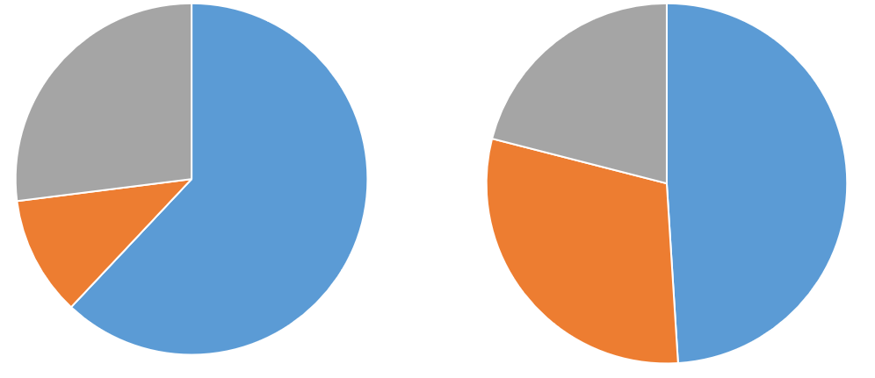

GCSE Paper 2- Question 2 Changing Economic World - Knowledge Organiser
K |  | India’s changing industrial structure
1 | Primary | Slowly decreasing but remains the largest sector people work in. Jobs are mainly agriculture and mining and often low paid.
2 | Secondary | This sector is increasing as India encourages industrial development. Jobs are mainly in manufacturing and are better paid than the primary sector but still not high.
3 | Tertiary | This sector has decreased however it does contribute the most to India’s GDP. Jobs here are in services and tend to be well paid.
India’s changing industrial structure
Primary
Secondary
Tertiary
1991
2014
L |  | India: Coca-Cola
1 | Advantages | Created 25,000 jobs directly 150,00 jobs indirectly Generates taxes which the government can then use to help improve services e.g. health care and transport. Set up primary education projects to help the poorest children get an education
2 | Disadvantages | Majority of the profit goes back to the USA Caused water tables surrounding the bottling factories to drop from 12m to 35m Some villagers are now forced to drink dirty water which can be contaminated. Wages are still low so the workers quality of life is slow to improve.
M |  | India – effects of economic development
1 | Environmental | Increased wealth means more money available to spend on protecting the environment e.g. national parks. Resulted in the population of tigers increasing More fossil fuels are being used which releases greenhouse gases (3rd largest contributor globally) which is adding to the enhanced greenhouse effect. May cities suffer with air and water pollution
2 | Quality of life | Wages have increased by 42 rupees since 2010. This means more money to buy basic necessities. Some jobs are dangerous with poor working conditions. Rapid industrialisation has led to rapid urbanisation resulting in some people living in slums.

Slide 16
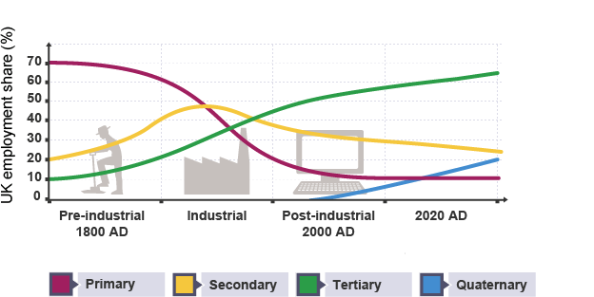
GCSE Paper 2- Question 2 Changing Economic World - Knowledge Organiser
N |  | India: Types of aid
 |  | Definition | Positive | Negative
1 | Short term | Given after a disaster as relief e.g. medical supplies | Can reduce the number of deaths in an emergency e.g. UK sent rescue teams after the 2010 Indian earthquake | Does not help with their development. The removal of this aid could leave them worse off
2 | Long term | Given over a long period of time to aid development | Helps the country to be more developed. Th UK gave £200 million a year until 2015 to tackle poverty | India has suffered from corruption so those who need the aid may never receive it
3 | Top down | Government receives aid and then decides what to do with it. E.g. money for a large infrastructure project | Large projects offer lots of employment and can help many people e.g. the Sardar Dam | Poorest may not benefit as they don’t have the skills to work on this project
4 | Bottom up | Aid given directly to those who need it for small scale projects | This aid is accessible and cheap. Can help improve health, skill and income of the poorest | It is small scale so not everyone benefits and it is normally reliant on donations
O | UK’s changing economy
1 | Primary | Since the industrial revolution this sector has seen a significant decrease. It has gone from employing 70% of the workforce to less than 10%
2 | Secondary | During the industrial revolution this sector saw an increase from 20% to 50% of the workforce. However this has since declined to 20%.
3 | Tertiary | The tertiary sector has seen the largest increase going from 10% to over 70% of the workforce. This is due to the decline in manufacturing and increase in peoples skills.
4 | Quaternary | This is the newest sector to develop and is currently near 10% of the workforce. This is due to the continued development if universities and technology.

Slide 17
GCSE Paper 2- Question 2 Changing Economic World - Knowledge Organiser
P | Causes of economic change
1 | Deindustrialisation | Fewer jobs in the manufacturing industry due to cost and out sourcing of jobs to other countries. This has caused the secondary and primary sector to decline in the UK.
2 | Globalisation | Due to better transport and communications e.g. internet it is easier than ever before to import cheaper goods from overseas.
3 | Government Policies | 1970s- 1980s: The government used to fund certain industries e.g. rail and steel making. This was costing the tax payer as they were no longer as profitable. The government sold many of these industries to private companies which resulted in job losses to try and make them profitable. 1990s – Today: The government is trying to rebalance the economy by investing in high tech manufacturing and encouraging smaller businesses through small loans.
Q | Post Industrial Economy
1 | Development of information technology | Over 1.3 million are employed in the IT sector by companies like Microsoft and IBM. This sector continues to grow as developments in IT continue.
2 | Service industries | This is the largest sector in the UK economy. As people are more able to specialise in different jobs. These jobs range widely from retail to entertainment, personal services e.g. hairdresser, healthcare and law.
3 | Finance | The UK is home to many financial institutions. London is seen as a financial capital for example HSBC have their headquarters in London. Financial services accounts for 10% of the UK’s GPD.
4 | Research | As the number of highly qualified people in the UK has grown so to has the importance of universities and their research. This now employs over 60,000 people and contributes £3 billion to the UK economy.
5 | Business and science parks | Science and business parks have developed to offer businesses a location where they can work together and develop. They are normally outside of city centres and near universities. They have helped with the development of research, IT, finance and service industries.

Slide 18
GCSE Paper 2- Question 2 Changing Economic World - Knowledge Organiser
R | Sustainable modern industrial development: Bristol and Bath Science Park
1 | Effective in being sustainable | Badger tunnels and bat poles –Helps to maintain local biodiversity 200sqm of solar panels – reduces reliance on fossil fuels and therefore reduces CO2 emissions and impact on the enhanced greenhouse effect Electric car charging points – encourages people to use more sustainable transport that don’t contribute to air pollution 220 of hedgerows – Helps to further preserve local wildlife and maintain a pleasant working environment.
2 | Ineffective in being sustainable | Built on a greenfield site – this caused destruction to some local wildlife and left brownfield sites in need of regeneration to become further degraded. Limited use of public transport – despite being near a local park and ride and having access to many bus route people still chose to use their cars due to the long journey times and not being within walking distance of local train stations. This has added to the increased traffic issues in the area. Solar panels don’t meet all energy demands – the science park still relies on fossil fuels for some of their energy which negatively impacts on the environment.
S | Economic changes in the rural landscape
 | Rural economy | Location | Population | Social changes | Economic changes
1 | North Somerset | South west of the UK and south of Bristol | Populations are increasing in many small towns and villages | Greater availability of services e.g. education and heath care. Increased demand has increased wait times for the NHS. Increased population has increased traffic and commute times. | House prices have increase benefitting homeowners but disadvantaging first time buyers Increase in businesses in the area which increases jobs
2 | Cumbria | North west of the UK and includes the lake district national park | Populations are decreasing in many small towns and villages | Communities are aging as young people leave to find opportunities elsewhere Decreased population means a decrease in demand for services so some close e.g. public libraries and post offices. | House prices are lower which can be a benefit for first time buyers. Unemployment is high due to businesses closing. This means less tax for the area to reinvest.

Slide 19
GCSE Paper 2- Question 2 Changing Economic World - Knowledge Organiser
T | Transport Improvements
1 | Roads | In 2022 the UK government announced a new road and bridge upgrades to boost economic growth Investing over £160 million in 4 key areas (Manchester, Cornwall, Newcastle and Southampton) Expected to generate £659.3 million in economic benefits.
2 | Railways | Network rail is investing £83 million to increase capacity and improve train times. Crossrail aims to increase capacity by 10% in central London with the new Elizabeth line. This project was delayed by 4 years and £3billion over budget.
3 | Airports | There are plans to increase capacity at London’s Heathrow airport which would generate over £61 billion over 60 years. However plans for the new run way are on pause as locals object to the plans.
4 | Ports | A new port has been constructed at the mouth of the River Thames. London Gateway is linked with 51 countries and over 90 ports. Once fully operational it is estimated to take 2000 HGVs off the road per day.
U | North South Divide
1 | Causes | Decline of industries such as coal mining increased unemployment and reduced investment in local services through taxes. Businesses have been more attracted to locating in London and the south leaving the north behind.
2 | Impacts | Wages in the north are lower – Huddersfield average is 40% less than London Health is poorer in the north – Glasgow has a life expectancy of 72 years while in Dorset it is 82 years Educational outcomes are lower in the north – children in London and the south east are 57% more likely to go to university than children in the North.
3 | Effective Solutions | Northern Powerhouse – Links up the major cities of the north to encourage businesses and create industrial areas. Media city is one example of an industry within the northern powerhouse that has created 4600 new jobs. Enterprise Zones – reducing the taxes of businesses (up to 100%) to encourage them to locate in the north.
4 | Ineffective Solutions | HS2 – High speed rail that was to connect the north of the UK to the south to help spread jobs and businesses from London to the North. In October 2023 it was announced that the remaining legs of the journey are to be scrapped. Only Birmingham will be connected to London. It has been suggesting it was £100 million over budget. Norther Powerhouse – More of a concept than actual plan. Investment has been limited and the spending on transport in London is greater than the entire budget for transport in the north.

Slide 20
GCSE Paper 2- Question 2 Changing Economic World - Knowledge Organiser
V | UK in the wider world
1 | Trade | The UK’s main trading partners are the EU, USA and China. Our overseas exports are worth £250 billion a year.
2 | Culture | Television is one of our leading creative industries worth over £1.25 billion a year. Programs such as X-Factor, Peppa Pig and Doctor Who have been successfully exported to many other countries.
3 | Transport | Increasing airport capacity has improved links with other counties. The channel tunnel provides a direct link to mainland Europe.
4 | Electronic Communication | Trans-Atlantic cables link Europe to the USA through the UK. These provide internet and phone communications. The UK is also linked through these cables to Africa, middle East, Asia and Australia.
5 | Political | EU – UK withdrew their membership in 2016 and officially left in 2020. The UK still has close ties with the EU through trade and tourism. While there have been some disagreements due to Brexit many laws are the same or similar to the EU but the UK now has sovereign control. Commonwealth – Made up of 53 countries it is one of the oldest political groups. Membership is optional. G7 – UK, France, Germany Italy, USA, Canada, Japan They meet yearly to discuss global economic issues

Slide 21
GCSE Paper 2- Question 3 and 4 Resources- Knowledge Organiser
Question 3- Resources in the UK
A | Key terms
1 | Distribution | The way something is arranged or located.
2 | Malnourished | Too little food, or a lack of nutrients, can cause deficiency diseases or death.
3 | Food miles | The distance food has travelled from farm to plate
4 | Carbon footprint | the total amount of carbon dioxide (and other greenhouse gases. ) which are emitted from an activity
5 | Agribusiness | Large scale farming using business skills to increase profit
6 | Insecurity | Having limited, unreliable or unaffordable access to a resource
7 | Deficit | A shortage (not enough) of a resources for the population
8 | Surplus | An excess (more than is needed) of a resources
9 | Water stress | When the demand for water exceeds (is higher than) the amount available
10 | Energy mix | The balance of the different types of energy which a country uses.
11 | Water transfer | Water taken from a place of surplus to a place of deficit
12 | Sanitation | The provision of clean drinking water and adequate sewage disposal.

Slide 22
GCSE Paper 2- Question 3 and 4 Resources- Knowledge Organiser
B | Food
1- How does a lack of food affect social well being? | Without access to enough safe, nutritious food people can become malnourished – which means to not have the right balance of nutrients in their diet, this can affect a child’s development. Malnourishment increases the likelihood of getting diseases – one third of all children under the age of 5 that die globally due to diseases linked to malnourishment. People who may not get enough to eat will not perform as well in school or at work. Meaning the population will lack the skills needed to help a country’s economic development.
2- Impacts of food insecurity | Famine – is a widespread shortage of food often causing malnutrition, starvation and death. There have been some devastating famines resulting from food insecurity such as the famine in Somalia between 2010-2012. Rising food prices – If an area suffers a poor harvest there is less food to go around. This causes the food prices to rise. This makes the cost of basic food such as bread too costly for the very poorest in society. Social Unrest – If a country does not have enough food this can cause people to riot and protest. This is because people expect the government to help them get enough food during times of food insecurity.
C | Water
1-How does a lack of water affect social well being? | Without sanitation, water sources can also become polluted e.g. by raw sewage Water borne diseases like cholera and typhoid kill millions of people each year It can also have a negative impact on the economic well being, as people spend all day searching for water meaning they can not work or attend school. This stops the country from developing
2- Impacts of Water insecurity | Disruption of education - Water insecurity means that many girls living in some rural areas of developing countries can spend hours walking to collect water rather than attending school. Waterborne disease - Drinking or using dirty water puts people at risk of waterborne diseases and illnesses, such as Schistosomiasis. Schistosomiasis is a parasitic worm that enters the body through the skin coming into contact with water that contains untreated sewage. It has been reported in 78 countries and 90% of people receiving treatment for it live in Africa. Lower food production - Water insecurity can lead to lower levels of food production. Irrigation can increase crop yields by as much as 400%. Places that do not have enough water to irrigate crops have less food to eat. Loss of Industrial output - Industry needs water for all stages of production. Water is used as a raw material, a coolant, a method of transport, and in some cases a source of energy. Areas that experience water insecurity are unable to operate factories and make products. This leaves them relying on imports, which may be expensive.

Slide 23
GCSE Paper 2- Question 3 and 4 Resources- Knowledge Organiser
D | Energy
1-How does a lack of energy affect social well being? | Energy is important for industry, transport and homes. Social well being will be negatively impacted without energy as people will not be able to heat homes, or turn lights on during the night. The economic well being in the country can be negatively impacted, as industries can not operate, meaning there are few jobs, which could help the country develop. Furthermore, people can not travel to jobs in other places, as the lack of energy makes travelling difficult.
2-Impacts of energy insecurity | Exploitation of ecosystems - countries like to find new sources of energy and this sometimes means that they use environmentally-sensitive areas. Fragile ecosystems can be put at risk as the desire for energy is greater than the desire for environmental protection. Increased economic costs - imported fuel is expensive. Exporting countries set the prices for fuel, leaving importing countries vulnerable. Loss of industrial output - manufacturing relies on energy. When energy is in short supply, it costs more to buy. This makes manufacturing more expensive. Countries that experience energy insecurity usually have a lower industrial output. Environmental cost - Some fuels cause a lot of pollution, e.g. coal causes smog and releases greenhouse gas when burnt contributing to the enhanced greenhouse effect. Countries that have a lack of energy are less likely to be able to invest in cleaner sources of energy so rely more on fuels that cause more pollution.
E | An overview of global inequalities in the supply and consumption of resources.
1 | The global distribution of resources is uneven
2 | Consumption of resources therefore depends on wealth and their availability
3 | HIC’s can afford to buy more resources, so consumption is greater to sustain their higher standards of living and social well being.
4 | In NEE’s like China consumption is growing quickly. Industry is developing very fast, which requires lots of energy) and population and wealth is also increasing rapidly
5 | However, in LICs they can not afford to exploit their resources or import from other countries, so consumption is low.

Slide 24
GCSE Paper 2- Question 3 and 4 Resources- Knowledge Organiser
An overview of resources in relation to the UK: Food
F | Demand for food across the UK
1 | 1960’s most fruit and veg sold in the UK was grown locally. Today- growing demand for seasonal produce to be supplied all year round. So now we import products including strawberries from Mexico and Apples from South Africa.
2 | Demand has grown for high value foods like exotic fruits, vegetables and spices. Theses high value foods have become more popular in the UK as people’s incomes have increased. These are often grown in LICs and imported to the UK.
G | Problems associated with UK food supply
1 | The growing, processing and packaging of our food produces C02 and other greenhouse gases. In 2013 9% of the UK’s greenhouse emission came from growing food.
2 | Transporting food from where it is grown to where it will be sold produces C02. This movement is called ‘food miles.’ The amount of greenhouse gas produced during growing, packaging and transporting is called it’s carbon foot print. A larger carbon footprint means more greenhouse gases and more climate change.
3 | Environmentalists are encouraging people to buy locally grown food to reduce food miles and the carbon footprint. Farmers markets, farm shops and locally produced vegetable boxes are becoming more popular – reducing the carbon footprint of the food we eat.
H | UK farming
1 | Since the 1960’s there has been a growth in large scale industrial farming where processes from the production of seeds and fertilisers, to the processing and packaging of food is controlled by large firms, known as agribusiness.
2 | This has caused farm sizes to increase. Small farms have been taken over and field sizes made bigger, so more can be produced.
3 | The use of chemicals has increased – large amounts of artificial fertilisers and pesticides are added to crops to help them grow. and special feed to animals to encourage growth
4 | The number of workers has fallen, as modern technology is capable of doing the work.
5 | Industrial farming has had negative environmental impacts, including hedgerow destruction (loss of habitats), increased soil erosion, and fertilisers running into streams and ponds, causing algae to grow and the fish life to die.

Slide 25
GCSE Paper 2- Question 3 and 4 Resources- Knowledge Organiser
An overview of resources in relation to the UK: Water
I | Demand for water across the UK
1 | In the UK the places with the best supply of water are not the areas with the greatest demand.
2 | The highest demand for water in the UK is in the South East, where the population is growing and there is little rainfall. The highest amount of rainfall is in the north west, where the population is actually declining.
3 | South east is an area of water deficit and north and west are areas of water surplus
4 | Demand for water has increased by 70%. Why? New appliances (dishwashers, power showers) and an increasing population
J | Problems associated with UK water supply
1 | Nitrates from fertilisers being washed into rivers and soaked into groundwater. Also, pollutants from vehicles being washed into water sources through run-off when it rains.
2 | pollution is affecting about 50% of this. Many groundwater supplies have been closed, or expensive treatment of them has taken place.
3 | Solution- putting stricter regulations on how much fertilisers and pesticides can be used. Also, higher taxes have been introduced on the most polluting cars
4 | Conserving water is also being used to lower the demand. The UK is trying to conserve water by: fixing leaking pipes, teaching children in schools about not wasting water i.e turning off taps while brushing your teeth, Using technology, duel flushing systems on toilets or collecting and using rain and grey water, Banning the use of hose pipes during times of water stress
K | Water Transfer
1 | One way to deal water deficit issues, is to transfer water from areas of surplus to deficit. Water Transfer schemes meet the demand for water by transferring water from areas of water surplus (low population, high rainfall) to areas of water of deficit ( high population, low rainfall and high industry).
2 | Its first creates a reservoir in an area of water surplus and holds it. This water is then transferred to areas of water deficit.
3 | However, water transfer can cause problems: Dams can be expensive to build and the reservoirs lead to huge areas being flooded, damaging farm land, habitats and causing people to be relocated. Political issues can exist e.g. people may not want their water transferred to another area.

Slide 26
GCSE Paper 2- Question 3 and 4 Resources- Knowledge Organiser
An overview of resources in relation to the UK: Energy
L | UK’s energy mix
1 | Traditionally the UK relied on fossil fuels (coal, oil and gas) to supply it’s energy. In 1970, 91% of our energy came from oil or coal.
2 | The discovery of large gas reserves under the North Sea meant that by 1980, 22% of the UK’s energy was supplied by gas.
3 | The use of nuclear energy to produce electricity also increased during the 1990’s.
4 | Recently there has been a movement towards using renewable energy supplies, (because of environmental awareness and because our supplies of gas are declining) rather than fossil fuels. All coal fired power stations in the UK are due to close by 2025. In 2014, 19% of all electricity produced in the UK was generated by renewable energy.
5 | Wind and bioenergy (energy from the burning of biological source e.g. food waste or oil rape seed) are the biggest sources of renewable energy, but the use of solar and hydroelectric power have also increased.
M | Problems associated with UK energy supply
1 | North Sea oil and gas reserves are rapidly running out.
2 | The UK still has coal reserves, but the use of coal has declined rapidly since the 1950’s. This decline has happened as we have tried to reduce C02 emissions and the cost of mining these reserves is very expensive.
3 | The use of shale gas from underground in the UK is being considered. This is extracted using a process known as fracking: fluid is pumped into shale rock at high pressure, causing it to crack. This forces gas trapped in the rock to flow back out of a well, where it is collected. Much of the fracking in the UK would take place in the North West of the country, this has the potential to create thousands of jobs in an area of economic decline.
N | Economic issues with energy extraction
1 | North Sea oil is especially expensive to extract. If the price of oil drops it may cost more to produce than to sell. This could lead to job loses.
2 | The cost of producing energy from renewables and nuclear is very high. This cost is often passed on to the consumer
3 | Renewable energy can be unreliable and inefficient. This means the UK still has to pay high prices to import energy from other countries.
4 | Nuclear waste is expensive to dispose of as it is highly dangerous. This pushes up the cost of producing electricity.
O | Environmental issues with energy extraction
1 | The burring of fossil fuels produces C02 and greenhouse gases, this is causing the greenhouse effect.
2 | Fracking may pollute groundwater and cause mini-earthquakes – this has led to some people campaigning to ban it.
3 | Large areas of land are needed to produce energy, this can destroy habitats and create a scar on the landscape (lowering house prices).
4 | Accidents such as oil spills or nuclear disasters, can leak toxic chemicals into water sources, soils and the atmosphere, killing animals and posing a significant risk to human health.

Slide 27
GCSE Paper 2- Question 3 and 4 Resources- Knowledge Organiser
Question 4- Food
P | Key terms
1 | Food security | is when people are able to eat enough nutritious food to stay heathy and active.
2 | Food insecurity | is when people aren’t able to get enough food to stay healthy or lead an active life.
3 | Scarcity | there is insufficient food for the demand
4 | food surplus | more food than is needed
5 | food deficit | not enough food to meet everyone's needs
6 | food insecurity | A result of food deficit
7 | Famine | Not enough food available for the amount of people who need it
8 | Aeroponics | plants are suspended in air and a fine mist containing plant nutrients is sprayed on the roots. The water drips off and it is used again.
9 | Hydroponics | plants are grown in a nutrient solution, supported by a material like gravel or clay balls. Only the roots are exposed to the solution.
10 | Irrigation | the process of artificially watering the land so plants can grow
11 | Green Revolution | application of modern farming techniques in LICs , eg fertilisers and pesticides, irrigation and high-yield crop varieties
12 | Biotechnology | The alteration of living organisms to develop or make products that help us e.g. GM crops

Slide 28
GCSE Paper 2- Question 3 and 4 Resources- Knowledge Organiser
Q | Factors affecting food supply- Physical
1 | Climate – Countries that have climates that are unsuitable for farming (too hot, too cold, too little rainfall) cant grow/produce enough food. Rainfall levels are decreasing in some areas causing a drought while in others it is increasing causing flooding, making some areas unsuitable for farming
2 | Water Stress - crops and livestock need water to survive. Areas that have low rainfall for water for irrigation is scarce struggle to grow enough food.
3 | Pests and diseases – pests reduce yields by eating crops e.g. rats may eat stored grain, huge locust swarms eat all vegetation in their path. Diseases affect most crops and livestock and can cause damage if they spread through crops and livestock can cause a lot of damage
R | Factors affecting food supply- Human
1 | Economic development- LIC – people living in poverty may not own their own land to grow food, also poorer farmers in LIC’S can not afford expensive fertilisers, pesticides and machines to help them farm the land effectively. At a global scale, poverty means that countries which cant grow enough cant afford to import food from countries with a surplus.
2 | Conflict – when a country is at war farmers may need to leave their land to fight, reducing production. Fighting may also damage the land or make it unsafe, making it difficult to grow enough food. Access to food becomes difficult for people who are forces to flee their homes. Conflicts also make it difficult to import food because of trade routes are disrupted and political relations with supply countries may break down.
3 | Economic development-HIC– farmers usually can afford pesticides which kill weeds and insects to prevent diseases. Improving yields. Some, farmers in HICs have large computerised irrigation systems so don’t need to rely on rainfall to ensure their crops are watered.
4 | Technology – the mechanisation of farm equipment (tractors etc) increases the amount of food that can be grown by making the process more efficient.
5 | Genetic Engineering can help protect plants from disease, increase their yields and help them grow better in harsher climates. Also, improvements to transportation and storage technology has increased year round availability to food.

Slide 29
GCSE Paper 2- Question 3 and 4 Resources- Knowledge Organiser
S | Impacts of food insecurity
1 | Famine – is a widespread shortage of food often causing malnutrition, starvation and death. There have been some devastating famines resulting from food insecurity such as the famine in Somalia between 2010-2012).
2 | Undernutrition - is a lack of a balanced diet and deficiency in minerals and vitamins, so you are unable to keep your body healthy.
3 | Rising food prices – If an area suffers a poor harvest due to climate or pests and diseases there is less food to go around. This causes the food prices to rise. In 2010 Russia suffered a poor wheat harvest so banned exports to other countries so their population had enough. This meant that countries who relied on this had to find other sources but this came at a much higher price.
4 | Rising prices - when there isn’t enough food available, food prices usually increase. This is because shops don’t have to lower their prices to complete for customers, people will pay any price to get the food they need. Rising prices means that the poorest people cant afford to feed themselves properly. In addition, food prices are rising across the world, due to increase cost of fertilisers, animal feed, food storage, processing and transportation.
5 | Social Unrest – If a country does not have enough food this can cause people to riot and protest. This is because people expect the government to help them get enough food during times of food insecurity. If governments don’t appear to be doing enough, make the situation worse or distribute aid unfairly, it can cause rioting or bigger conflict like a civil war.
6 | Soil erosion – Involves the removal of fertile top soil layers by wind and water. This decreases the fertility of the soil and makes it even more difficult to grow crops. Overgrazing - Pressure to get enough to eat (meat) may also lead to over grazing, when there are more animals than the land can support. Overcultivation If people are struggling to get enough food, they may not use the best agricultural practices e.g. they may over cultivate the land (grow crops repeatedly, without allowing the soil to recover its nutrients (so more nutrients out than in).

Slide 30
GCSE Paper 2- Question 3 and 4 Resources- Knowledge Organiser
T | Strategies to increase food supply
1 | Strategy | How it increases food supply | Benefits | Costs
2 | Aeroponics and Hydroponics | By allowing plants to get nutrients without growing in soil, and requiring land. Providing a nutrient supply, direct to the plants, without soil. | The growing environment is kept free of pests and diseases. If a plant does become infected it can be quickly removed limiting impact on the other plants. Less water is required than plants grown in soil Enables small scale farmers to increase yields and lower production costs Less land is needed | Expensive, and only used for high value crops Some aeroponic environments are not perfectly sealed so pests and diseases may still cause a threat.
3 | Irrigation | By artificially watering plants It increases food supply by making dry areas more productive or increase the yield of crops. | Improves crop yields > more crops to sell > thus improving standard of living During dry periods irrigation can help provide water so there is enough to keep farming. Drip irrigation can be very low tech creates very little waste water, | Water is usually extracted from rivers, underground stores, so can cause the depletion of water in other areas and stores.
4 | Appropriate Technology | Increases the food supply by using skills or materials that are cheap and easily available e.g. drip irrigation | A practical option for poorer farmers, as it is affordable. | Unlikely to create the large yields needed to increase economic output hugely.
5 | Biotechnology | genetically engineering crops to improve productivity, including have higher yields, resistant to drought, disease or pests, higher nutritional value | Higher crop yields > more crops to sell > thus improving standard of living. Example C4 rice. Resistance to drought, disease, pests, which reduces the need for pesticides. Higher nutritional value, e.g potatoes with more protein or rice with more Vitamin A. | Ethical and environmental concerns. They may reduce biodiversity, because fewer variety of crops. GM plants may interbreed with wild plants and pass on their genes or disrupt ecosystems.
6 | The New Green Revolution | using a mixture of biotechnology and sustainable farming techniques | This will help to provide more food as the worlds population increases, especially in Sub-Saharan Africa which is greatly affected by climate change. Evidence it worked in India. Does not require the use of expensive fertilisers but the use of seeds that are high yielding, so less impact on the environment. | Reduced biodiversity as only a few crops are relied on instead of a variety. Some argue this is unsustainable as the land can not support this amount of people even with the green revolution

Slide 31
GCSE Paper 2- Question 3 and 4 Resources- Knowledge Organiser
Case Study- a large scale agribusiness- Almeria, Spain
U | What they did
1 | Huge number of greenhouses, made from polythene and plastic. In fact it has the largest concentration of green houses in the world, covering over 30,000 hectares., producing over 2.7 million tonnes of produce each year.
2 | It started in 1950, when farmers were struggling to protect their crops from the wind. They put up plastic sheeting on poles to stop the wind damaging their plants. They realised this had a secondary benefit, it helped their plants ripen and be ready for sale earlier, because it increased the temperature the plants were growing in. Protecting their crops, meant farmers also extended the growing season
3 | They grow the plants using hydroponics, plants are grown in bags and water and nutrients fed into the base of the plant via drip irrigation
V | Advantages
1 | provides hundreds of jobs for the local area > increase wages > increase in standard of living > increase in GDP
2 | Get 2 crops a year > increase in profits
3 | Generates over $1.5 billion every year.
4 | Less water used by drip irrigation and hydroponics > no use of soil > less soil erosion > keeping soil rich for future generations
5 | The farms use drip irrigation and hydroponics to conserve water > no water pumped from sources > not depleting water sources
W | Disadvantages
1 | Almeria uses many immigrant workers for labour from North Africa, Eastern Europe and South America > low wage and work in poor conditions > many work illegally and enter the country through dangerous methods
2 | Lots of litter has been left in the area including chemical containers and plastic has been dumped into the sea.

Slide 32
GCSE Paper 2- Question 3 and 4 Resources- Knowledge Organiser
X | Sustainable food supplies
 | Scheme | Examples | How this works | Positives | Negatives
1 | Low impact Farming | Organic Framing | Farming without using chemicals (growing crops or rearing livestock). | This helps farmers improve their health by reducing their exposure to chemicals Often sell their produce close to where it is produced, to reduce the amount of transport and C02. | Production and labour costs may be higher than other forms of farming. Food bugs can still be on the fruit when sold.
2 |  | Permaculture | trying to produce food in a way that recreates natural ecosystems to protect soil, insects and wildlife. E.g. growing your own food, eating seasonally and harvesting rainwater | Less CO2 due to less transport costs, less meat consumed and greater number of vegetation planted. Range of vegetation increases a variety of wildlife like bubble bees. Less depletion of water sources Soil is not depleted and farming on the land can continue for years to come. | Farmers whose income relies on this (esp in LICs) have been unable to switch to this way of farming as it is time consuming and does not produce crop yields to generate enough income Cannot complete with large scale agribusinesses. Not suited to urban living easily
3 |  | Urban Farming Initiatives | Include using empty land, roof tops and balconies to grow food and raise animals in towns and cities e.g. allotments in cities to grow fruit and vegetables. | Adds to greenery of the urban environment, making it more attractive Reduces the dependency of urban areas on food produced industrially. Reduces transportation of food. Habitat for wildlife and bees | Will never produce enough food for the entire population, as empty land, roof tops and balcony space is limited.
4 | Easting Seasonally |  | Buying food that has been grown in the local area opposed to food transported from another country. | As food is not being imported from LICs food miles will be reduced and so to will the carbon footprint. Continues local farming, which is struggling to complete with international cheaper imports. Support local economy. | Food can be more expensive due to the higher cost of labour in HICs. Difficult to find farm labour in HIC, especially I the UK now we have left the EU. Reduces the amount imported, which would result in loss of jobs and contribution to the economy.

Slide 33
GCSE Paper 2- Question 3 and 4 Resources- Knowledge Organiser
X | Sustainable food supplies
 | Scheme | Examples | How this works | Positives | Negatives
5 | Meat and fish from sustainable sources |  | Farming for meat causes deforestation. Reverting to small scale live stock farms and organic methods has a smaller impact on the environment. Grass fed meat is more sustainable as less fertiliser is needed. Over fishing and bottom trawling (large nets) reduces fish stock. Sustainable fishing involves having quotas and following the Marine Stewardship Council | Animal welfare standards are higher Natural manure on grassland Norway, salmon farms are spread out along the coastline to reduce the spread of disease. | Prices are higher in the shops Difficult to meet the demands of meat using this methods, especially cheaper low value meat It is difficult to monitor fish numbers, breeding, and fishing techniques. Fish sources outside the EU is less regulated.
6 | Reducing waste and losses |  | One third of food that is produced is lost or wasted Schemes like Think.Eat.Save and Love Food Hate Waste encourage people to be less wasteful with food by encouraging them to Buy and cook only what you need. Clear food labelling such as Best before or Used by dates.. Turn leftover food into compost to fertilise plants. | Raise awareness in the amount of food which is wasted and change habits Less food wastes, less needed to be grown. | Cost more, lead to increase cost of food Create more plastic waste The poorest in HIC’s will be impacted if prices increase, where you would argue need cheaper fruit and vegetables Composting available for those with compost bins (usually rural)

Slide 34
GCSE Paper 2- Question 3 and 4 Resources- Knowledge Organiser
Case Study- Local sustainable farming – Jamalpur, Bangladesh
Y | What they did
1 | Construction: Practical Action (a charity) works with a farmer to identify a suitable site: one that is less likely to be washed away should a flood occur. Together they then build a dyke approximately 60cm high around the outskirts of the field. This has a dual purpose – to keep the fish in the rice fields and enable vegetable cultivation around the field. The next step is digging a ditch for the fish to live in during the dry season.
2 | Planting and stocking : The farmer plants the rice in rows that are roughly 35cm apart, then fills 50% of the ditch with water. The water is purified with a small quantity of lime, and a little organic fertiliser is added. Then, when the rice starts to grow, the water level across the field is increased to 12–15cm, and small fish are released into the ditch. As soon as they have acclimatised to the rice field water, the farmer releases them into the field and raises the water level as both the fish and rice grow.
3 | Harvesting: At the first harvest, approximately four to five months later, the farmer will harvest the rice first, and then drain the rice field to collect the fish into the ditch where they can easily be caught.
Z | Advantages
1 | Increases food supplies and diets improve due to access to a greater variety of food (fish, rice and vegetables) this improves peoples health and quality of life.
2 | Fish eat the pests that would eat the rice
3 | The rice shelters the fish from predators
4 | Fish waste helps to fertilise the rice
5 | Rice yields increase so farmers have extra they can sell at local markets
6 | Farmers have a higher income so can afford to send their children to school = better quality of life
Z | Disadvantages
7 | The farms are small scale – not enough for large scale farming or large communities > does not help the whole of Jamalpur
8 | Require the charity to supply the concrete and knowledge on how to farm the land successfully > depend on overseas aid donations from the public.

